Slide 1


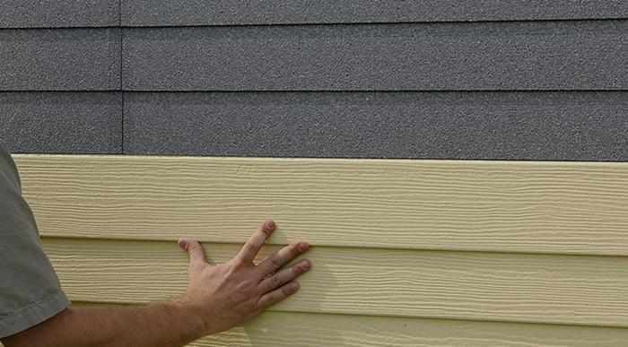
NOT YOUR GRANDMOTHER’S
VINYL SIDING
THE ADVANTAGES OF GRAPHITE POLYSTYRENE INSULATED VINYL SIDING
Course #23
Provider #50111211
1 LU|HSW
Notes:
Welcome to today’s presentation “Not your Grandmother's Vinyl Siding”. I am --- from ---. Today we are going to discuss why and how graphite polystyrene insulated vinyl siding is a high performance building system that delivers multiple benefits for new and existing residential and commercial buildings.

Slide 2
COPYRIGHT MATERIALS
This presentation is protected by U.S. and International
copyright laws. Reproduction, distribution, display, and
use of the presentation without written permission
of BASF is prohibited.
©BASF, 2023
Notes:
This presentation is protected by U.S. and International copyright laws. Reproduction, distribution, display, and use of the presentation without written permission of BASF is prohibited.

Slide 3

AIA CES PROVIDER STATEMENT
AIA has registered and approved the following course for continuing education credit under Provider Number 50111211. All registered AIA CES Providers must comply with the AIA Standards for Continuing Education Programs. Any questions or concerns about this provider or this learning program may be sent to AIA CES (cessupport@aia.org or (800) AIA 3837, Option 3).
This learning program is registered with AIA CES for continuing professional education. As such, it does not include content that may be deemed or construed to be an approval or endorsement by the AIA of any material of construction or any method or manner of handling, using, distributing, or dealing in any material or product.
AIA CES has reviewed and approved AIA continuing education credit for this learning program. Learners must complete the entire learning program to receive continuing education credit. AIA continuing education Learning Units earned upon completion of this course will be
reported to AIA CES for AIA members. Certificates of Completion for AIA and non-AIA members are available upon request.
Notes:
This learning program is registered with AIA CES for continuing professional education. As such, it does not include content that may be deemed or construed to be an approval or endorsement by the AIA of any material of construction or any method or manner of handling, using, distributing, or dealing in any material or product.

Slide 4
COURSE DESCRIPTION
This course examines the unique advantages of graphite polystyrene (GPS) insulated vinyl siding as a high-performance building systems for new and existing buildings to:
  Provide exterior, continuous insulation
  Manage moisture
  Increase durability and environmental performance
  Enhance appearance
Participants will also have the option of completing nano courses that further examine GPS insulated vinyl siding’s
  Environmental Impacts
  Energy Codes Compliance
  GPS Insulated Vinyl Siding & the 2022 Inflation Reduction Act
Notes:
This course covers how graphite polystyrene-insulated vinyl siding is used to improve energy efficiency, manage moisture, and optimize environmental performance and occupant comfort while improving the aesthetic value of both new and existing buildings.
Additional modules will be offered for .25 credit providing greater detail regarding
Environmental Product Declarations and ecological life cycle impacts
Energy codes and ASHRAE compliance
Federal tax incentives including in the Inflation Reduction Act

Slide 5
LEARNING OBJECTIVES
Describe
How GPS vinyl siding offers continuous insulation, moisture management, reduced environmental impacts and improved overall performance.
Explain
Specify
GPS vinyl siding into sustainable high-performance designs for both new and existing buildings.
Identify
The emergence of graphite polystyrene (GPS) vinyl siding as a high-performance building system.
GPS vinyl siding design opportunities & aesthetic advantages.
Notes:
After the course, you will be able to
Explain the history of graphite polystyrene vinyl siding and how it emerged as a high performance building system.
Describe how GPS vinyl siding helps meet energy code requirements.
Specify GPS vinyl siding to achieve performance objectives for energy efficiency, occupant health and safety, durability and reduced environmental impacts.
Identify GPS vinyl siding design options and aesthetic advantages.

Slide 6
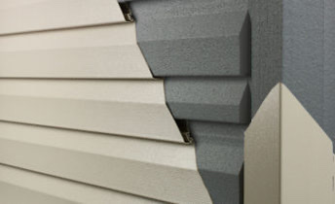
Chapter 1:
The Emergence of Graphite Polystyrene (GPS) Vinyl Siding
History of Vinyl Siding
Uses of Vinyl & Polystyrene
Vinyl & Polystyrene in Construction
Graphite Polystyrene Explained
Image Courtesy Progressive Foam
Notes:
To understand the value of GPS vinyl siding, we’ll review a brief history of vinyl and expanded polystyrene and look at the major innovations in both materials that led up to its introduction.

Slide 7
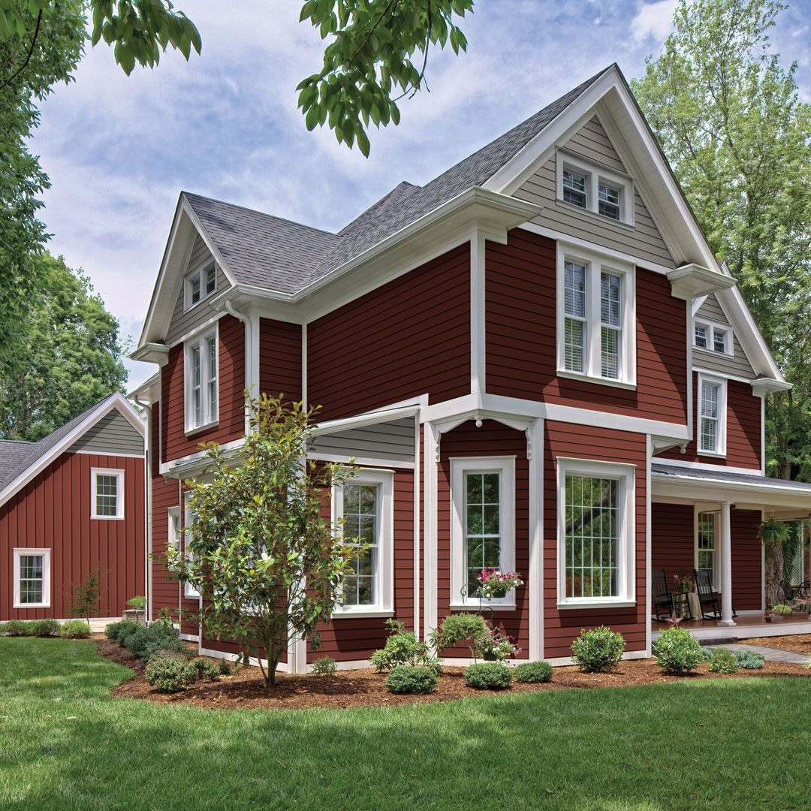
HISTORY OF VINYL SIDING
1950: Vinyl Siding Introduced by Crane Plastics
1970s: Improved Impact Resistance & More Color Options
1980s: Grows in Popularity
Progressive Foam Introduces Insulated Vinyl Siding
Progressive Foam adds GPS for 25% More R-Value
Progressive Foam Introduces Slide-In Retrofit Insulation
More Design Options & Complete CI System Available
Insulated Vinyl Siding Recognized by DOE & EPA as Continuous Insulation
1950s
1970s
1980s
1990s
2010s
Courtesy Alside: Prodigy® Next-Generation Insulated Siding
Both DOE and EPA recognize insulated siding as a way to improve a home’s energy efficiency. Insulated siding will reduce thermal bridging and provide continuous insulation. -- Energy.gov
2020s
Notes:
Vinyl siding was introduced to the cladding market in the late 1950s as a replacement for aluminum siding by Crane Plastics in Columbus, Ohio. It was originally “mono-extruded” into a shiplap shape. Colors were added and blended manually.
By the 1970s, manufacturing improvements resulted in production speed, impact resistance, and range of colors. Vinyl siding grew steadily in popularity in the 1980s, primarily due to its durability, versatility, and ease of maintenance.[3]
Wiki
Insulated vinyl siding was invented in 1992 by Progressive Foam Technologies, Inc. In 2012, the company innovated the category once more by adding Graphite EPS to their insulated vinyl siding, which increased the systems R-Value by ~25%
Today in the U.S., vinyl siding is the most purchased siding with insulated vinyl siding gaining momentum as a duel-purpose building system that delivers insulation and siding in one step

Slide 8
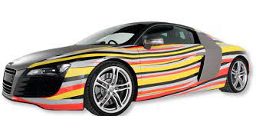




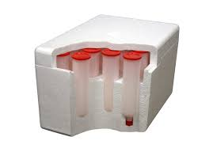
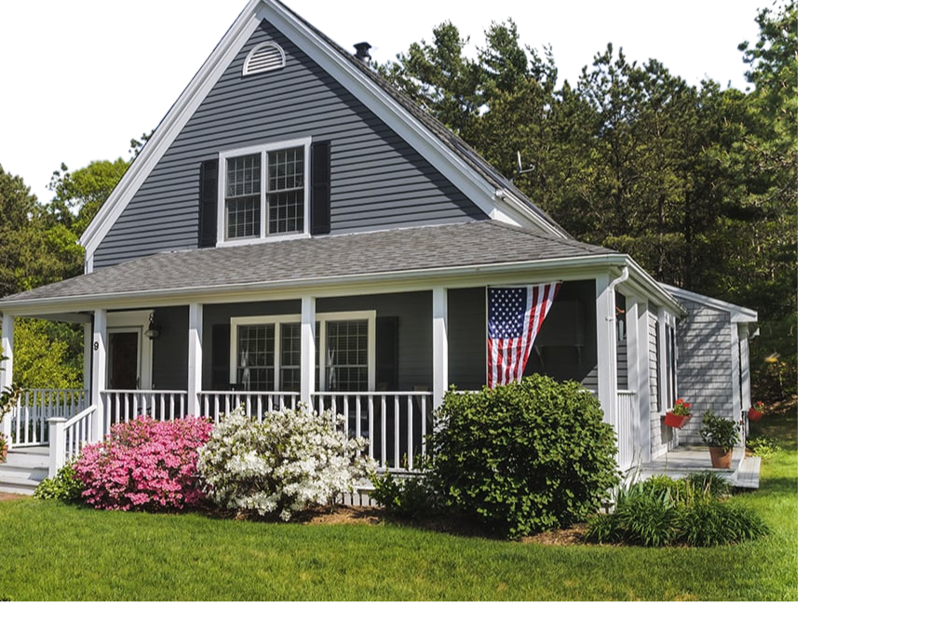
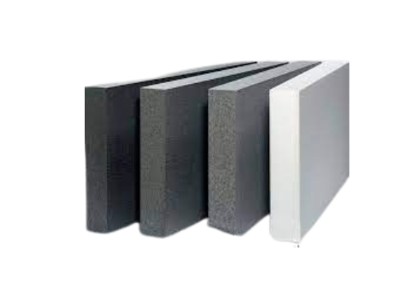
INSULATED VINYL SIDING: COMPONENT MATERIALS AT A GLANCE
Safe &Trusted
Polyvinyl Chloride (PVC)
Expanded Polystyrene (EPS)
Durable
Automotive
Versatile
Apparel
Medical
Innovative
Graphite Polystyrene (GPS)
High-Performance
Construction
Notes:
For several decades, vinyl and expanded polystyrene have been used in hundreds of applications. Both are safe, easy to use, durable, economical, and environmentally friendly.
First let’s start with vinyl. Whether called "vinyl" or "PVC," this useful material can be formulated to provide specific properties for specific product applications and can come in most colors, textures, or shapes.
Rigid materials are sometimes called unplasticized PVC or "UPVC." Examples of rigid vinyl applications include pipes, siding, and window frames. When formulated with plasticizers, vinyl can be flexible, such as in wall coverings, upholstery fabric, roofing membranes and coatings.
Expanded polystyrene (EPS) was developed and patented by BASF in 1951 under Styropor. It is a ubiquitous material used safely and effectively in various fields and applications due to its shock-absorbing and insulating properties.
Applications include consumer products such as car seats, helmets, medical transportation, refrigeration, trucks, and storage. EPS also makes disposable foam coolers and packing peanuts for shipping.

Slide 9
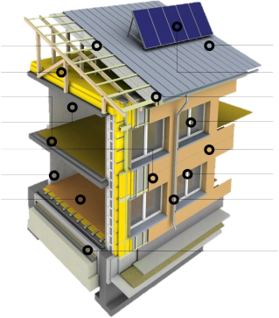
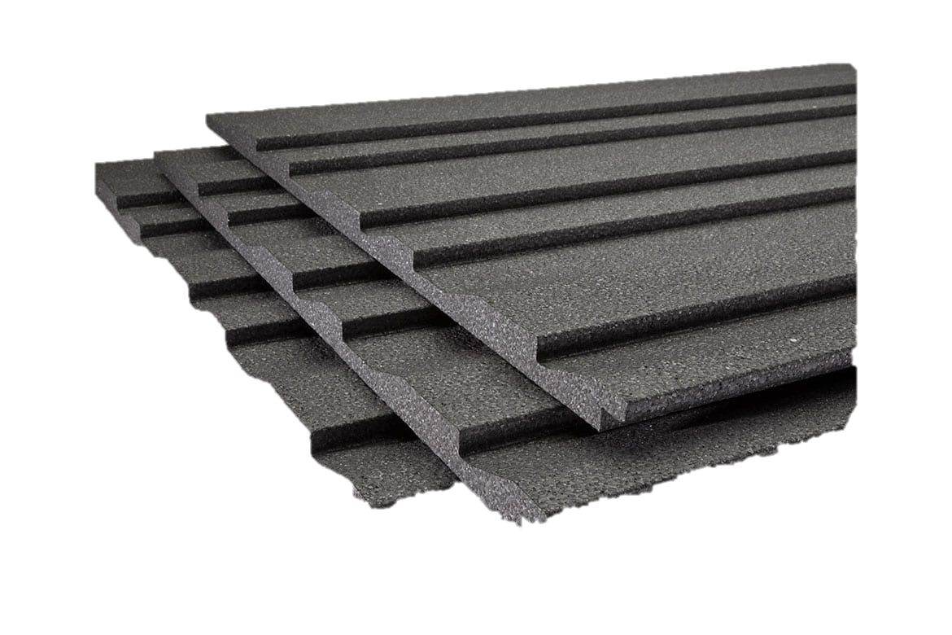
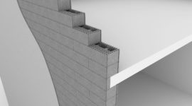
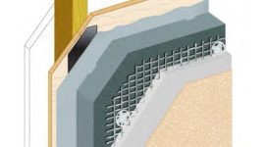
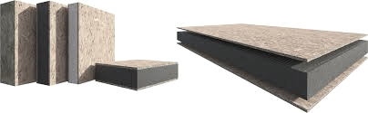
VINYL & GRAPHITE POLYSTYRENE (GPS) IN BUILDINGS
PVC roofing
GPS Roof &
Attic insulation
Vinyl sealants
Vinyl flooring,
wall coverings
Vinyl membranes & coatings
GPS CI Sheathing
Vinyl window framing
Vinyl cladding
GPS wall assemblies
PVC millwork
GPS subfloor
PVC pipe
GPS slab, perimeter
GPS
ICFs
GPS Stucco
GPS
SIPs
GPS Vinyl
Siding
GPS drop in insulation for uninsulated siding
Image Courtesy Progressive Foam
Notes:
Because of its greater insulating and thermal properties, GPS is used nearly everywhere traditional EPS is used in construction, including (speak to slide) slab perimeters, ICFs, SIPS, EIFS, and CI sheathing. It can be argued, though, that GPS vinyl siding is not only a category upgrade; it's a high performance building system serving to deliver aesthetic appeal, optimal energy, water, and waste conservation while reducing lifecycle impacts.

Slide 10
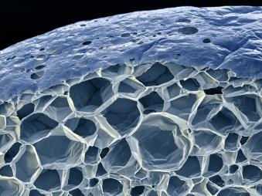

GPS INSULATION EXPLAINED
Nominal Water Absorption
100% Recyclable
Low Embodied Carbon
Adheres EPS ASTM
GPS Safe & Stable
+25 R-Value
Notes:
Patented graphite-enhanced EPS in 1995 under the brand name NEOPOR.
Graphite improves the overall performance of eps in several essential ways.
Graphite increases r-value ~25% over white eps via its ability to reduce thermal conductivity and reflect radiant heat
Graphite is the most stable form of carbon and a completely safe substance that doesn't react with other chemicals or off-gas in the building.
It adheres to the same astm standards of traditional eps and xps, the other main polystyrene-based foams (astm c578); however, its performance characteristics are different enough that the main specification tools in the aec industry in north america (bsd speclink and masterspec) have created an entirely new "graphite polystyrene" category to help product specifiers identify its attributes.)
Through lca and product-specific epds, gps has proven to display lower embodied carbon than any other rigid insulation in north america, including eps, xps, polyiso, and mineral wool.
It uses 30% less material mass than xps for the same r-value. It also offers 20% more thermal resistance than EPS at the same thickness.
Source: information in this slide sourced from "insulation materials.” (N.D.). Energy saver. Retrieved from https://www.Energy.Gov/energysaver/weatherize/ insulation/insulation- materials
GPS insulation provides all of the benefits of traditional EPS insulation, including nominal water absorption, low embodied carbon, recyclable and ASTM standards. However, due to the reflective properties of graphite, GPS has about 25% more R-value.

Slide 11
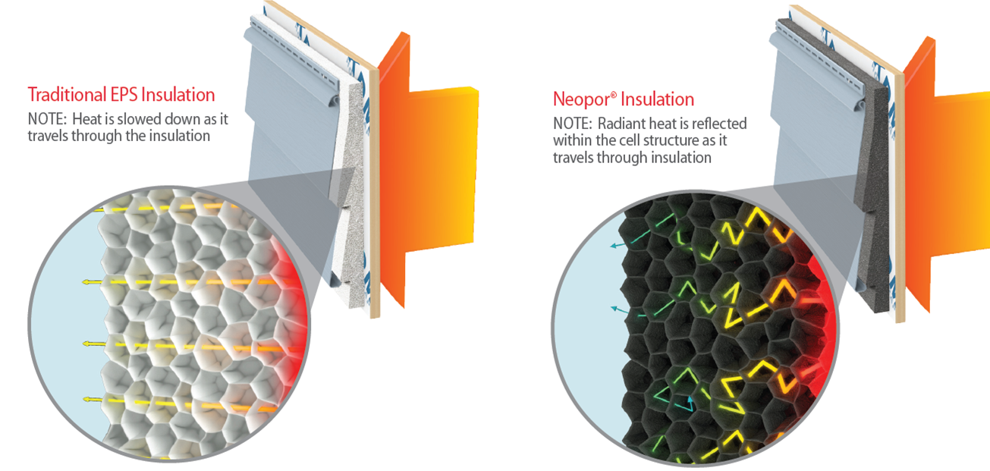
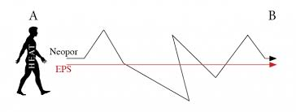
REFLECTIVE PROPERTIES OF GRAPHITE DELIVER MORE R-VALUE
GPS INSULATION EXPLAINED
Traditional EPS Insulation
GPS Insulation
Notes:
Here's how GPS works:
As you may know, warm air always moves towards cold air, and while no insulation completely stops this heat transfer, it does slow it down.
EPS works because it creates tiny air pockets within each bead when formed, trapping air in these pockets and slowing the movement toward cooler air. Graphite EPS works this way, too but also uses the power of reflectivity to increase insulation.
As radiant heat moves through the graphite-enhanced material, its reflected hundreds of times, significantly slowing down this transfer. The result is increased energy efficiency.
Another way of understanding it is by visualizing the heat transfer as a person walking on a path from point A to point B. Walking in a straight line (like traditional insulation) would be much faster than if the path took many twists and turns along the way (like graphite EPS).

Slide 12
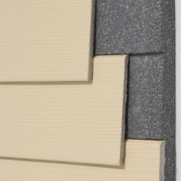
CHAPTER 2:
Advantages of GPS Vinyl Siding
Reduced Environmental Impacts
Continuous Insulation
Moisture Management
Better Performance
Notes:
In this chapter, we will review the advantages of GPS vinyl siding, including reduced environmental impacts and its ability to help provide continuous insulation requirements. We will also look at how the system aids in moisture management and overall better performance, including durability, less maintenance, and more.

Slide 13
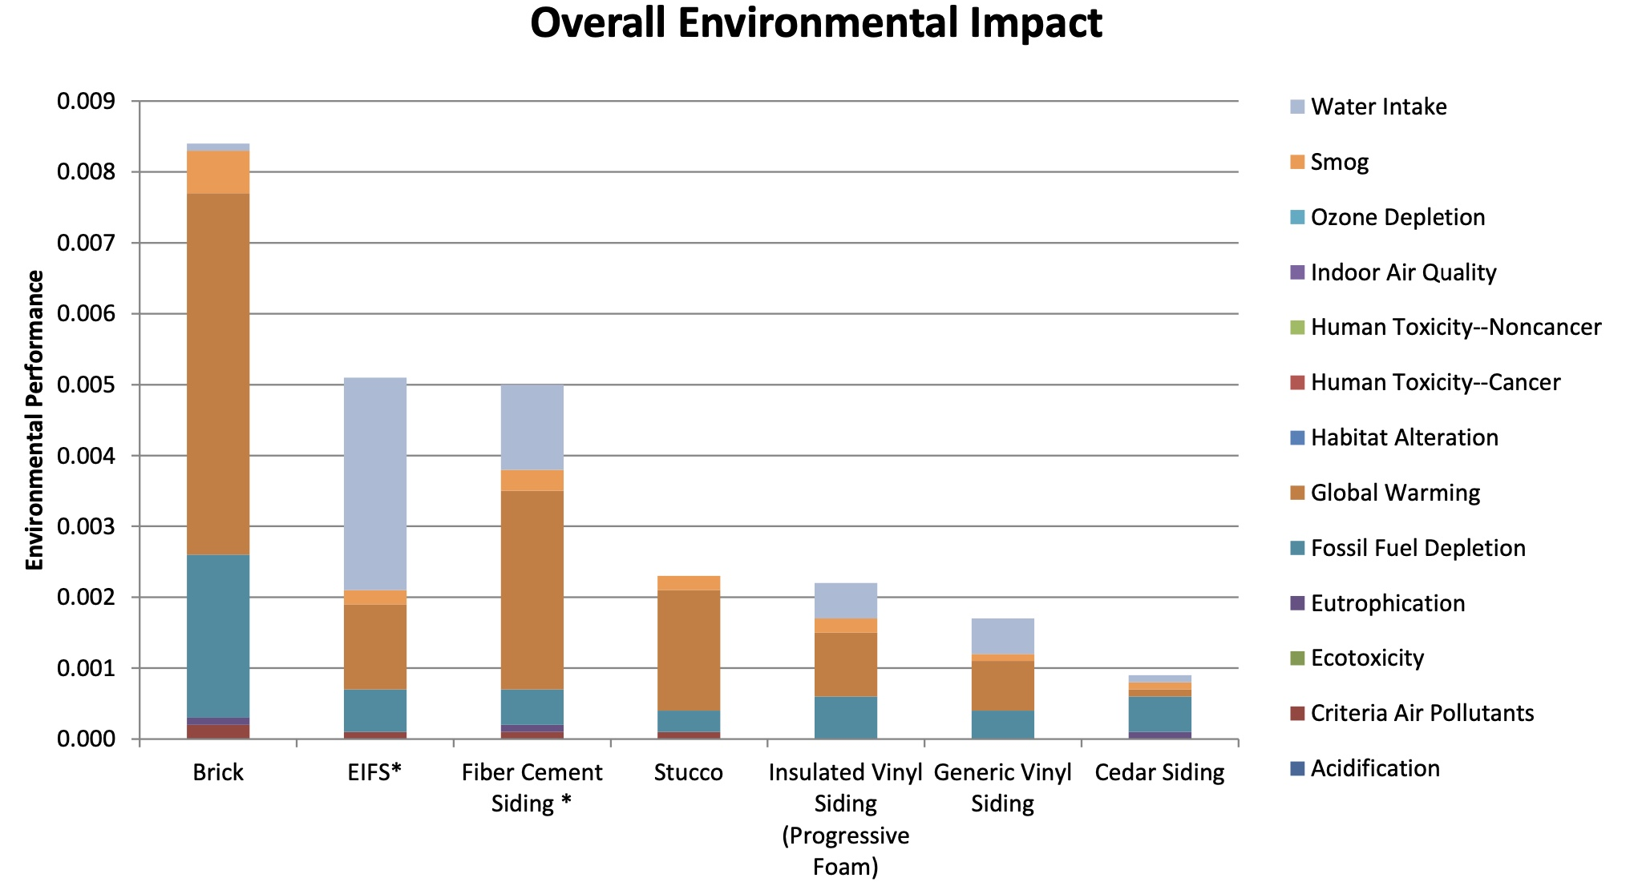
INSULATED VINYL SIDING: LESS IMPACT THAN MOST OTHER OPTIONS.
Only Option that Reduces Pollution Over Time
Specifically Qualifies for Green Building Programs/Incentives
Reduced Environmental Impacts
Courtesy Progressive Foam
Based on the Building for Economic and Environmental Sustainability (Bees) software
Notes:
Furthermore, a life cycle analysis conducted on behalf of Progressive Foam for insulated vinyl siding with EPS insulation provides further proof that insulated vinyl siding has far less embodied carbon than most other alternatives while reducing energy consumption and carbon emissions throughout its life.
(Source:https://www.progressivefoam.com/wp-content/uploads/LCA-Summary-Sheet.pdf)

Slide 14
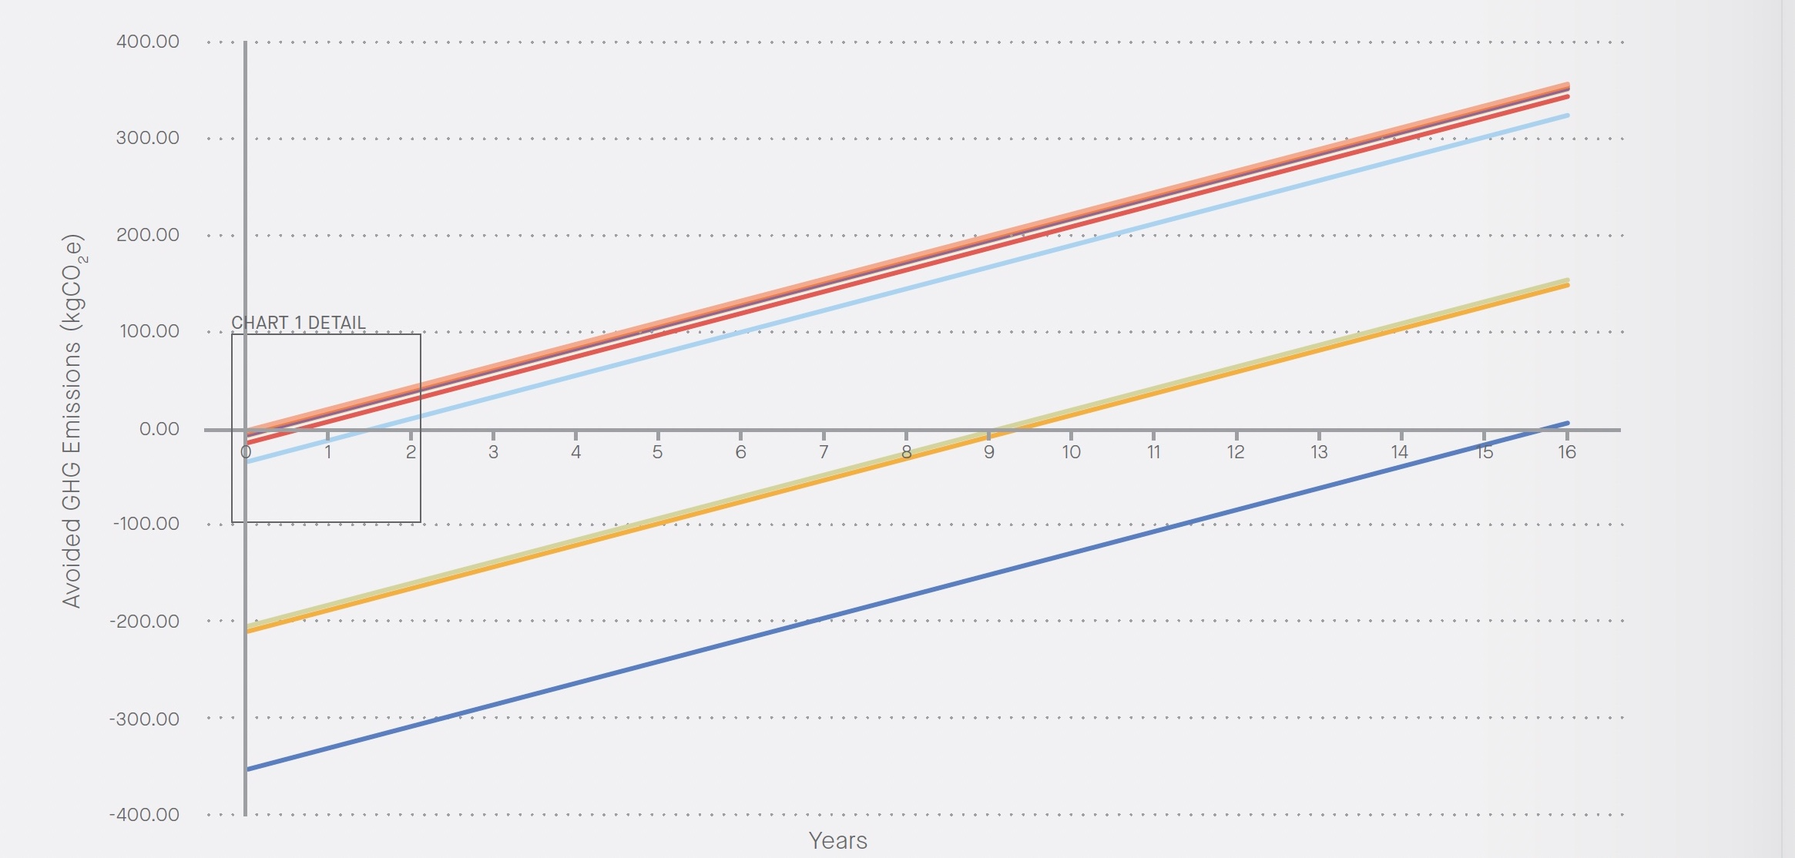
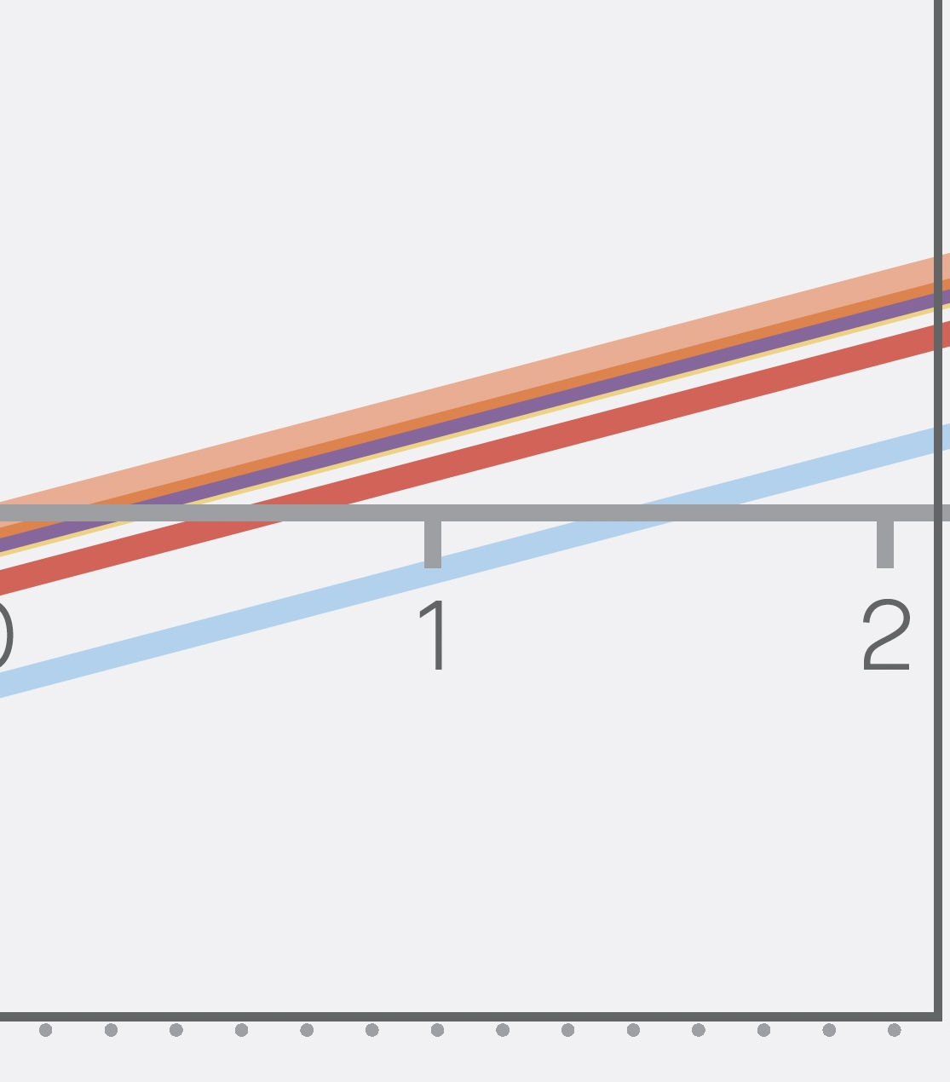
Carbon Payback Analysis Natural Gas Heating Scenario (0-16 Years)
GPS INSULATION: LESS CARBON/ SHORTER CO2 PAYBACK PERIOD
GPS 6 MONTH CO2 PAYBACK
Reduced Environmental Impacts
Source: Embodied Carbon Values in Common Insulation Materials; KPMB Architects
Notes:
But what about the carbon payback period? How long does it take for the insulation material to save more operational carbon emissions than it took to make it? This chart shows the payback period for the home if heated with natural gas. Using a heat pump scenario, the study found, “XPS is an outlier in this selection of materials, with a GWP 15 to 20 times greater than the other materials. In the electric heat pump scenario, it is not reasonable to expect the operational carbon savings to ever outweigh the embodied carbon of the material itself.”
For Neopor GPS, the payback period was roughly 6 months, the study found.

Slide 15
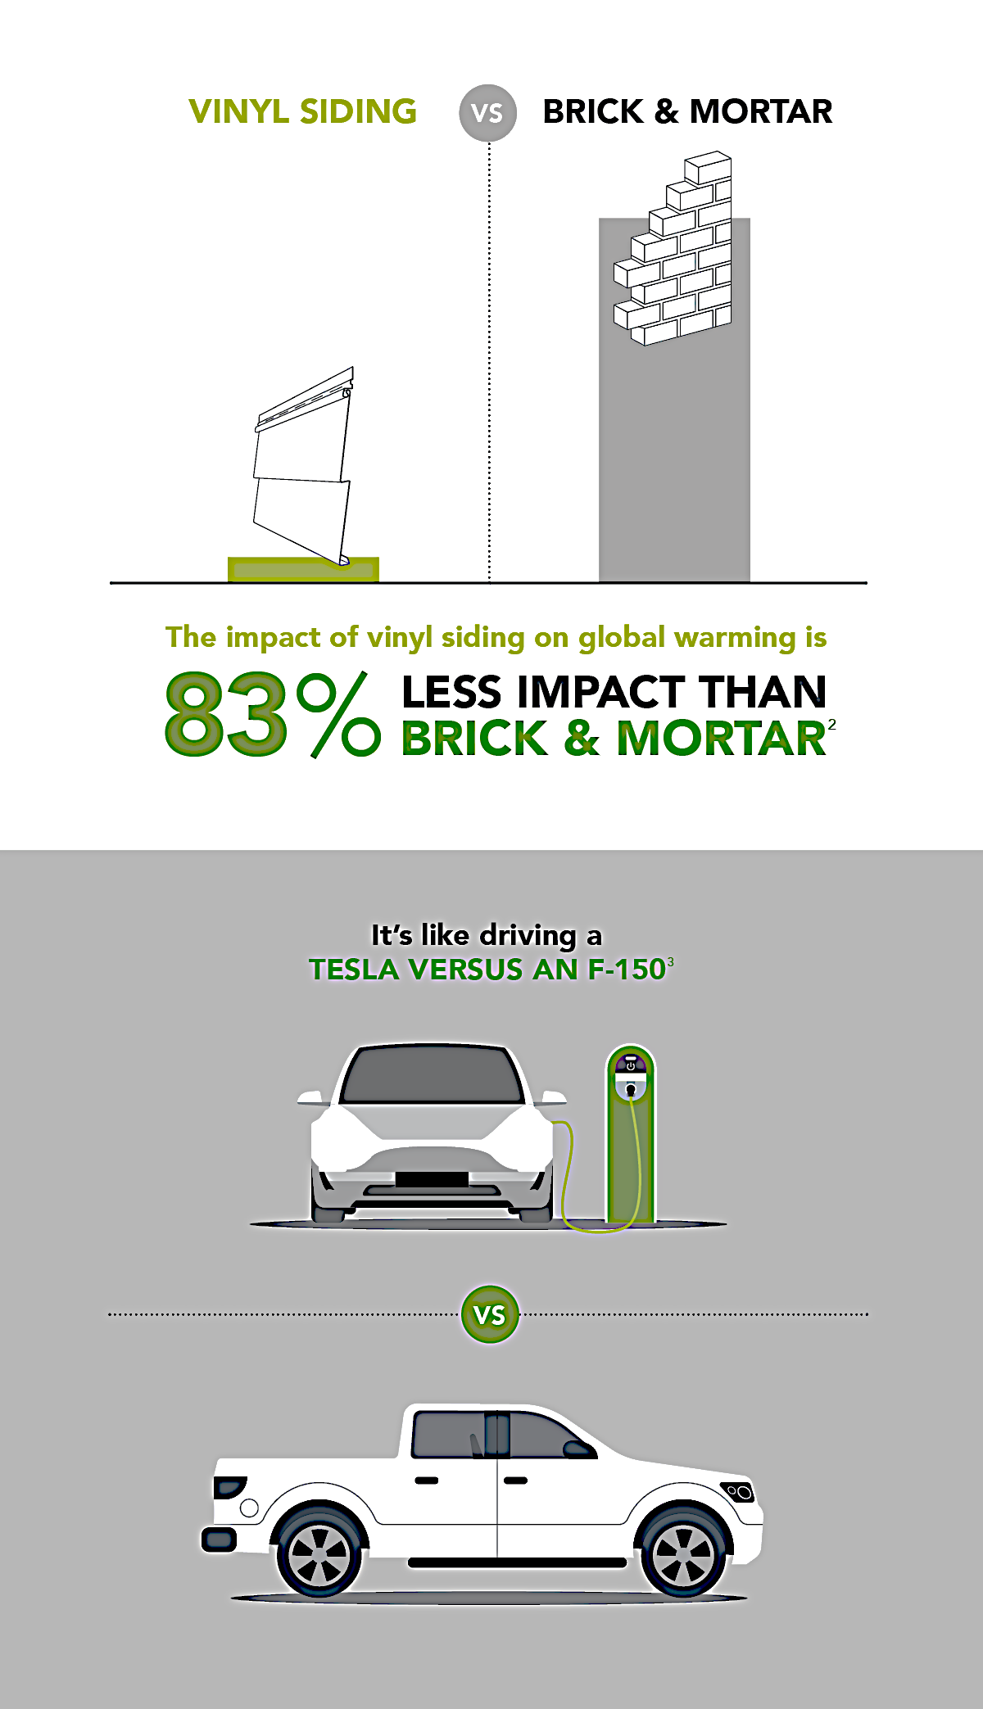
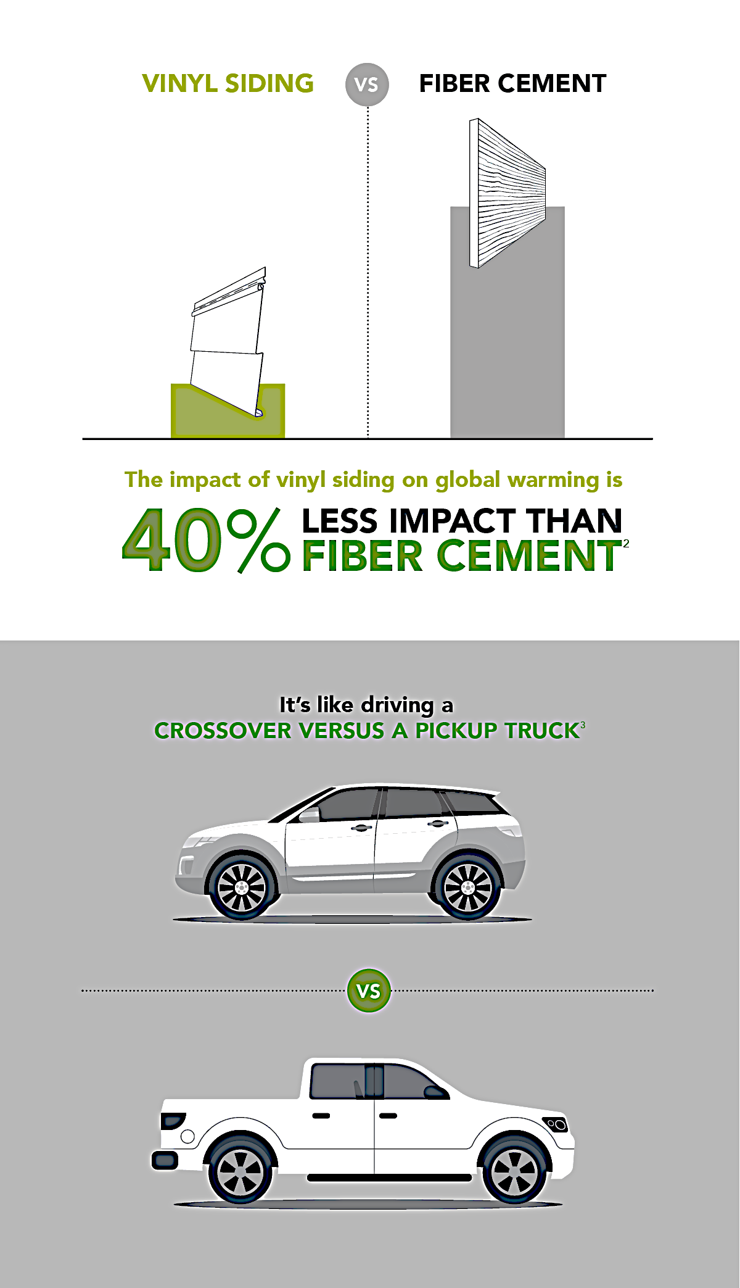
VINYL SIDING: LESS GLOBAL WARMING POTENTIAL
Reduced Environmental Impacts
Courtesy Vinyl Siding Institute
Notes:
Now, let’s look at the analysis of embodied carbon of vinyl siding in comparison with alternatives, according to a recent industry-wide EPD published by the Vinyl Siding Institute.
The Global Warming Potential of vinyl siding versus fiber cement and brick is seen here and with parallels to the auto industry. The prevalence of emissions stickers has helped us make informed decisions when selecting climate-friendly automobiles. For the built environment, comparing data in tools like EPDs can also serve this function. (speak to the slide)

Slide 16
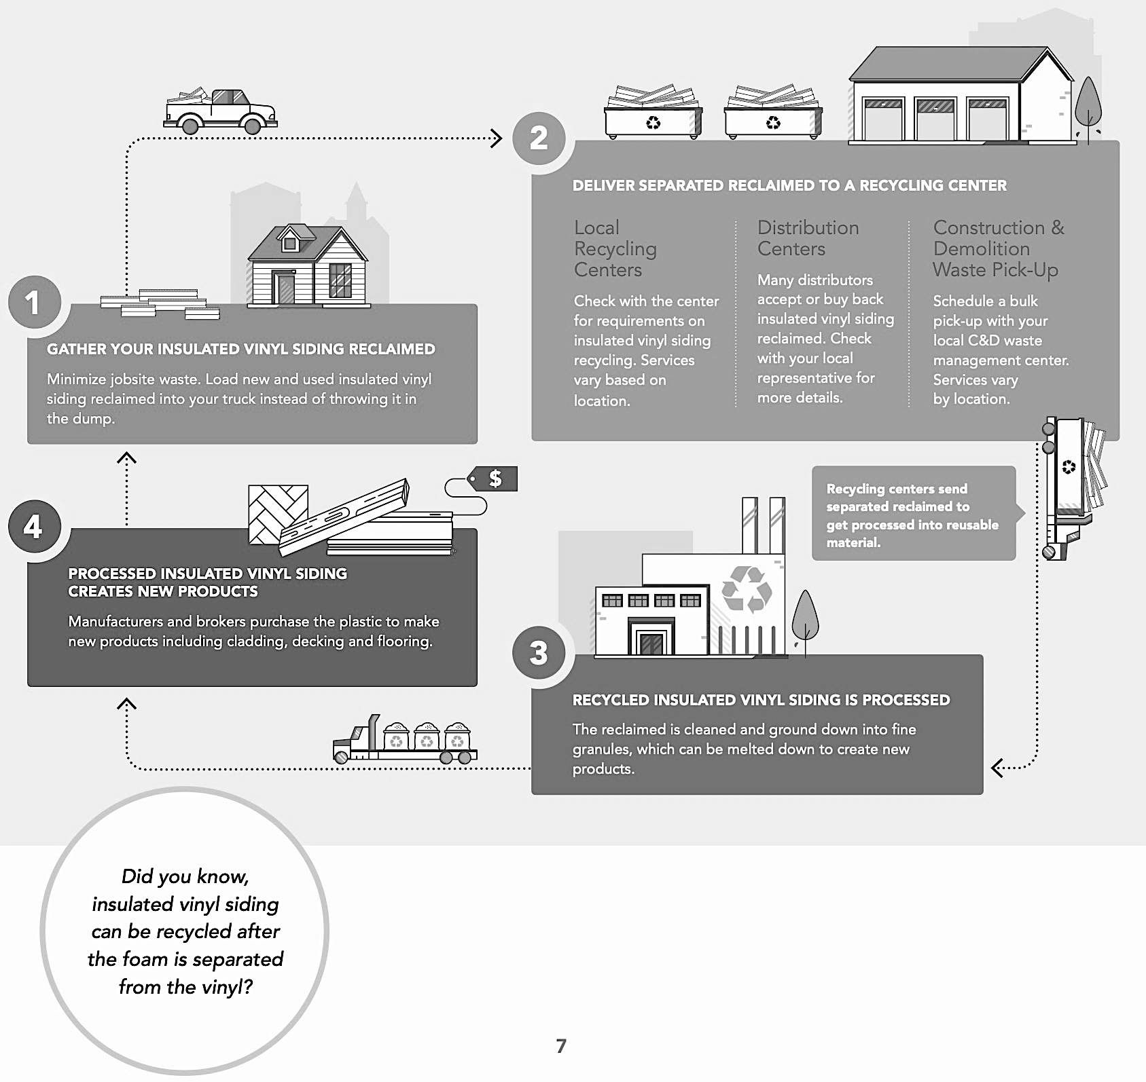
GPS INSULATED VINYL SIDING: RESOURCE-EFFICIENT & 100% RECYCLABLE
Reduced Environmental Impacts
Courtesy Vinyl Siding Institute
Notes:
Additionally, insulated vinyl siding with either EPS or GPS insulation is exceptionally resource-efficient and uses few ingredients in manufacturing. It is also 100 % recyclable. (Speak to slide)

Slide 17
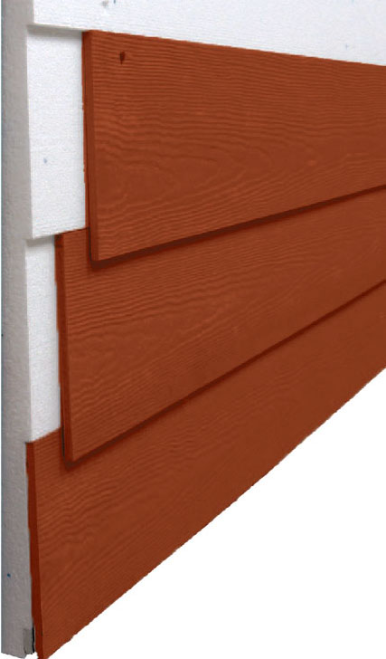

DOE & EPA: INSULATED SIDING PROVIDES CONTINUOUS INSULATION
According to the US Dept. of Energy, insulated siding is designed to achieve higher levels of thermal performance and provide continuous insulation, verified through specific R-value and therefore…
“
”
Most new homes can save significant resources by specifying insulated siding over fiber cement.
Continuous Insulation
Source: Energy.gov
Notes:
In fact, the DOE and EPA recognize insulated siding as a way to improve a home’s energy efficiency, reduce thermal bridging and provide continuous insulation. (Source: House is Sided and Sealed: Insulated Siding Provides Continuous Insulation)
According to the DOE, you “can save significant resources by specifying insulated siding over fiber cement siding.”

Slide 18
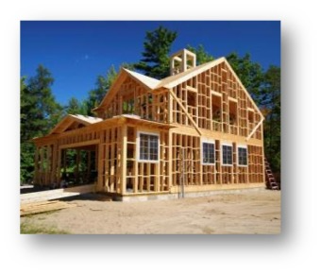
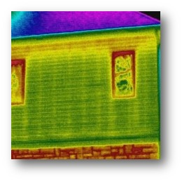
CONTINUOUS INSULATION SOLVES THERMAL BRIDGING
Studs & Framing 25% of Wall Surface Area
Major Heat Loss Due to Thermal Bridging
Continuous Insulation
Notes:
In traditional stick-built residential construction, framing makes up 25% of the exterior wall surface. It’s here, between the insulated wall cavities, we see heat transfer occur more quickly. This is referred to as "thermal bridging," as seen in the right-hand image represented by the vertical yellow lines.

Slide 19
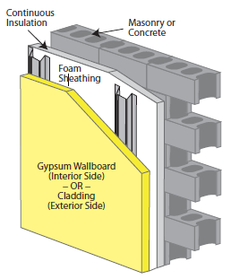
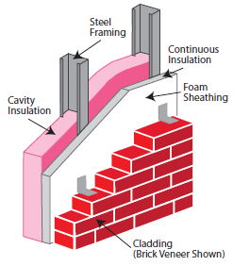
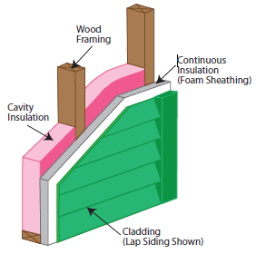
CONTINOUS INSULATION (CI)
  “Continuous insulation runs continuously over structural members and is free of significant thermal bridging.”
  (Source: Energy.gov)
Continuous Insulation
Notes:
To reduce thermal bridging and promote better energy efficiency, experts such as the Department of Energy recommend utilizing "Continuous Insulation." This method entails strategically placing insulation that covers all structural members to prevent significant heat transfer. “It is installed on the interior, exterior, or is integral to any opaque surface of the building envelope.: (Source: energycodes.gov)
“Alternative combinations of cavity insulation and sheathings in thicker walls can be used, provided the total wall assembly has a U-factor that is less than or equal to the appropriate climate zone construction requirements." – Energy.gov
See also, “How is Cavity and Continuous Wall Insulation Calculated in REScheck? https://www.energycodes.gov/technical-assistance/faqs/how-cavity-and-continuous-wall-insulation-calculated-rescheck#:~:text=under%20the%20siding.-,Continuous%20Insulation,surface%20of%20the%20building%20envelope.

Slide 20
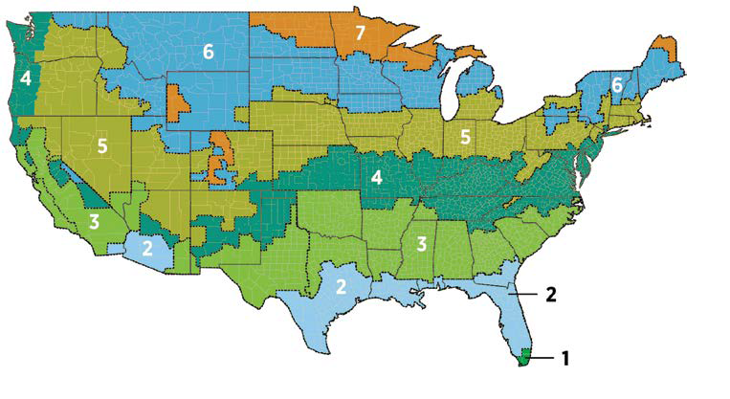
CI IS REQUIRED IN 2021 IECC & ASHRE 90.1
CLIMATE ZONE | UNINSULATED ATTIC | 3-4 INCHES OF EXISTING ATTIC INSULATION | UNINSULATED FLOOR | UNINSULATED WOOD-FRAME WALL | INSULATED WOOD FRAME WALL
1 | R30–R49 | R19–R38 | R13 | R13 or R0 + R10 CI* | N/A
2 | R49–R60 | R38–R49 | R13 | R13 or R0 + R10 CI | N/A
3 | R49–R60 | R38–R49 | R19 | R20 or R13 + R5 CI or R0 + R15 CI | Add R5 CI
4 EXCEPT MARINE | R60 | R49 | R19 | R20 + R5 CI or R13 + R10 CI or R0 + R15 CI | Add R10 CI
4 MARINE AND 5 | R60 | R49 | R30 | R20 + R5 CI or R13 + R10 CI or R0 + R15 CI | Add R10 CI
6 | R60 | R49 | R30 | R20 + R5 CI or R13 + R10 CI or R0 + R20 CI | Add R10 CI
7 AND 8 | R60 | R49 | R38 | R20 + R5 CI or R13 + R10 CI or R0 + R20 CI | Add R10 CI
Continuous insulation for uninsulated wood frame walls required in most climate zones.
Continuous Insulation
*Note: In the table above, CI stands for "continuous insulation" that is applied to the exterior of the wall assembly just inside the cladding. Source: energy.gov
Notes:
For years, building codes have been shifting towards mandating continuous insulation. The latest International Energy Conservation Code, updated in 2021, now requires continuous insulation for uninsulated wood-frame walls in most climate zones. ASHRAE 90.11, the standard for buildings with four or more stories, has required continuous insulation as part of the Prescriptive Wall Insulation Requirements since 1999. This information is sourced from BuildingEnclosureonline.com.

Slide 21
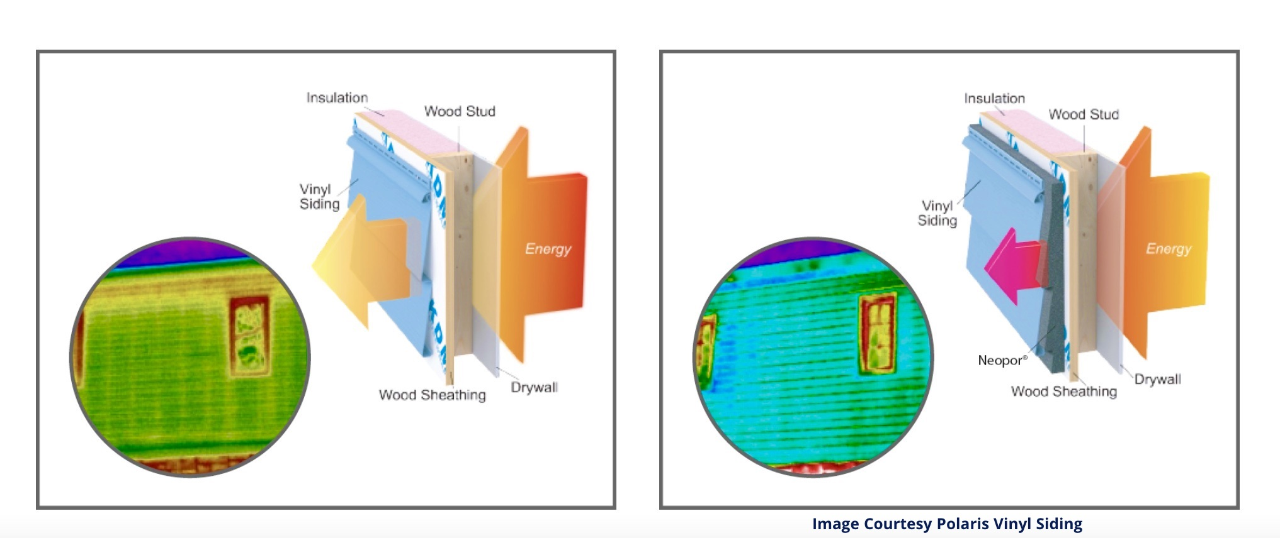
Before GPS Vinyl Siding
After GPS Vinyl Siding
Red, Yellow Shows Energy Leaks/ Thermal Bridging via Stud
& Framing
Solid Blue Shows
Energy Leaks /Thermal
Bridging Solved!
Continuous Insulation
Without… before
With… after
Notes:
See two areas of energy loss indicated in red at the top of the wall where cavity insulation has accumulated and the yellow lines where energy escapes via the studs. On the right, we see how once the insulated siding was installed; those areas were no longer a source of significant energy loss results.

Slide 22
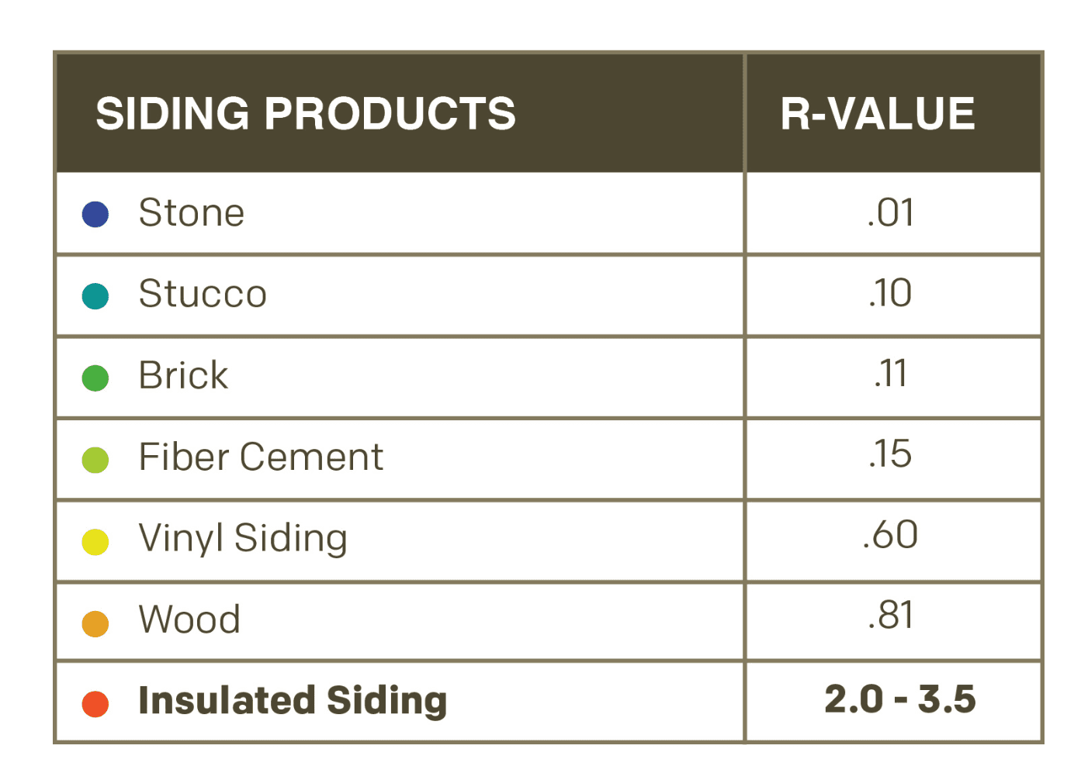
OTHER SIDING OPTIONS DO NOT OFFER SIGNIFICANT R-VALUE
Insulated Vinyl Siding: Provides CI
Insulated Vinyl Siding: Adds 2.0 -3.5 R-Value
Uninsulated Siding: Little R-Value
Continuous Insulation
Source: Progressive Foam
Notes:
Insulated siding systems serve the dual purpose of providing continuous insulation and cladding. As we see in this chart, it can increase thermal performance up to six times and help prevent thermal bridging.

Slide 23
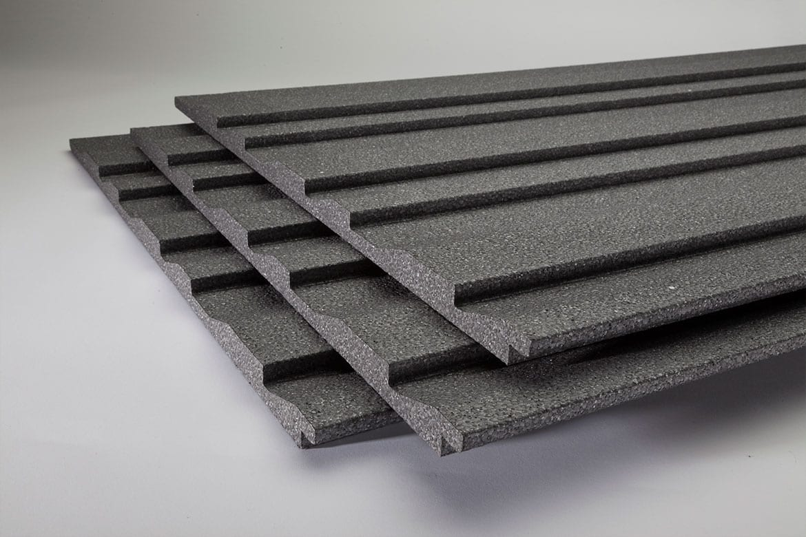
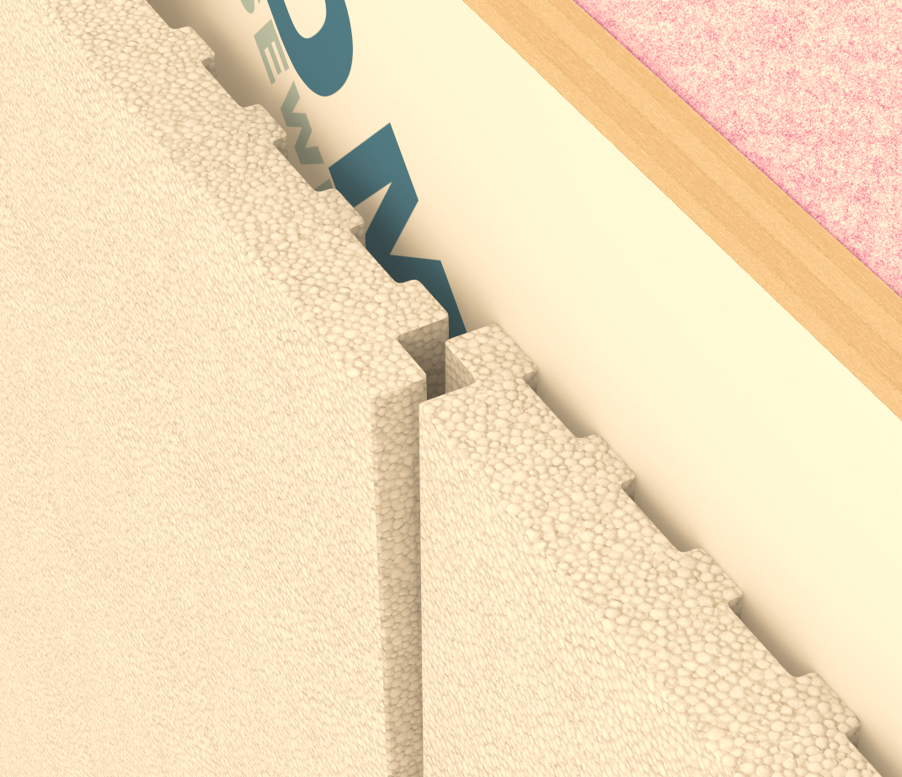
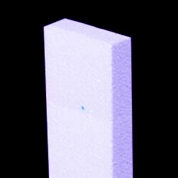
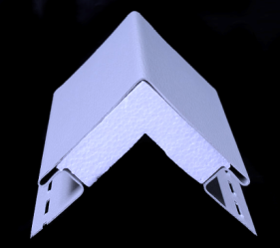
ADDITIONAL GPS INSULATED SIDING OPTIONS FOR ADDED CI
Shadow lines that are more pleasing
Drop in boards for uninsulated siding
Consistent, parallel siding lines
Trim options for corners, other details
Continuous Insulation
Courtesy Progressive Foam
Notes:
A full range of insulated trim options includes details for corners, and windows, and more, enabling a comprehensive continuous insulation and water management system.

Slide 24
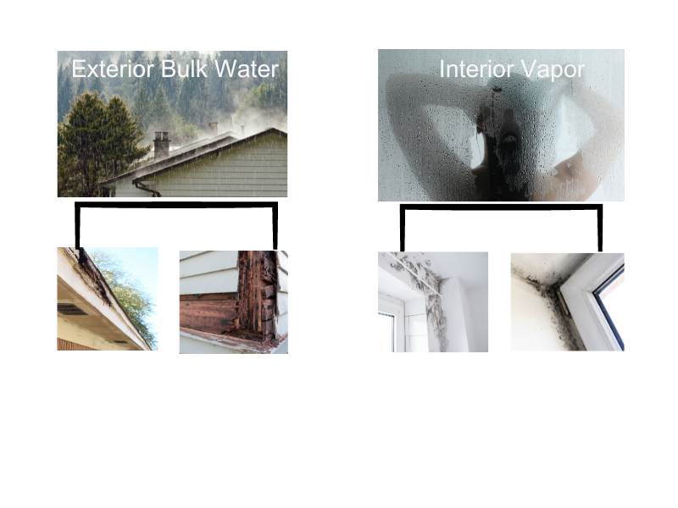
MOISTURE MANAGEMENT
GPS INSULATED VINYL SIDING
Moisture Management
Notes:
The attributes of EPS and GPS-insulated siding offer several advantages for managing water and vapor on the outside and from within the building, which we’ll explore in this chapter.

Slide 25

HANDLING MOISTURE IS CRITICAL FOR HEALTHY INTERIORS
Moisture Management
An average household produces 4-6 gallons of water vapor daily through activities like cooking & cleaning.
Notes:
A family of four produces an average of four gallons of water vapor daily in the "wet rooms" of their home, such as the kitchen, laundry, and bathrooms. Insulated vinyl siding on the house's exterior can help regulate this interior moisture, which is a benefit many people are unaware of.

Slide 26
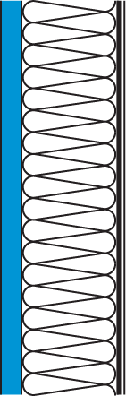
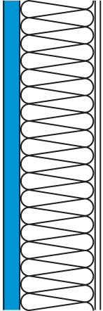
MOISTURE MANAGEMENT
Permeance Drives Wall Design
1 - Dry to outside
2 - Dry to inside
3 - Dry in both directions
Semi-Permeable
Insulating
Sheathing
Semi-Impermeable
or Impermeable
Insulating
Sheathing
Permeable or
Semi-Permeable
Insulating
Sheathing
Semi-Impermeable
Interior Finish or
Vapor Retarder
Permeable or
Semi-Permeable
Interior Finish
Permeable or
Semi-Permeable
Interior Finish
Moisture Management
Cold Climate Wall Section
(Drying Primarily to the
Exterior)
Hot-Humid Wall Section
(Drying Primarily to the
Interior)
Mixed-Humid Wall Section
(Drying to both the
Exterior and the Interior –
"Flow through approach")
Notes:
Since EPS/GPS is classified as semi-permeable insulation, allowing any water vapor/moisture to pass through easily, they are approved in all climate zones.

Slide 27
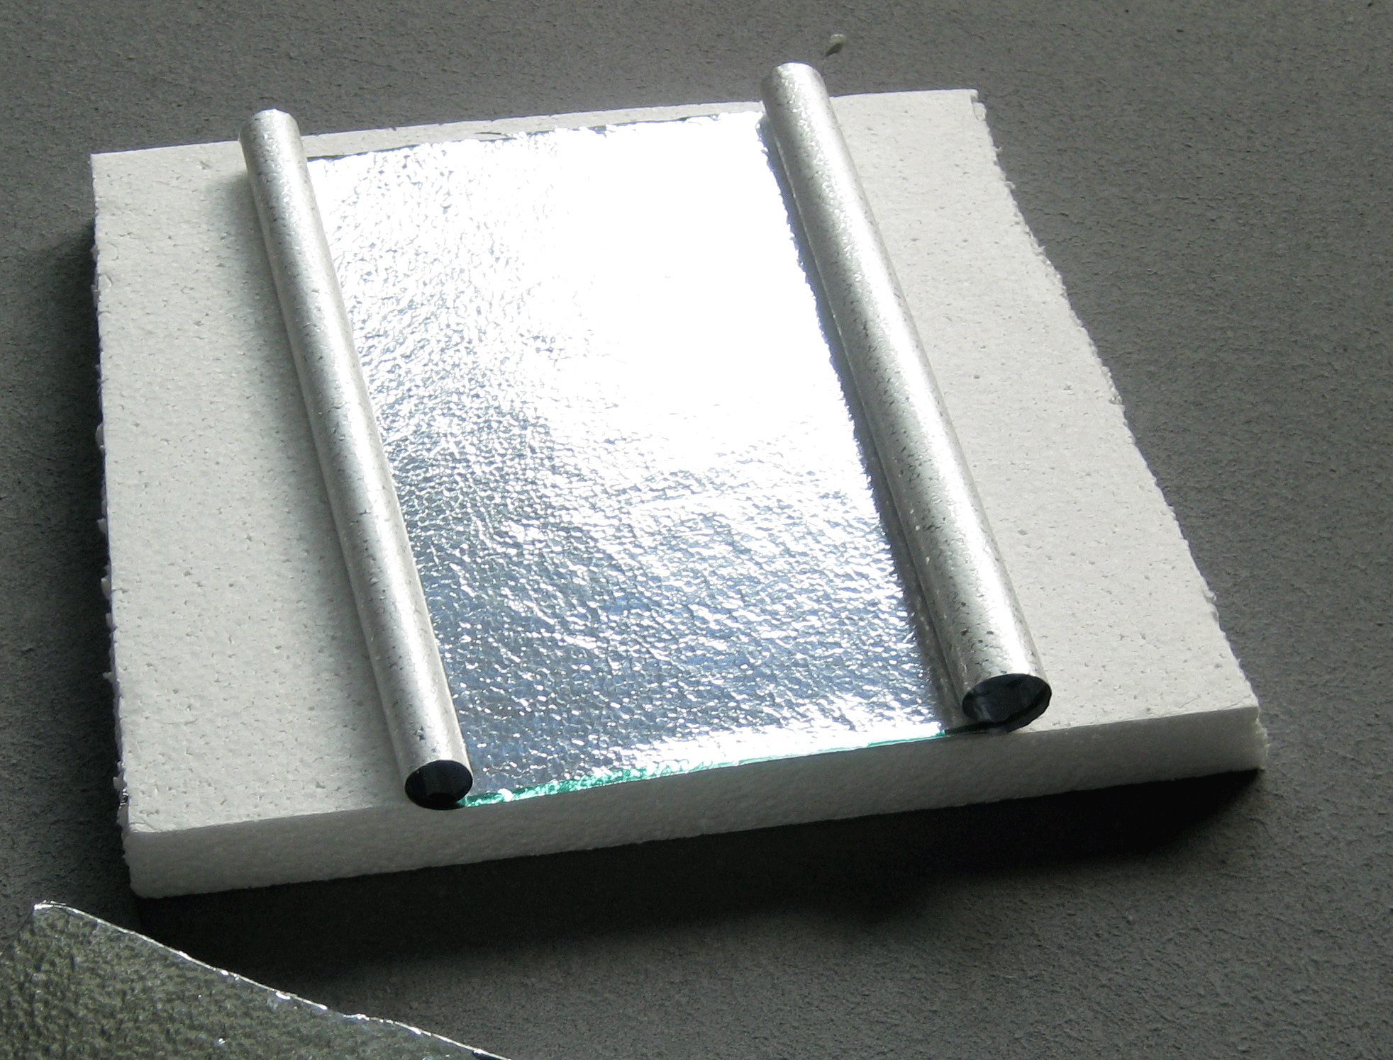
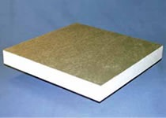
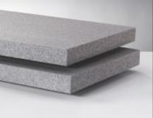
PERMEABILITY FACTOR: EPS/GPS VS XPS
GPS Retains R-Value and Dries Quicker
Vapor Retarder Characteristics
Class | Perm Rating | Description
I | < 0.1 perm | Impermeable
II | 0.1 – 1.0 perm | Semi-Impermeable
III | > 1.0 perm* | Semi-Permeable
Moisture Management
*Above 10 perm material is considered Permeable and no longer a Vapor Retarder
EPS, Type I, 1.0 lb/ft³
XPS, Type X, 1.60 lb/ft³
Unfaced, GPS has a perm rating of 3.5 which allows drying to the interior or the exterior
Notes:
EPS/GPS are classified as semi-permeable vapor retarders and acceptable for all climate zone assemblies.
XPS, on the other hand, is a semi-impermeable vapor retarder. The perm rating of a rigid foam board product is determined by the thickness of the foam + the perm rating of the facer.
The thicker the foam board, the lower the perm rating becomes.
With a base Perm Rating of 1.1 per inch before adding a facer, XPS is almost always < 1.0 perm, making it a semi-impermeable vapor retarder, which may be a limitation in some climate zones. Unfaced, GPS has a perm rating of 3.5, which facilitates interior or exterior drying. Oak Ridge National Laboratory testing found that XPS holds more water than GPS. When it absorbs water, XPS loses its insulating ability and drops in R-value.
EPS/GPS keeps nearly full R-value, 94% vs. 52% for XPS.
Other source:
EPS Below Grade Series 103, November 2008 http://www.epsindustry.org/sites/default/files/EPS%20B elow%20Grade103.pdf

Slide 28
Quiz
Name one way GPS’s properties contribute toward thermal performance and moisture management in insulated vinyl siding.
Notes:
GPS is breathable, allowing it to dry quickly.
Due to breathability, GPS retains R-Value over time much more than XPS.
Depending on zones, permeability is addressed with facer options from the manufacturer.
GPS is suited for all climate zones with 3.5 Perm

Slide 29
Answers
GPS’s thermal performance is ~25% higher than traditional EPS.
GPS, like traditional EPS, is a Type III Vapor Retarder and, therefore, semi-permeable, allowing vapor to escape and retain its R-Value, even when wet.
Notes:
GPS is breathable, allowing it to dry quickly.
Due to breathability, GPS retains R-Value over time much more than XPS.
Depending on zones, permeability is addressed with facer options from the manufacturer.
GPS is suited for all climate zones with 3.5 Perm

Slide 30
CHAPTER 3:
OVERALL IMPROVED PERFORMANCE
Durability
Reduced Noise
Less Maintenance
Fire Safety
Notes:
In this section we will discuss several other important benefits of GPS-insulated vinyl siding including hurricane and impact resistance, sound attenuation, reduced maintenance and fire safety.

Slide 31
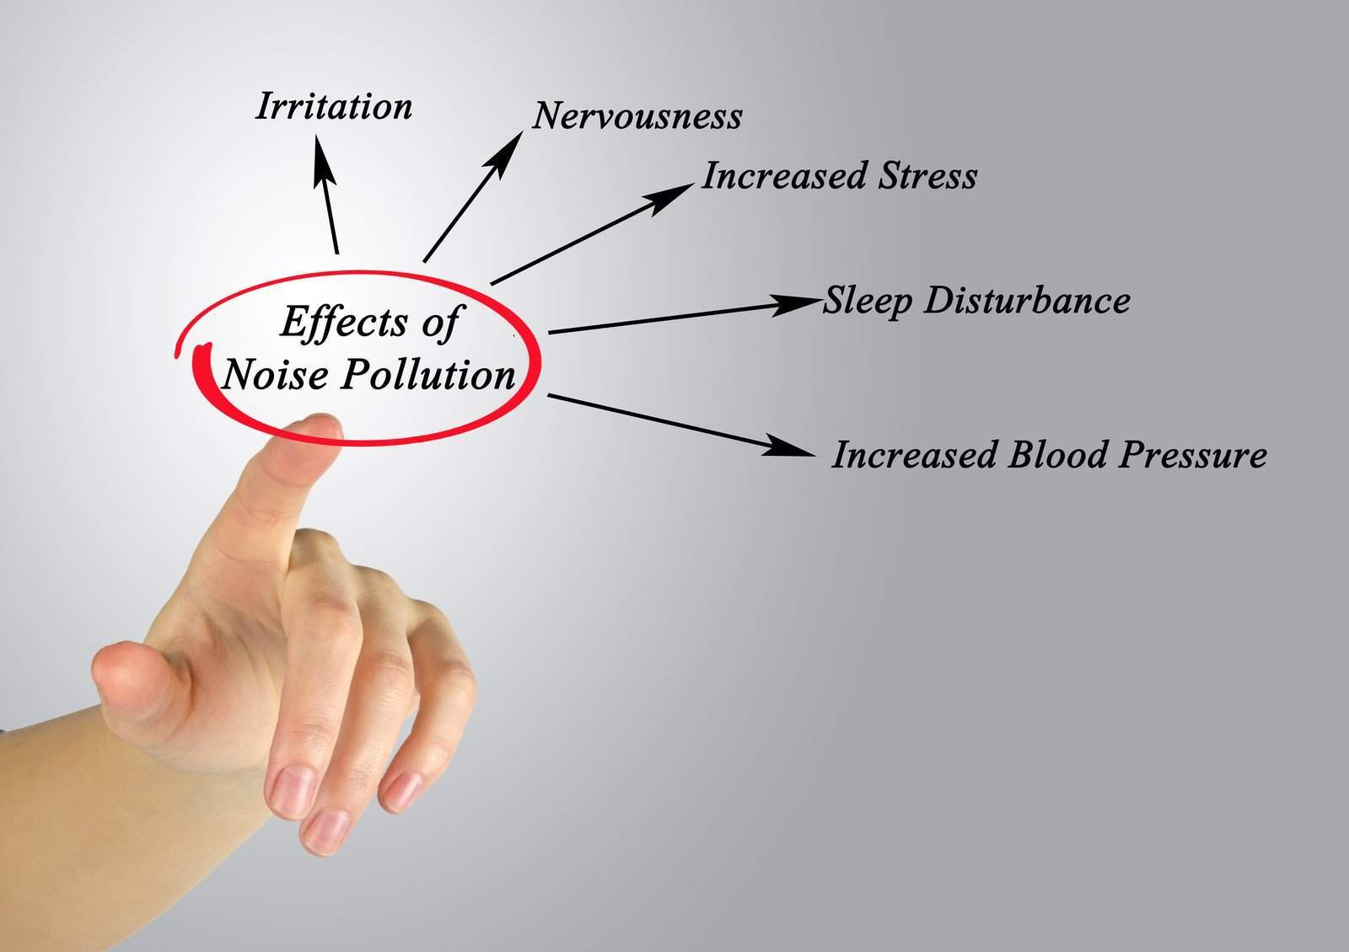
Noise Pollution Causes Several Health Problems.
Source: EPA
Reduced Noise
“Loud noises can signal to the auditory system that something is wrong, triggering a fight-or-flight-response, which floods the body with stress hormones that cause inflammation and can lead to disease.”
Peter James, associate professor in the Department of Environmental Health at Harvard T.H. Chan School of Public Health.
Notes:
EPA reports that noise pollution can cause a number of health problems, including sleep disturbance, reduced study performance, anxiety, irritability, and general emotional stress. With 98% of the continental US experiencing highway noise, noise pollution is not relegated to cities. (Source: Noise Pollution Clearinghouse.) The good news is that insulated vinyl siding can help solve this problem.

Slide 32
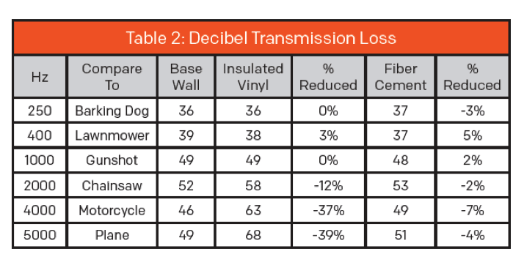
INSULATED VINYL SIDING REDUCES NOISE BY +/- 39%
Reduces Noise 8Xs More Than Fiber Cement Siding
Reduced Noise
Notes:
That’s’ why it's important to note that insulated vinyl siding reduces sound transmission by up to 39%, according to the testing laboratory, Intertek Building & Construction on behalf of Progressive Foam Technologies, inventors of insulated vinyl siding.
The tests also showed that insulated vinyl siding reduces sound transmission 8x more than fiber cement.
You can see in Table 2 that insulated vinyl siding reduces the sound transmission of 5000 Hz (comparable to a plane taking off) while fiber cement reduces the sound by only 4%.)

Slide 33
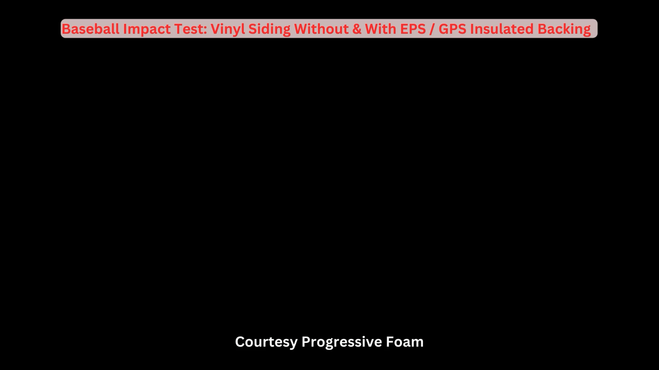
GPS INSULATED VINYL SIDING: IMPACT & PEST RESISTANT
Durability
Insulation Acts as a Shock Absorber
No Space for Pests
Prevents Cracking, Denting, Breakage
Notes:
This video shows how insulated vinyl siding reduces the probability of damage from wind-blown debris for both laminated insulation siding and contoured insulation that can be added separately. (Play video)
Here, the EPS insulation fills the voids behind the siding, acting as a shock absorber that prevents cracking, denting, and breakage. This also eliminates space where pests can nest behind the siding and can be treated with a safe insecticide to protect it from termites.

Slide 34
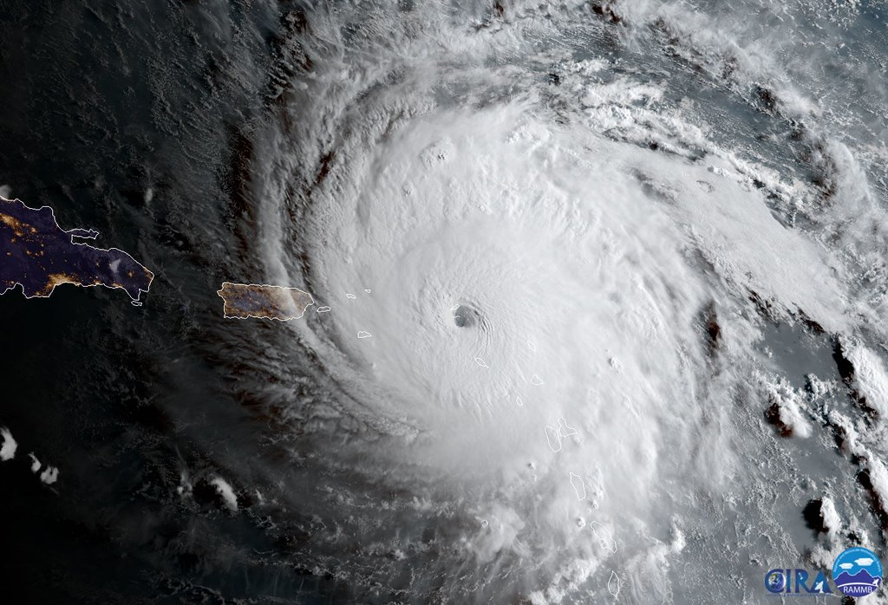
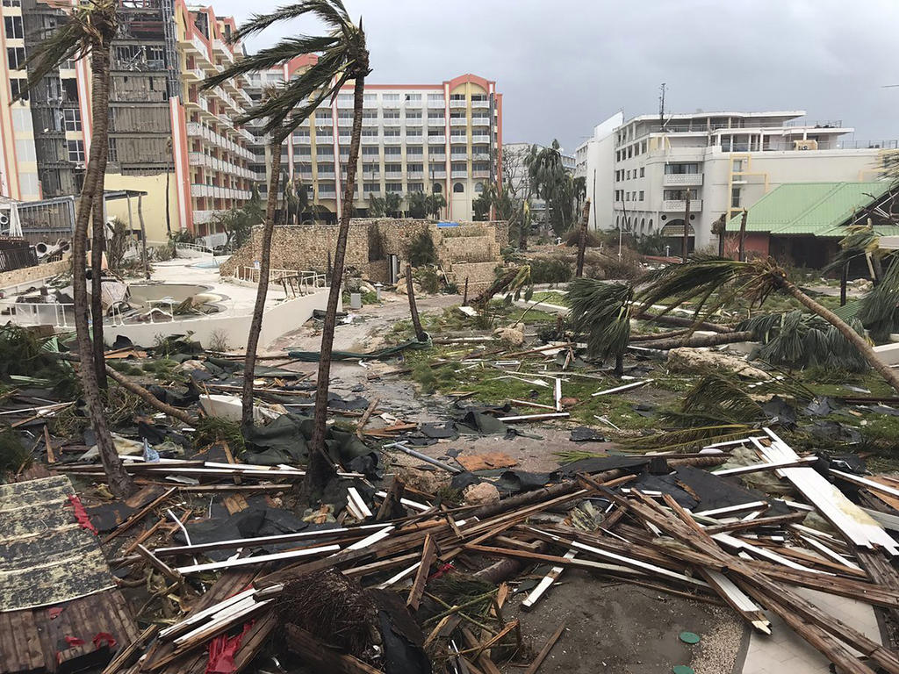
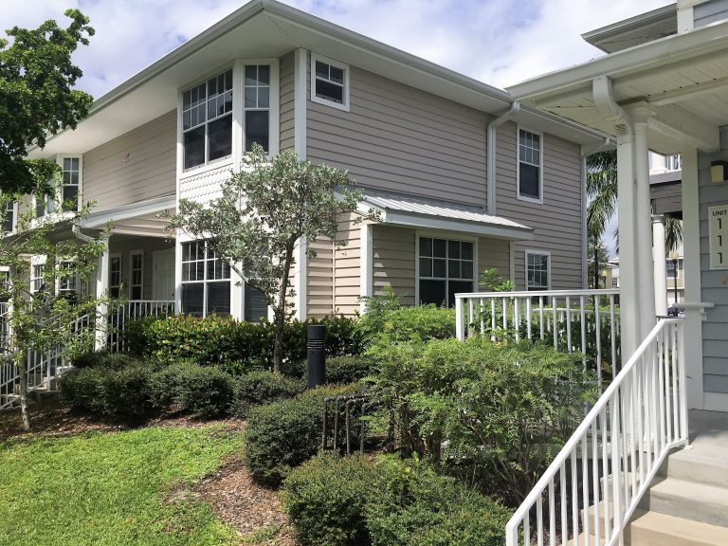
INSULATED VINYL SIDING MAKES A HOME SAFER
Hurricane Irma & Insulated Vinyl Siding
Designed for 160-MPH Winds
Withstood Cat 3 Winds
No Visible Damage
No Water Infiltration
Durability
“Gulf Breeze, clad with insulated vinyl siding, suffered no visible damage and no water infiltration to the interior, saving the developer from repair headaches and protecting the tenants from suffering devastating storm damages.”– The Vinyl Institute Report 12/2017
Notes:
According to the Vinyl Siding Institute, insulated vinyl siding can be designed to resist winds up to 160 mph with many profiles meeting Florida’s restrictive inland and coastal code requirements.
In this case study from the Vinyl Siding Institute, on September 10, 2017 Hurricane Ima slammed Punta Gorda with Category-Three force winds, with average gusts between 111-130 MPH but the Gulf Breeze's residents in Punta Gorda suffered no significant losses. The vinyl siding specified by the developer of this 171-unit development was designed to withstand 160-MPH. It withstood the storm, saving the owners repair costs and helping to protect the tenants from what could have been a devastating loss. (Source:https://www.vinylsiding.org/wp-content/uploads/2018/08/VSI_Hurricane_Irma_Sheet.pdf)

Slide 35
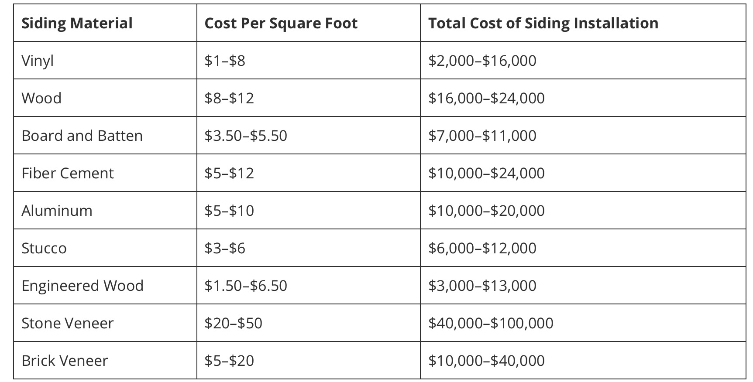
VINYL SIDING: LOWEST INITIAL COST & LIFETIME MAINTENANCE
Lowest Cost
Occasional Cleaning
No Painting, Scraping, Solvents
Maintenance
Courtesy Todayshomeowner.com
Notes:
Insulated and non-insulated vinyl sidings are the lowest maintenance siding products available today, reducing their lifetime costs compared to other products. While sidings like fiber cement and wood require regular scraping, painting, and caulking, vinyl siding only requires occasional cleaning with a standard scrub brush, soap, and water from the house.

Slide 36
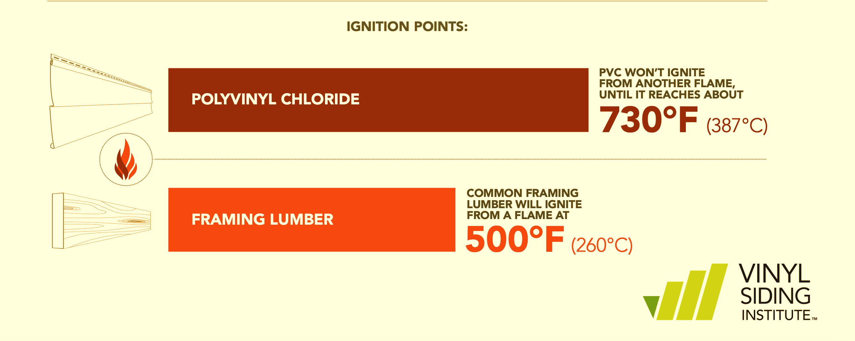
FIRE SAFETY: VINYL IS HARDER TO IGNITE THAN WOOD
Fire Safety
All Organic Materials Will Ignite.
Those with Higher Ignition Temperatures Are Safer.
Courtesy The Vinyl Siding Institute
Notes:
Vinyl siding is made of polyvinyl chloride or PVC, which is inherently fire resistant. PVC will not ignite until it reaches temperatures of about 750 degrees Fahrenheit. PVC also requires a uniquely large amount of oxygen to keep it burning. This means a fire is difficult to ignite initially and even harder to keep burning.

Slide 37
Chapter 4
Improved Aesthetics
Increases Support
Allows for Richer Colors
Wider, Flatter Panels Options
Better Finishing
Notes:
(Speak to Slide) Improved Aesthetics: Insulated vinyl siding features contoured foam that supports the siding panel. This, in turn, allows for darker, richer colors that previously struggled with extreme sun and high temperatures. In addition, the supportive foam helps maintain sharp, crisp profile lines that best emulate the appearance of natural wood products and allow for wider panels. Insulated vinyl siding can also help eliminate the appearance of imperfect walls and reduce dents from impacts.

Slide 38
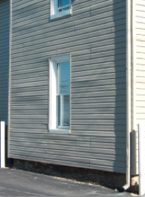

INCREASED SUPPORT IMPROVES AESTHETICS
Without Insulated Siding
With Insulated Siding
Courtesy Progressive Foam
Reduces the Appearance of Inconsistencies in the Framing or Wall.
Maintains Improved Appearance Throughout Service Life.
Notes:
As you can see here, insulated vinyl siding improves appearance over uninsulated siding, resulting in straighter lines and better symmetry.
Insulated vinyl siding can help eliminate the appearance of imperfect walls.

Slide 39


ALLOWS FOR RICHER COLORS
Courtesy Polaris Weathertech Vinyl Siding
Notes:
The added insulation allows vinyl siding manufacturers to make products in darker, richer colors that previously struggled with extreme temperatures from the sun.

Slide 40



WIDER, FLATTER PANEL OPTIONS
Courtesy Cedar Ridge Siding
Notes:
It also facilitates wider, flatter panel options, adding more architectural design choices.

Slide 41



SUPPORTS CURRENT DESIGN TRENDS
Courtesy Westlake Royal Building Products
Notes:
It also facilitates wider, flatter panel options, adding more architectural design choices.

Slide 42
Chapter 5
HOW TO SPECIFY GPS VINYL SIDING
GPS for More R-Value & CI
Fire, Durability, Sound
Reduced Environmental Impacts
Advanced Moisture Management
Notes:
As discussed, insulated vinyl siding offers several advantages to achieving many aesthetic and performance specifications, including targeted R-value, moisture management goals, environmental considerations, durability, etc. Here are some ways that you can specify these attributes into your designs.

Slide 43
SPECIFY CLOSED-CELL FOAM & TARGET R-VALUE
EPS & GPS Siding Insulation: R-Value 2.0 - 5.0
Density (lb/ft3) ~ 1.0 - 1.25
Cladding R-Value:
0.01 - 0.81
Base Thickness…
0.75” to 1.25”
Siding Material | R-Value
Stone | 0.01
Stucco | 0.10
Brick | 0.11
Fiber Cement | 0.59
Vinyl Siding | 0.62
Steel Siding | 0.62
Wood | 0.81
Notes:
Here are the four factors that will determine the actual R-Value of the siding insulation that you specify:
The density of the foam per cubic foot ~ from 1.0# to 1.25#
The base thickness~ from 0.75 inches to 1.25 inches
The cladding R-Value e.g., fiber cement, vinyl, steel, and wood, all provide some R-Value

Slide 44

SPECIFY ADVANCED MOISTURE MANAGEMENT
Specify Systems that Channel Water/Condensation Safely Away
Ensuring Wall System Can Dry Out, Eliminating Wall damage & Mold
Grooves on the back side of the insulation panels
GPS & EPS for Type 111 Semi -Permeable Vapor Retarder
Maintains R-Value while directing vapor away from interiors
Courtesy Progressive Foam
Notes:
Specify GPS vinyl siding for your water management design. You can see here that the GPS siding has grooves that shepherd the exterior bulk water down and away from the building envelope. Specify GPS vinyl siding for optimal whole wall permeance as part of the indoor moisture management plan.

Slide 45



SPECIFY SYSTEMS WITH GPS CI DETAILS
Details for CI
Adhered Insulation
GPS for Maximum R-Value
Notes:
To ensure that your GPS vinyl siding design is complete and comprehensive, 1) specify detail options that achieve continuous insulation e.g. around windows, doors and corners 2) specify permanently adhered insulation options 3) Specify profiles with chases that direct water down and away from the building envelope.

Slide 46
SPECIFY GPS
Adheres to the same ASTM standards as traditional EPS and XPS, the other main polystyrene-based foams (ASTM C578)
However, its performance characteristics are different enough that the main specification tools in the AEC industry in North America (BSD SPECLINK and MASTERSPEC) have created an entirely new "graphite polystyrene" category to help product specifiers identify its attributes.
Notes:
Read Slide

Slide 47


SPECIFY HEALTHY INTERIORS
_{Benefits:}
Allowable Emission Levels and Measurement
Products are measured for chemical and particle emissions, as they are tested to simulate actual product use. Most building materials and furnishings are required to meet allowable emission levels within 7 to 14 days of installation.
All products are tested in dynamic environmental chambers following guidance of
          ASTM Standards D-5116 and D-6670
          US Environmental Protection Agency's (USEPA) testing protocol for furniture
          State of Washington's protocol for interior furnishings and construction materials
          Germany's Blue Angel Program
          California’s Department of Public Health Services (CDPH) Standard Practice for Specification Section 01350
          ISO 16000 environmental testing series
          ANSI/ASHRAE Standard 62.1-2007
          World Health Organization
          LEED for New Construction (LEED-NC) and LEED for Commercial Interiors (LEED-CI)
Notes:
Specify GPS insulated vinyl siding for healthy Interiors. Here are some of the related certifications and credentials to include in your designs.

Slide 48



CASE STUDY: NJIT RESIDE RIGHT STUDY
Notes:
EPA and DOE studies have found that infiltration in a typical American house accounts for up to 40 percent of the heating and cooling loads. That’s why The New Jersey Institute of Technology’s Center for Building Knowledge received a DOE grant to study opportunities for improved energy efficiency when homes are being re-sided. The “Re-side Right project” incorporates graphite polystyrene (GPS) rigid foam insulation in a re-siding effort for existing homes. The study concluded that siding Insulation is an effective and cost-effective way to increase energy efficiency. The average reduction in infiltration among the homes was 18.64%. (Source: https://news.njit.edu/njit-research-partnership-basf-and-united-way-taking-climate-action)

Slide 49
Profile: Residential Exterior Remodel – Bolivar, Ohio
CI achieved with Halfback H2O by Progressive Foam Technologies
CraneBoard 7-inch clapboard vinyl siding by Royal Building Products
Fiberglass entry door by JELD-WEN with GPS core
“We are so pleased with how our project turned out. Our home used to be drafty in the winter, and in the summer, we had some rooms that were too warm to enjoy. We have already noticed a difference in the comfort level of our home.”
Ben and Kathy Higl, Homeowners
Thermographic images: BEFORE
Thermographic images: AFTER
Notes:
Halfback H2O by Progressive Foam Technologies as continuous insulation, which significantly improved the performance of the existing wall insulation.
CraneBoard 7-inch clapboard vinyl siding by Royal Building Products, backed by Solid CoRe insulation — an R-3 insulated siding product that integrates GPS to further mitigate thermal bridging through the existing wall structure
Fiberglass entry door by JELD-WEN, which features an insulating core made of GPS

Slide 50
CONCLUSION: GPS INSULATED VINYL SIDING IS A HIGH-PERFORMANCE BUILDING SYSTEM THAT DELIVERS
Improved Performance: Maintenance, Wind, Noise
Aesthetics: More Pigments; Better/Flatter Finish
Superior Continuous Exterior Wall Insulation
Building Code/ ASHRAE Compliance
Environmentally & Financially beneficial
Effective Moisture Management

Slide 51
GPS INSULATED VINYL SIDING COURSE SUITE
A Full Suite of AIA CEU Approved Courses About the Advantages of GPS Insulated Vinyl Siding Are Now Available Under Provider 5011211
Main Course: Not Your Grandmother's Vinyl Siding: the Advantages of Graphite Polystyrene Insulated Vinyl Siding | AIA Credit: 1 LU HSW | COURSE 12
EPDs and Graphite Polystyrene Insulated Vinyl Siding | AIA Credit: 0.5 HSW | Course 27
GPS Insulated Vinyl Siding & Energy Code Compliance | AIA Credit: 0.5 HSW | Course 51
GPS Insulated Vinyl Siding & the 2022 Inflation Reduction Act | AIA Credit: 0.5 HSW | Course 22
More Courses https://neopor.basf.us/resources/courses
Notes:
Also, please check out the other courses in this series, including GPS Insulated Vinyl Siding and Energy Code Compliance, GPS Vinyl Siding, and the 2022 Inflation Reduction Act. You can find information about these courses and more at https://neopor.basf.us/resources/courses

Slide 52
Notes: Additional Resources
ContinuousInsulation.org
Foam Sheathing Coalition
Progressivefoam.com
Neopor.us/commercial
Master Format Number: Division 7 20.2100
Sustainable Minds http://www.SustainableMinds.com
Add: There will usually be a need for additional CI. Check your local codes.

Slide 53
Contact information:
Ron Heidt
BASF – Neopor Business Development
Ron.Heidt@BASF.com
www.Neopor-Insulation.com
Notes:
Thank you for your interest in the course, “NOT YOUR GRANDMOTHER'S VINYL SIDING: THE ADVANTAGES OF GRAPHITE POLYSTYRENE INSULATED VINYL SIDING;’ . This course is sponsored by BASF in conjunction with Progressive Foams. If you’d like to further the discussion about any of the topics or products mentioned in the course, feel free to reach out to me by email, through our website, or on social media. Thank again, and I hope you enjoyed the course.
Contact information for BLANK
EMAIL@BASF.com
LinkedIn: www.linkedin.com/in/NAME
Website: www.neopor-insulation.com

