Slide 1
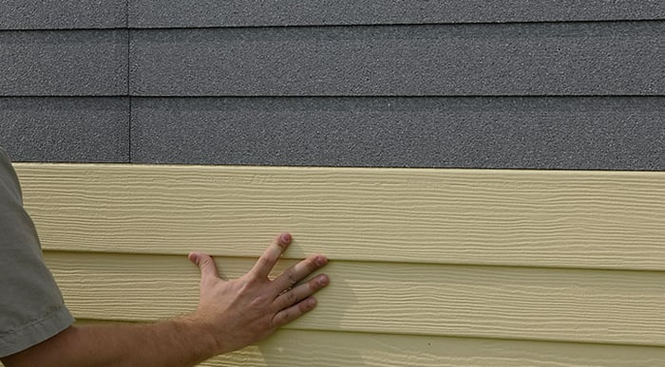
GRAPHITE POLYSTYRENE INSULATED VINYL SIDING & THE 2022 INFLATION REDUCTION ACT
Course Number: 31
Provider Number: 50111211
Credit: This course is 0.5 LU|HSWs
Notes:
Welcome to today’s “Graphite Polystyrene & the Inflation Reduction Act” presentation. I am --- from ---. This program has been approved for 0.5 AIA CEUs in Health Safety and Welfare.

Slide 2
COPYRIGHT MATERIALS
This presentation is protected by U.S. and International copyright laws. Reproduction, distribution, display, and use of the presentation without written permission of BASF is prohibited.
©BASF, 2023
Notes:
This presentation is protected by U.S. and International copyright laws. Reproduction, distribution, display, and use of the presentation without written permission of BASF is prohibited.

Slide 3
AIA CES PROVIDER STATEMENT
Provider Number 50111211. All registered AIA CES Providers must comply with the AIA Standards for Continuing Education Programs. Any questions or concerns about this provider or this learning program may be sent to AIA CES (cessupport@aia.org or (800) AIA 3837, Option 3).
This learning program is registered with AIA CES for continuing professional education. As such, it does not include content that may be deemed or construed to be an approval or endorsement by the AIA of any material of construction or any method or manner of handling, using, distributing, or dealing in any material or product.
AIA CES has reviewed and approved AIA continuing education credits for this learning program. Learners must complete the entire learning program to receive continuing education credit. AIA continuing education Learning Units earned upon completion of this course will be reported to AIA CES for AIA members. Certificates of Completion for AIA and non-AIA members are available upon request.
Notes:
This learning program is registered with AIA CES for continuing professional education. As such, it does not include content that may be deemed or construed to be an approval or endorsement by the AIA of any material of construction or any method or manner of handling, using, distributing, or dealing in any material or product.

Slide 4
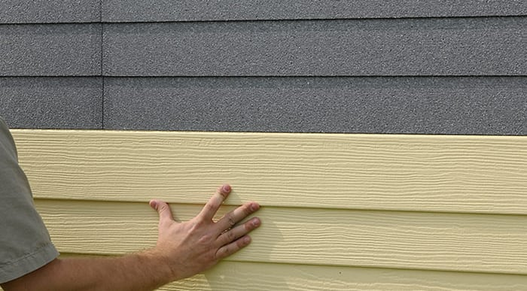
COURSE DESCRIPTION
This course explains how graphite polystyrene insulated vinyl siding acts as Continuous Insulation and, as such, can help earn tax credits/rebates and the HUD funding requirements associated with the 2022 Inflation Reduction Act (IRA).
Prerequisite Knowledge: The participants should have completed the overview course "Not Your Grandmother's Vinyl Siding, the Advantages of Graphite Polystyrene Insulated Vinyl Siding.”
HSW Justification: This course delves into the energy efficiency and carbon reduction incentives provided by the 2022 Inflation Reduction Act (IRA), a federal tax program designed to reduce the energy demand and associated carbon emissions of our nation's building infrastructure.
Notes:
This course explains how graphite polystyrene insulated vinyl siding acts as Continuous Insulation and, as such, can help earn tax credits/rebates and the HUD funding requirements associated with the 2022 Inflation Reduction Act (IRA).
Prerequisite Knowledge: The participants should have completed the overview course "Not Your Grandmother's Vinyl Siding, the Advantages of Graphite Polystyrene Insulated Vinyl Siding.”
HSW Justification: This course delves into the energy efficiency and carbon reduction incentives provided by the 2022 Inflation Reduction Act (IRA), a federal tax program designed to reduce the energy demand and associated carbon emissions of our nation's building infrastructure.

Slide 5
BENEFITS OF GPS INSULATED VINYL SIDING AS A HIGH-PERFORMANCE BUILDING SYSTEM REVIEW
Superior Continuous Exterior Wall Insulation
Effective Moisture Management
Improved Performance: Maintenance, Wind, Noise
Aesthetics: Better, more durable pigments
Building Code/ ASHRE Compliance
Tax & Funding Advantages
Environmentally Beneficial
Notes:
In the previous program, “Not Your Grandmother’s Vinyl Siding,” we learned about the many advantages of graphite polystyrene insulated vinyl siding as a high-performance building system. We will refer back to several of these today since these benefits allow project designers, managers, and owners to take advantage of several tax incentives and funding opportunities associated with the 2022 Inflation Reduction Act.
These include the benefits circled here, including
GPS-insulated vinyl siding as exterior continuous insulation
GPS-insulated vinyl siding’s role in decreasing energy and, therefore, carbon emissions
GPS-insulated vinyl siding’s role in helping to meet new energy codes
Finally, the topic of today’s course is the associated tax incentives and funding opportunities related to using GPS-insulated vinyl siding.

Slide 6
LEARNING OBJECTIVES:
Upon completion, participants will be able to
Explain
What continuous insulation (CI) is and how graphite polystyrene insulated vinyl siding provides CI.
Understand
How the 2022 Inflation Reduction Act (IRA) incentivizes and supports energy-efficient and sustainable building and design decision-making.
Know
Why graphite polystyrene insulated vinyl siding is a valuable method to help earn IRA-related tax incentives and meet the pending HUD financing IECC 2021 requirements.
Notes:
After the course, participants will be able to:
Explain that continuous insulation (CI) and graphite polystyrene insulated vinyl siding provide CI.
Understand how the 2022 Inflation Reduction Act (IRA) incentivizes and supports energy-efficient and sustainable building and design decision-making.
Know why graphite polystyrene insulated vinyl siding is a valuable method to help earn IRA-related tax incentives and meet the pending HUD financing IECC 2021 requirements.

Slide 7
LEARNING OBJECTIVE 1
Understand continuous insulation (CI)
Understand graphite polystyrene (GPS) insulated vinyl siding as CI.
Understand Graphite Polystyrene.
Notes:
We will take a moment to review the definition and need for continuous insulation and why GPS insulated siding serves as CI. We will also review some of the benefits of graphite polystyrene insulation in these systems.

Slide 8
THE PROBLEM: THERMAL BRIDGING
Studs & framing are 25% of wall surface area.
Heat loss due to thermal bridging is a significant contributor to energy loss.
Notes:
In traditional stick-built residential construction, framing makes up 25% of the exterior wall surface. Here, between the insulated wall cavities, we see heat transfer occur more quickly. This is referred to as "thermal bridging," as seen in the right-hand image represented by the vertical yellow lines.
...
The number one strategy for reduced energy usage
Avoid leakage (seal the envelope)
Reduce loss through the ceiling, walls, and floor through by increasing insulation (R-value) and reducing thermal bridging.
Properly installed siding insulation increases the airtightness of the structure, adds R-value, and breaks the thermal bridge.

Slide 9
THE SOLUTION: CONTINUOUS INSULATION (CI)
CI: Insulation that runs continuously over structural members and is free of significant thermal bridging.
--Energy.gov
Graphite Polystyrene Insulation
Acts as Continuous Insulation
Notes:
Continuous insulation is insulation that runs continuously over structural members and is free of significant thermal bridging; such as rigid foam insulation above the ceiling deck. It is installed on the interior, exterior, or is integral to any opaque surface of the building envelope. Source: Energy.gov
The 2021 International Energy Conservation Code requires continuous insulation for uninsulated wood frame walls in most climate zones because it significantly reduces energy loss through uninsulated studs.
There are many ways to achieve CI. GPS insulated vinyl siding is one.

Slide 10
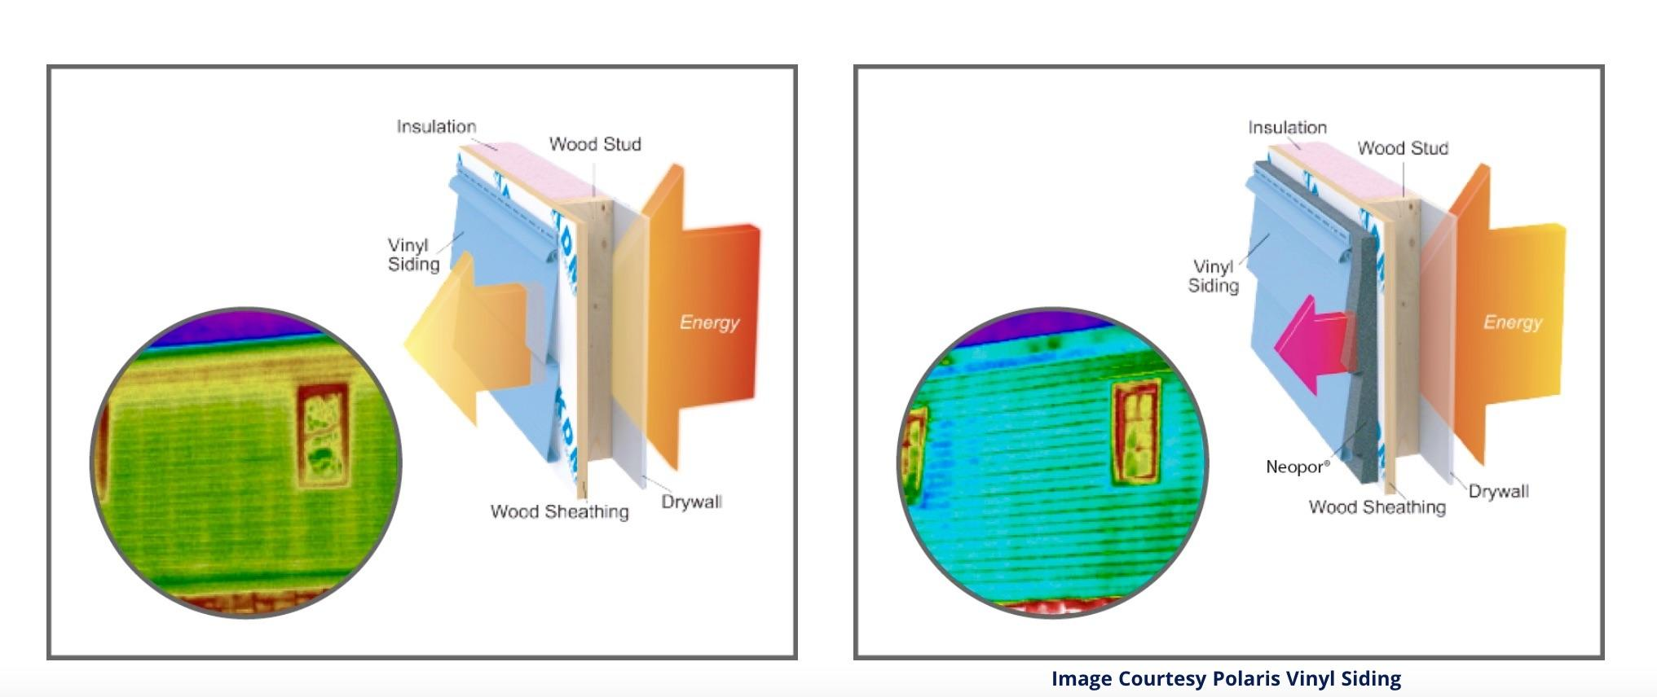
GPS-INSULATED VINYL SIDING PROVIDES ADDED R-VALUE & CI FOR NEW & EXISTING BUILDINGS.
Before GPS Vinyl Siding
After GPS Vinyl Siding
Red, Yellow Shows Energy Leaks/ Thermal Bridging via Stud & Framing
Solid Blue Shows Energy Leaks /Thermal Bridging Solved!
Without… before
GPS
With… after
Notes:
GPS-insulated vinyl siding provides added R-value and continuous insulation for both new and existing buildings, making it a perfect system to optimize energy performance and reduce operational carbon emissions in new and existing buildings.
Before GPS Vinyl Siding: Two energy leaks are visible with thermal imaging: red at the top of the wall, where cavity insulation has accumulated over time and yellow lines where energy escapes via studs.
After GPS Vinyl Siding: energy loss and thermal bridging are no longer seen through the studs and the top of the wall dramatically reduces energy loss through exterior walls. The Department of Energy recommends continuous exterior insulation because it works… and lowers the energy consumption of homes. These two thermal images of the same wall dramatically illustrate the impact of insulated siding. You can see that the heat, or warmth, escaping through the wall has been reduced significantly. Also, the thermal bridging through the studs, shown as the vertical yellow lines in the Before image, has been almost eliminated.

Slide 11
2021 IECC REQUIRING CONTINUOUS INSULATION TO REDUCE CARBON EMISSIONS
CLIMATE ZONE | UNINSULATED ATTIC | 3-4 INCHES OF | UNINSULATED FLOOR | UNINSULATED WOOD-FRAME WALL | INSULATED WOOD FRAME WALL
1 | R30–R49 | R19–R38 | R13 | R13 or R0 + R10 CI* | N/A
2 | R49–R60 | R38–R49 | R13 | R13 or R0 + R10 CI | N/A
3 | R49–R60 | R38–R49 | R19 | R20 or R13 + R5 CI or R0 + R15 CI | Add R5 CI
4 EXCEPT MARINE | R60 | R49 | R19 | R20 + R5 CI or R13 + R10 CI or R0 + R15 CI | Add R10 CI
4 MARINE AND 5 | R60 | R49 | R30 | R20 + R5 CI or R13 + R10 CI or R0 + R15 CI | Add R10 CI
6 | R60 | R49 | R30 | R20 + R5 CI or R13 + R10 CI or R0 + R20 CI | Add R10 CI
7 AND 8 | R60 | R49 | R38 | R20 + R5 CI or R13 + R10 CI or R0 + R20 CI | Add R10 CI
*Note: In the table above, CI stands for "continuous insulation" applied to the wall assembly’s exterior just inside the cladding. Source: energy.gov
Notes:
For years, building codes have been shifting towards mandating continuous insulation. The latest International Energy Conservation Code, updated in 2021, now requires continuous insulation for uninsulated wood-frame walls in most climate zones along the prescriptive path. ASHRAE 90.11, the standard for buildings with four or more stories, has required continuous insulation as part of the Prescriptive Wall Insulation Requirements since 1999. BuildingEnclosureonline.com.

Slide 12
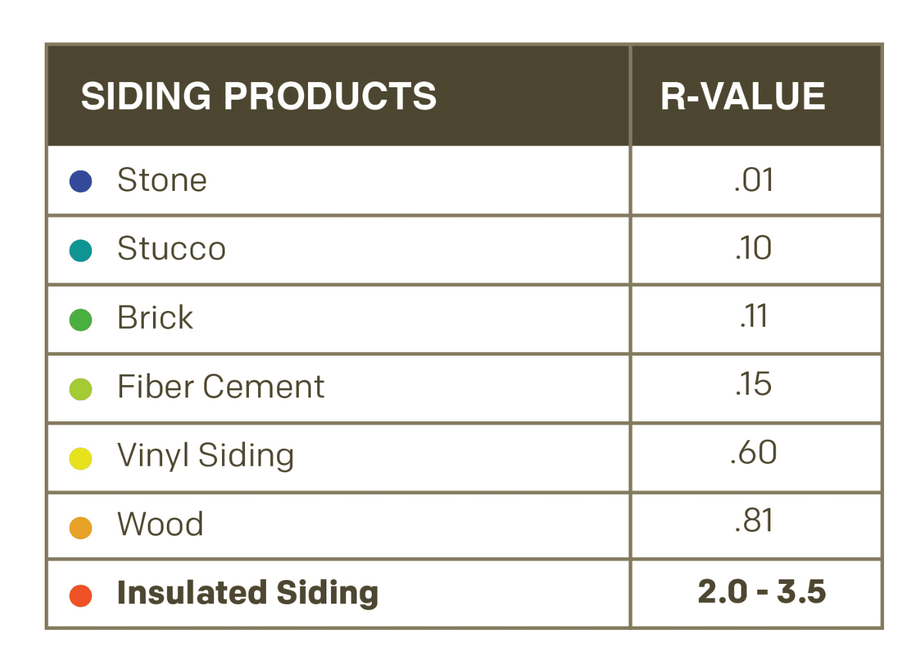
GPS INSULATED VINYL SIDING ADDS CI PLUS ADDED R-VALUE
Only Insulated Siding Offers CI
GPS Insulated Vinyl Siding R-Value of 2.0 to 3.5
Uninsulated Siding - Little R-value
Source: Progressive Foam
Notes:
Only insulated siding is designed to have insulation value. Siding insulation can add up to six times the thermal performance… while breaking the thermal bridge between the studs and the siding. This is why you should consider adding insulated siding as a go-to method for helping to reach new energy codes, secure funding and earn tax incentives.

Slide 13
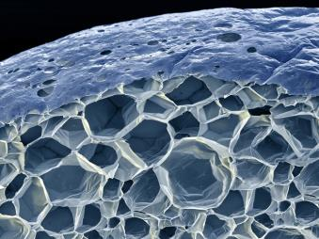
WHY GPS INSULATION?
Nominal Water Absorption
100% Recyclable
GPS Safe & Stable
+25 R-value
Low Embodied Carbon
Adheres EPS ASTM
Notes:
Patented graphite-enhanced EPS in 1995 under the brand name NEOPOR.
Graphite improves the overall performance of eps in several essential ways.
Graphite increases r-value ~25% over white eps via its ability to reduce thermal conductivity and reflect radiant heat
Graphite is the most stable form of carbon and a completely safe substance that doesn't react with other chemicals or off-gas in the building.
It adheres to the same astm standards of traditional eps and xps, the other main polystyrene-based foams (astm c578); however, its performance characteristics are different enough that the main specification tools in the aec industry in north america (bsd speclink and masterspec) have created an entirely new "graphite polystyrene" category to help product specifiers identify its attributes.)
Through lca and product-specific epds, gps has proven to display lower embodied carbon than any other rigid insulation in north america, including eps, xps, polyiso, and mineral wool.
It uses 30% less material mass than xps for the same r-value. It also offers 20% more thermal resistance than EPS at the same thickness. Source: information in this slide sourced from "insulation materials.” (N.D.). Energy saver. Retrieved from https://www.Energy.Gov/energysaver/weatherize/ insulation/insulation- materials
But why should you specify graphite polystyrene insulation?
GPS insulation provides all of the benefits of traditional EPS insulation, including nominal water absorption, low embodied carbon, recyclable and ASTM standards. However, due to the reflective properties of graphite, GPS has about 25% more R-value.

Slide 14
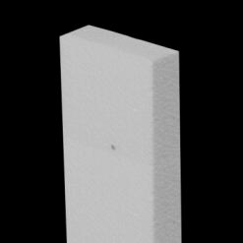
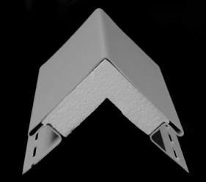
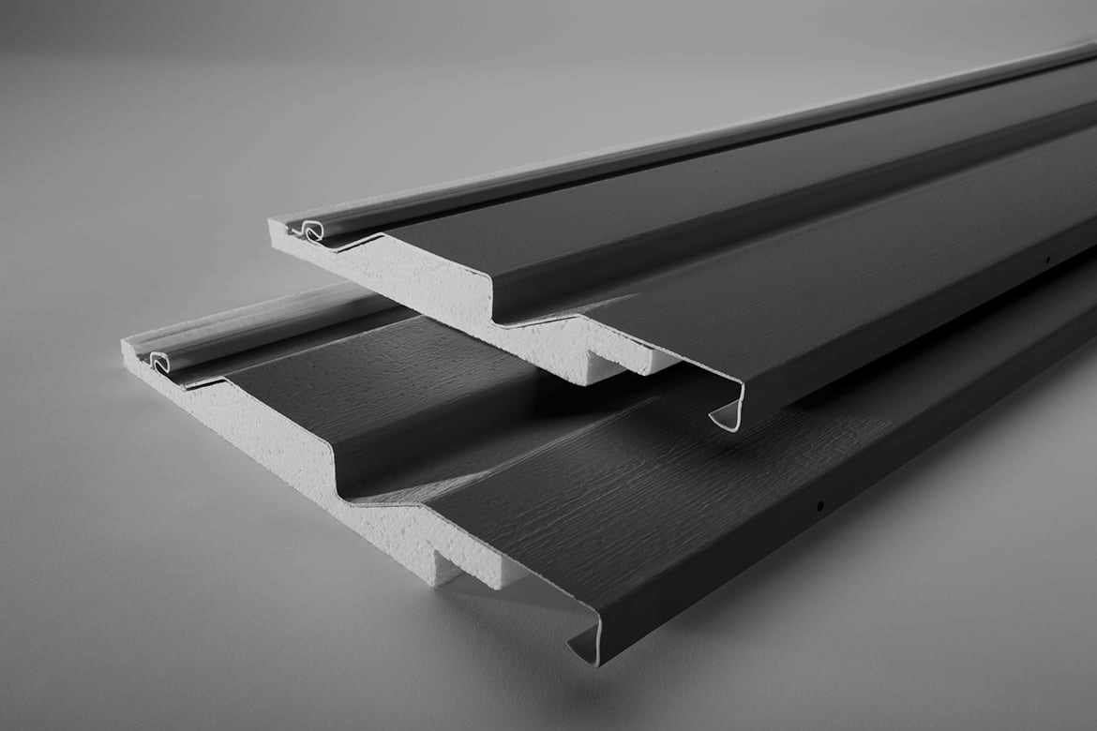
FOR CI: SPECIFY SYSTEMS WITH GPS CI DETAILS
Adhered Insulation
Details for CI
GPS for Maximum R-Value
Notes:
To ensure that your GPS vinyl siding design is complete and comprehensive, 1) specify detail options that achieve continuous insulation, e.g., around windows, doors and corners 2) specify permanently adhered insulation options; and 3) specify profiles with chases that direct water down and away from the building envelope.

Slide 15
Learning Objective 2:
Understanding The Inflation Reduction Act & How it Impacts Construction
The 2022 Inflation Reduction Act (IRA)
Tax Incentives
Funding Opportunities
Notes:
Now that our quick review is complete, let's take a look at some Federal tax and funding programs where GPS insulated vinyl siding’s added R-value and CI literally pay off.

Slide 16
FEDERAL INCENTIVES TO REDUCE CARBON
Infrastructure Investment & Jobs Act 2021
$7.5 billion to build first national EV charging infrastructure
$245 million to DOE Resilient & Efficient Codes Implementation program. 27 projects selected so far.
Inflation Reduction Act (IRA) 2022
45L Homebuilder Tax Credit
25C Home Efficiency Improvement Tax Credit
179D Commercial Buildings Energy-Efficient Tax Deduction
Related HUD Financing
Our Focus
Source: https://www.whitehouse.gov/briefing-room/statements-releases/2021/08/02/updated-fact-sheet-bipartisan-infrastructure-investment-and-jobs-act/
Notes:
Although we will be focusing on the 2022 Inflation Reduction Act’s tax incentives and funding opportunities, it is essential to note that these initiatives are part of broader Federal energy and carbon reduction strategies that incentivize states to adopt the more rigorous energy codes, specifically the 2021 International Energy Conservation Code, which we discuss in a separate nano course on that topic.
First, in 2021 , the bipartisan Infrastructure Investment and Jobs Act was created to stimulate the economy, earmarking $550 billion for infrastructure, reducing carbon emissions, improving renewable energy infrastructure like charging stations and instituting programs for resilience against climate-related weather events. The Department of Energy’s Resilience & Efficient Code Implementation program is part of this effort, which helps states adopt the latest 2021 energy codes.
This is important because the 2021 IECC includes requirements for continuous insulation, which can be met many times through the integration of insulated vinyl siding.
But, in today’s nano course, we will focus the next 20 minutes on some of the 2022 Inflation Reduction Act provisions, including significant tax credits and rebates, grants and financing.

Slide 17
What is the 2022 Inflation Reduction Act (IRA)
…the single largest investment in climate and energy in American history, enabling America to tackle the climate crisis, advancing environmental justice, securing America’s position as a world leader in domestic clean energy manufacturing, and putting the United States on a pathway to achieving the Biden Administration’s climate goals, including a net-zero economy by 2050. -- Source Energy.gov
It contains $369 billion of funding for Energy Security and Climate Change
Numerous loan programs and tax incentives are within that large swath of funding and programming. (Source: https://investmentpolicy.unctad.org)
Notes:
So, what is the Inflation Reduction Act of 2022? The Inflation Reduction Act is a large legislative package passed by Congress and signed into law by President Biden to fight inflation, lower the deficit, reduce the price of prescription drugs for seniors, and reduce the country's carbon emissions. (Retrieved: https://www.usatoday.com/story/money/2023/05/25/guide-to-the-inflation-reduction-act/70249464007/)
It contains $369 billion of funding for Energy Security and Climate Change
Numerous loan programs and tax incentives are within that large swath of funding and programming.
(Source: https://investmentpolicy.unctad.org/investment-policy-monitor/measures/4004/-369-billion-in-investment-incentives-to-address-energy-security-and-climate-change #:~:text=The%20law%20includes%20about%20369,of%20clean%20energy%20production%20and)

Slide 18
SEC. 45L HOMEBUILDER TAX CREDIT
Incentivizes homebuilders and multifamily developers to reduce energy consumption with a per dwelling unit tax credit.
Key credit details include:
ENERGY STAR: $2,500 credit
$5,000 Zero Energy Ready Homes Program (ZER).
Multifamily units meeting prevailing wage requirements added $2,500 credit/ $5,000 for ZER.
What’s Changed? Now extended to homebuilders and single-family or multifamily developers who meet national and local energy-saving requirements.
The 45L tax credit is a great opportunity to reduce project costs, increase your cash flow, reduce maintenance costs, and enhance your ROI.
GPS Insulated Vinyl Siding helps meet the continuous insulation requirement on the building exterior (re: 2021, 2018 IECC building codes).
Notes:
“The Inflation Reduction Act of 2022 (IRA) amended Internal Revenue Code Section 45L to provide eligible contractors with a tax credit for eligible new or substantially reconstructed homes that meet applicable ENERGY STAR home program or DOE Zero Energy Ready Home (ZERH) program requirements.
Section 45L incentivizes homebuilders and multifamily developers to reduce energy consumption with a per dwelling unit tax credit. Key credit details include two tiers of credits, with the higher credits for eligible homes and dwelling units certified to applicable ZERH program requirements.
The 45L tax credit is $5,000 for single-family and manufactured homes eligible to participate in the EPA's ENERGY STAR Single Family New Homes Program or the ENERGY STAR Manufactured New Homes Program, respectively, and which are certified to applicable ZERH program requirements.
The 45L tax credit is $1,000 for dwelling units that are part of a building eligible to participate in the EPA’s ENERGY STAR Multifamily New Construction Program, and which are certified to applicable ZERH program requirements, unless the project meets prevailing wage requirements, in which case the 45L tax credit is $5,000 per dwelling unit.
The amended 45L tax credit applies to qualified energy-efficient homes acquired after December 31, 2022, and before January 1, 2033, for use as a residence during the taxable year.
Initially, 45L was only available for low-rise residential developments. The 2022 updates now extend these credits to homebuilders and single-family or multifamily developers. Source: energy.gov

Slide 19
UPDATES SEC. 25C HOME EFFICIENCY IMPROVEMENT TAX CREDIT
Extended and Improved
Homeowners can claim more for energy–saving improvements
30% tax credit (up to $1200 annually) to homeowners who take certain steps to make their homes more energy efficient.
Tax credits can also be combined with rebates offered through DOE’s forthcoming $8.8 billion Home Energy Rebates Program. (Available 2024)
This Photo by Unknown Author is licensed under CC BY-SA-NC
Notes:
IRA extended and revitalized the 25C tax credit by substantially increasing the amount homeowners can claim on their taxes for energy-efficient home improvements such as insulation, exterior doors, and similar energy-saving improvements.
Beginning Jan. 1, 2023, the credit equals 30% of certain qualified expenses, including:
Qualified energy efficiency improvements installed during the year
Residential energy property expenses
Home energy audits
There are limits on the allowable annual credit and on the amount of credit for certain types of qualified expenses. The credit is allowed for qualifying property placed in service on or after Jan. 1, 2023, and before Jan. 1, 2033.
The maximum credit you can claim each year is:
$1,200 for energy property costs and certain energy-efficient home improvements, with limits on doors ($250 per door and $500 total), windows ($600) and home energy audits ($150)
$2,000 per year for qualified heat pumps, biomass stoves or biomass boilers
The credit has no lifetime dollar limit. You can claim the maximum annual credit every year that you make eligible improvements until 2033.
In most cases, the home must be your primary residence. You can't claim the credit if you're a landlord or other property owner who doesn't live in the home or If you use the property solely for business purposes. (Source: irs.gov)

Slide 20
UPDATES TO THE SEC 179 D
New Revenue Steams for Expanded Nonprofit Teams
$5.36 per square foot
Notes:
The Sec. 179D deduction has been in effect since Jan. 1, 2006 but was updated as part of the 2022 IRA for qualifying properties placed in service after 2022. Changes include as much as $5.36 per square foot in deductions for commercial and multifamily buildings that are at least four stories tall.
In addition, certain provisions expand the opportunity for energy-efficient retrofits of older buildings to become eligible for the deductions by reducing applicable requirements.
The new provisions now allow for opportunities for design-build professionals working on projects for tax-exempt organizations to take advantage of these deductions, which previously were allowed only once over the lifetime of a building.
Additionally, maximum deductions can be taken every 3 or 4 years up to ten years. which previously was only allowed once.
However, taxpayers must also be aware of added complexity under the new rules, including the requirement to meet certain prevailing wage and apprenticeship standards to achieve the maximum deduction. (Source: thetaxadviser.com)

Slide 21
GPS INSULATED VINYL SIDING’S CI & ADDED R-VALUE HELP MEET NEW PENDING HUD FUNDING REQUIREMENTS
Department of Housing and Urban Development (HUD) PENDING: ADOPTING 2021 IECC 7 ASHRAE 90.1 FROM 2006 IECC.
Requiring Developers to Construct HUD-Funded Homes to IECC 2021 for Low-density Housing and ASHRAE 90.1 for Multi-family Projects.
VA Loan Recipients of FHA Loans (a government-backed mortgage designed for low-income earners)
Notes:
According to the “Adoption of Energy Efficiency Standards for New Construction of HUD- and USDA-Financed Housing: Preliminary Determination and Solicitation of Comment”
"..the preliminary determination of HUD and USDA, as required under section 481(d)(1) of EISA, that the 2021 IECC and ASHRAE 90.1–2019 will not negatively affect the affordability and availability of housing covered by EISA.”
Making this preliminary determination is the first step to ultimately requiring compliance with these standards in HUD and USDA housing, https://www.federalregister.gov/d/2023-10596/p-3
It's important to note that most HUD and USDA grant-funded projects currently have energy code requirements, with many using the 2009 IECC as a minimum https://www.federalregister.gov/d/2023-10596/p-100
Federal loans help finance about one-fifth of all new single-family homes purchased every month
One-eighth of new units are in multifamily buildings
FHA and VA loans are commonplace and this mandated shift will result in better enormous energy savings and quality housing for a huge swath of the American population. (Source: SIPS.org)

Slide 22
HUD BLOCK GRANTS & FINANCING
The HOME Investment Partnerships Program (HOME) $1.5 billion to for affordable housing
EXAMPLE: The Green and Resilient Retrofit Program (GRRP) provides owners of HUD-assisted Multifamily housing with funding to reduce carbon emissions improve efficiency. incorporate renewable energy sources.
GRRP will provide up to $750k per property or $40k per unit for construction and transaction costs.
Development Block Grants (CDBG) $3.3 billion to 1239 states and localities to build stronger communities — The Community
GRRP of eligible HUD-assisted multifamily properties. up to $4 billion in loan authority
Source: https://www.hud.gov/sites/dfiles/PA/documents/Climate_Resources_for_Housing_Supply_Framework.pdf
Notes:
HUD block grants and programs with pending increased energy efficiency requirements include:
The HOME Investment Partnerships Program (HOME) the largest federal block grant to state and local governments designed exclusively to create affordable housing for low-income households. HOME funds are awarded annually as formula grants to participating jurisdictions. (Source: ttps://www.hud.gov/program_offices/comm_planning/home)
$3.3 billion to 1239 states and localities to build stronger communities — The Community Development Block Grants (CDBG) provides annual grants on a formula basis to states, cities, counties, and insular areas to develop stronger, more resilient communities by providing decent housing and a suitable living environment.

Slide 23
QUIZ: HOW DOES GPS-INSULTED VINYL SIDING HELP ACHIEVE IECC 2021 & TAX CREDITS, DEDUCTIONS & HUD FINANCING REQUIREMENTS?

Slide 24
ANSWER: GPS-INSULATED VINYL SIDING PROVIDES ADDED R-VALUE & CONTINUOUS INSULATION FOR BOTH NEW AND EXISTING BUILDINGS.
Notes:
The 2021 International Energy Conservation Code requires continuous insulation for uninsulated wood frame walls in most climate zones because it significantly reduces energy loss through uninsulated studs. HUD financing and grants may soon require adherence to the 2021 IECC, too. Tax incentives for energy efficiency upgrades and new construction can also benefit from integrating GPS-insulated vinyl siding.
There are many ways to achieve CI. GPS-insulated vinyl siding is one.

Slide 25
BENEFITS OF GPS INSULATED VINYL SIDING AS A HIGH-PERFORMANCE BUILDING SYSTEM REVIEW
Superior Continuous Exterior Wall Insulation
Effective Moisture Management
Improved Performance: Maintenance, Wind, Noise
Aesthetics: Better, more durable pigments
Building Code/ ASHRE Compliance
Tax & Funding Advantages
Environmentally Beneficial
Notes:
In the previous program, “Not Your Grandmother’s Vinyl Siding,” we learned about the many advantages of graphite polystyrene insulated vinyl siding as a high-performance building system. We referred back to several of these today since these benefits allow project designers, managers, and owners to take advantage of several tax incentives and funding opportunities associated with the 2022 Inflation Reduction Act.
These benefits are circled here, including
GPS-insulated vinyl siding as exterior continuous insulation
GPS-insulated vinyl siding’s role in decreasing energy and, therefore, carbon emissions
GPS-insulated vinyl siding’s role in helping to meet new energy codes
Finally, today’s course discusses the associated tax incentives and funding opportunities related to using GPS-insulated vinyl siding.

Slide 26
GPS Insulated Vinyl Siding Course Suite
A Full Suite of AIA CEU Approved Courses About the Advantages of GPS Insulated Vinyl Siding Are Now Available Under Provider 5011211
Main Course: Not Your Grandmother's Vinyl Siding: the Advantages of Graphite Polystyrene Insulated Vinyl Siding | AIA Credit: 1 LU HSW | COURSE 12
EPDs and Graphite Polystyrene Insulated Vinyl Siding | AIA Credit: 0.5 HSW | Course 27
GPS Insulated Vinyl Siding & Energy Code Compliance | AIA Credit: 0.25 HSW | Course 26
GPS Insulated Vinyl Siding & the 2022 Inflation Reduction Act | AIA Credit: 0.5 HSW HSW | Course 31
More Courses https://neopor.basf.us/resources/courses
Notes:
Also, please check out the other courses in this series, including GPS Insulated Vinyl Siding and Energy Code Compliance, GPS Vinyl Siding, and the 2022 Inflation Reduction Act. You can find information about these courses and more at https://neopor.basf.us/resources/courses

Slide 27
Notes: Additional Resources
ContinuousInsulation.org
Foam Sheathing Coalition
Progressivefoam.com
neopor.us/commercial
Master Format Number: Division 7 20.2100
Sustainable Minds http://www.sustainableminds.com
Add: There will usually be a need for additional CI. Check your local codes.

Slide 28
Contact information
Contact Info:
Ron Heidt
BASF – Neopor Business Development
Ron.Heidt@BASF.com
www.Neopor-Insulation.com
Notes:
BASF sponsors this course in conjunction with Progressive Foams. If you’d like to further the discussion about any of the topics or products mentioned in the course, feel free to contact me by email, through our website, or on social media. Thank you again, and I hope you enjoyed the course.
Contact information for BLANK
EMAIL@BASF.com
LinkedIn: www.linkedin.com/in/NAME
Website: www.neopor-insulation.com

