Slide 1
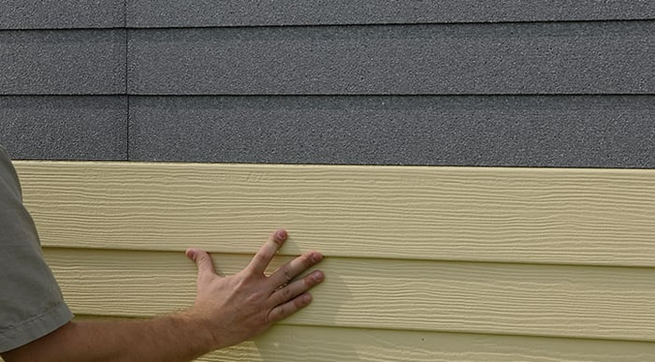
GRAPHITE POLYSTYRENE INSULATED
VINYL SIDING & ENERGY CODE COMPLIANCE
Course Number: 51
DELIVERY TYPE: LIVE
AIA Approved: 0.50 LU|HSW
Provider Number: 50111211
Notes:
Welcome to today’s “Graphite Polystyrene & Energy Code Compliance” presentation. I am --- from ---. This program has been approved for 0.5 AIA CEUs in Health Safety and Welfare.

Slide 2
COPYRIGHT MATERIALS
This presentation is protected by U.S. and International copyright laws. Reproduction, distribution, display, and use of the presentation without written permission of BASF is prohibited.
©BASF, 2023
Notes:
This presentation is protected by U.S. and International copyright laws. Reproduction, distribution, display, and use of the presentation without written permission of BASF is prohibited.

Slide 3
AIA CES PROVIDER STATEMENT
AIA has registered and approved the following course for continuing education credit under Provider Number 50111211. All registered AIA CES Providers must comply with the AIA Standards for Continuing Education Programs. Any questions or concerns about this provider or this learning program may be sent to AIA CES (cessupport@aia.org or (800) AIA 3837, Option 3).
This learning program is registered with AIA CES for continuing professional education. As such, it does not include content that may be deemed or construed to be an approval or endorsement by the AIA of any material of construction or any method or manner of handling, using, distributing, or dealing in any material or product.
AIA CES has reviewed and approved AIA continuing education credit for this learning program. Learners must complete the entire learning program to receive continuing education credit. AIA continuing education Learning Units earned upon completion of this course will be reported to AIA CES for AIA members. Certificates of Completion for AIA and non-AIA members are available upon request.
Notes:
This learning program is registered with AIA CES for continuing professional education. As such, it does not include content that may be deemed or construed to be an approval or endorsement by the AIA of any material of construction or any method or manner of handling, using, distributing, or dealing in any material or product.

Slide 4
REVIEW GPS INSULATED VINYL SIDING AS A HIGH-PERFORMANCE BUILDING SYSTEM
Improved Performance: Maintenance, Wind, Noise
Aesthetics: Better, more durable pigments
Superior Continuous Exterior Wall Insulation
Building Code/ ASHRAE Compliance
Environmentally Beneficial
Effective Moisture Management
Notes:
In the previous program, “Not Your Grandmother's Vinyl Siding”, we learned about the advantages of graphite polystyrene insulated vinyl siding as a high-performance building system. Today, we will discuss how this system can help achieve the requirements in recent model energy codes and standards updates.

Slide 5
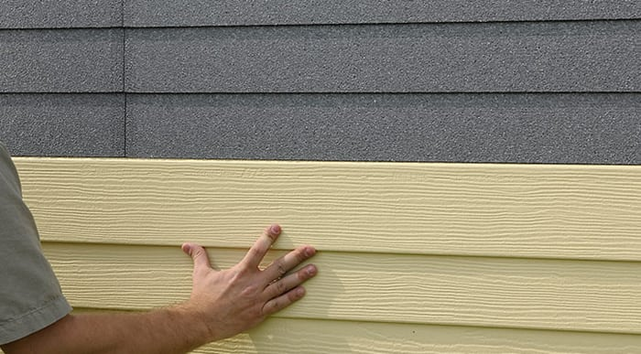
COURSE DESCRIPTION
Overview: This 0.5 credit course provides greater detail about how graphite polystyrene insulated vinyl siding contributes to 2021 energy codes and ASHRAE 90.1. as continuous insulation requirements, regional hurricane and high wind codes.
Prerequisite Knowledge: The participants should have completed the overview course “Not Your Grandmother’s Vinyl Siding, the Advantages of Graphite Polystyrene Insulated Vinyl Siding.”
HSW Justification: Graphite polystyrene insulated vinyl siding is an approved method for meeting continuous insulation required by the 2021 International Residential Energy Code and ASHRAE 90.1 and, therefore, reduces energy consumption and associated carbon emissions. Moreover, specialized systems have been developed to meet the rigorous codes in hurricane-prone areas, underscoring their effectiveness in mitigating structural damage and enhancing occupant safety.
Notes:
Prerequisite Knowledge: The participants should have completed the overview course “Not Your Grandmother’s Vinyl Siding, the Advantages of Graphite Polystyrene Insulated Vinyl Siding.”
HSW Justification: Graphite polystyrene insulated vinyl siding is an approved method for meeting continuous insulation required by the 2021 International Residential Energy Code and ASHRAE 90.1, and therefore reduces energy consumption and associated carbon emissions.

Slide 6
LEARNING OBJECTIVES:
Upon completion, participants will be able to
Identify
Identify the difference between national, state and municipal energy codes and which ones require continuous insulation.
Define
Locate
Locate where the 2021 IECC residential and ASHRAE 90.1 codes have been adopted.
Define continuous insulation and how GPS insulated vinyl siding serves as continuous insulation (CI).
Notes:
Refer to slide

Slide 7
CONTINUOUS INSULATION (CI) & GPS INSULATED VINYL SIDING
What is CI?
What problem does CI address?
How does GPS Vinyl Siding provide a solution?
Notes:
We will take a moment to review the definition and need for continuous insulation (CI) and why GPS insulated siding serves as CI. We will also review some of the benefits of graphite polystyrene insulation in these systems.

Slide 8
THE PROBLEM: THERMAL BRIDGING
Studs & framing are 25% of wall surface area.
Heat loss due to thermal bridging is a significant contributor to energy loss.
Notes:
In traditional stick-built residential construction, framing makes up 25% of the exterior wall surface. Here, between the insulated wall cavities, we see heat transfer occur more quickly. This is referred to as "thermal bridging," as seen in the right-hand image represented by the vertical yellow lines.
Properly installed siding insulation increases the airtightness of the structure, adds R-value, and breaks the thermal bridge.

Slide 9
THE SOLUTION: CONTINUOUS INSULATION (CI)
CI: Insulation that runs continuously over structural members and is free of significant thermal bridging.
--Energy.gov
Graphite Polystyrene Insulation
Acts as Continuous Insulation
Notes:
As discussed previously, continuous insulation (CI) runs continuously over structural members and is free of significant thermal bridging such as rigid foam insulation above the ceiling deck. It is installed on the interior, exterior, or integral to any opaque building envelope surface. Source: Energy.gov
The 2021 International Energy Conservation Code requires continuous insulation for uninsulated wood frame walls in most climate zones because it significantly reduces energy loss through uninsulated studs.
There are many ways to achieve CI. GPS insulated vinyl siding is one.

Slide 10
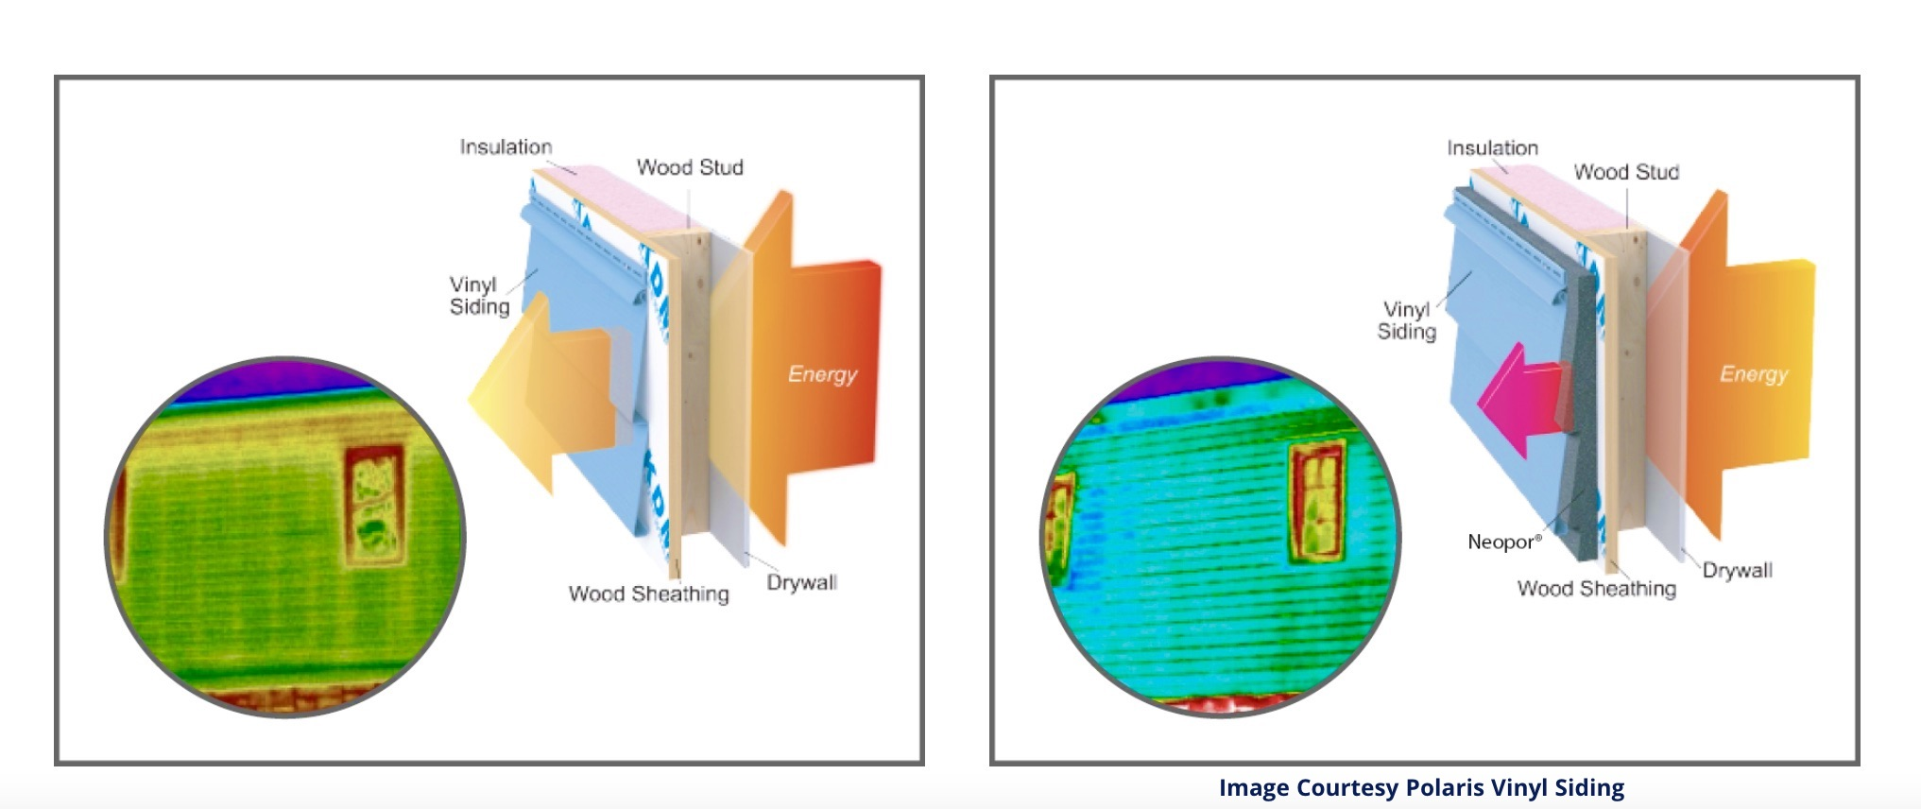
GPS VINYL SIDING IS ONE-STEP SIDING & CI
Before GPS Vinyl Siding
After GPS Vinyl Siding
Red, Yellow Shows Energy Leaks/ Thermal Bridging via Stud & Framing
Solid Blue Shows Energy Leaks /Thermal Bridging Solved!
Without… before
GPS
With… after
Notes:
Let's look at these before-and-after images captured by a thermal imaging camera. Before GPS Vinyl Siding: Two energy leaks are visible with thermal imaging: red at the top of the wall, where cavity insulation has accumulated over time, and yellow lines where energy escapes via studs
After GPS Vinyl Siding: energy loss and thermal bridging no longer seen via through the studs and top of the wall dramatically reduces the loss of energy through exterior walls.
The only difference between the walls in the Before and After photographs is the application of insulated siding. You can see that the heat, or warmth, escaping through the wall has been reduced significantly. Also, the thermal bridging through the studs, which shows as the vertical yellow lines in the Before image, has been almost eliminated.

Slide 11
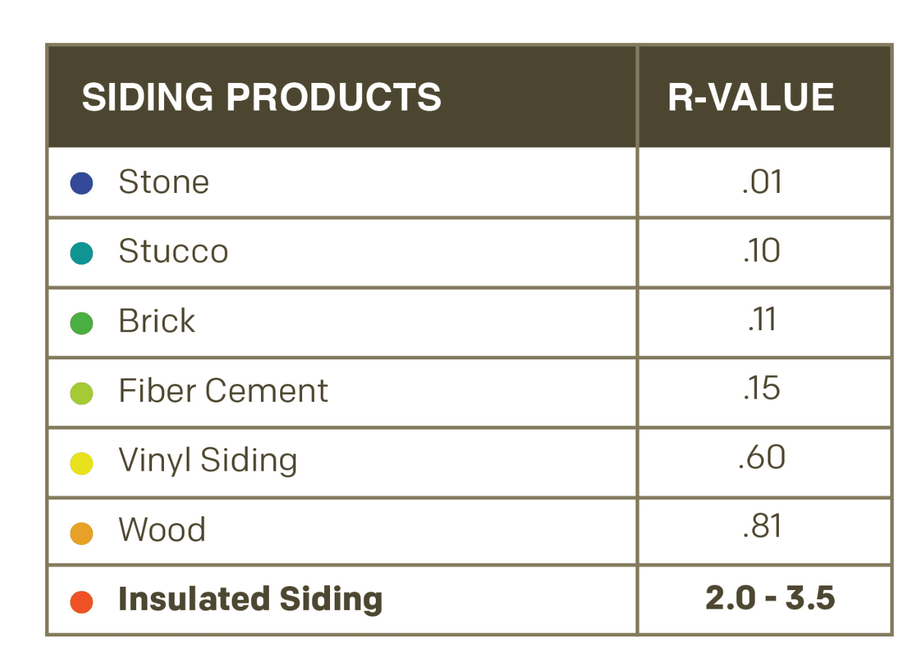
GPS INSULATED VINYL SIDING ADDS CI PLUS ADDED R-VALUE
Only Insulated Siding Offers CI
GPS Insulated Vinyl Siding R-Value of 2.0 to 3.5
Uninsulated Siding - Little R-value
Source: Progressive Foam
Notes:
Insulated siding systems serve the dual purpose of providing continuous insulation and cladding. As we see in this chart, it can increase thermal performance up to six times and help prevent thermal bridging.

Slide 12
CI & ENERGY CODES
Which energy codes require CI?
Where have these codes been adopted?
What is the International Energy Conservation Code?
Notes:
In this section, we will review what the IECC is, which energy codes require continuous insulation and where have these codes been adopted.
To understand the significance of designing for continuous insulation, let’s review the model energy codes and where CI has and will be adopted.

Slide 13
IECC Model Energy Code + ASHRAE Standards
International Energy Conservation Code (IECC): includes both residential and commercial provisions. Updated every 3 years. Latest is 2021.
ASHRAE 90.1: Minimum standard of energy efficiency that is referenced in the IECC commercial provisions for all buildings except low rise (under 4 stories).
ASHRAE 90.2 IECC provisions for residential structures 3 stories or less.
IECC can add more requirements to ASHRAE Standards. Considered more stringent.
IECC & ASHRE Standards can be adopted or modified per jurisdiction.
Notes:
*The IECC is the model residential energy code in the US; for commercial buildings, ASHRAE 90.1 is considered the model code, though most states adopt the commercial IECC with the option to comply via ASHRAE 90.1.
There is a distinction to be made between codes, standards, and model codes.^{[9][6][11]} Codes are mandatory, legally enforceable requirements adopted by state and local jurisdictions.^{[16][6][13]} Standards, founded on evidence-based technical information, are non-mandatory recommendations and guidelines for best practices regarding various aspects of building design and construction.^{[6][16][17][18]} Though jurisdictions can adopt standards directly in a building code, “standard committees generally write standards with the intent that they become a component of a model code.”^{[9]} A model building code is a building code that incorporates standards and is “developed and maintained by an organization independent of the jurisdiction responsible for enacting the building code.”^{[6][11]}
https://energyefficientcodes.org/iecc/

Slide 14
There are no national building codes nor energy codes; only Model Codes.
States, Counties, Cities Select One of the Following Paths.
The International Energy Conservation Code is a Model Code.
Modifies model code
State-specific code
Adopts model code; jurisdictions opt-in
No state code; jurisdictions decide
Adopt commercial energy codes but, not residential
More stringent "stretch" code
Building/ Energy Code Options
Existing model energy code
Notes:
Most states have adopted a statewide building code that automatically applies to every community in the state. Some states have a statewide code but let local jurisdictions decide whether to enact it (either through an opt-in or opt-out system). And a few states have no statewide building codes and leave it entirely up to local jurisdictions.
State-Specific Energy Codes
Examples: California Title 24 The Energy Conservation Construction Code of New York State. For example, Missouri has no statewide building code, and codes are adopted on the local level. Arizona has no statewide building codes, but most larger towns and cities have adopted codes.
Sources: https://www.primalsurvivor.net/no-building-codes-USA/https://absorb/public-policy/building-codes-by-state/
A stretch code is a locally mandated code or alternative compliance path that is more aggressive than the base code, resulting in buildings that achieve higher energy savings. The primary baseline national model energy codes are the International Energy Conservation Code (IECC), the ANSI/ASHRAE/IESNA Standard 90.1: Energy-Efficient Standard for Buildings Except Low-Rise Residential Buildings (ASHRAE 90.1), and ASHRAE Standard 90.2: Energy-Efficient Standard of New Low-Rise Residential ...

Slide 15
MODEL ENERGY CODE RULES TO REMEMBER
Code ~ always get tougher.
Must pass DOE 10-year payback period.
Code min. = worst allowed by law.
Monthly $ flow positive or neutral?
Notes:
A few rules to know about energy codes in general is that 1) they also get tougher 2) they need to meet a rigorous 10-year payback period analysis conducted by the Dept. of Energy 3) Building to code minimum is the least energy efficient building you can build by law. It's never a bragging right. 4) Is the investment cash positive or neutral monthly?

Slide 16
WHERE IS THE NEW CI REQUIREMENT IN THE RESIDENTIAL IECC?
Included in the Prescriptive Pathway
ASHRAE 90.1 requires CI
Where the 2021 CI requirement is added
Notes:
A model energy code covers 3 major components: Lighting, HVAC and Building Envelope, including roof & wall assemblies, windows, skylights, doors, foundation and floor.
Builders can select one of four pathways: Prescriptive, Total Building Performance, Energy Rating Index and Tropical Climate Regions. Along the prescriptive path, we see the new CI requirement in most climate zones.

Slide 17
2021 IECC Requiring Continuous Insulation to Reduce Carbon Emissions
CLIMATE ZONE | UNINSULATED ATTIC | 3-4 INCHES OF | UNINSULATED FLOOR | UNINSULATED WOOD-FRAME WALL | INSULATED WOOD FRAME WALL
1 | R30–R49 | R19–R38 | R13 | R13 or R0 + R10 CI* | N/A
2 | R49–R60 | R38–R49 | R13 | R13 or R0 + R10 CI | N/A
3 | R49–R60 | R38–R49 | R19 | R20 or R13 + R5 CI or R0 + R15 CI | Add R5 CI
4 EXCEPT MARINE | R60 | R49 | R19 | R20 + R5 CI or R13 + R10 CI or R0 + R15 CI | Add R10 CI
4 MARINE AND 5 | R60 | R49 | R30 | R20 + R5 CI or R13 + R10 CI or R0 + R15 CI | Add R10 CI
6 | R60 | R49 | R30 | R20 + R5 CI or R13 + R10 CI or R0 + R20 CI | Add R10 CI
7 AND 8 | R60 | R49 | R38 | R20 + R5 CI or R13 + R10 CI or R0 + R20 CI | Add R10 CI
*Note: In the table above, CI stands for "continuous insulation" applied to the wall assembly’s exterior just inside the cladding. Source: energy.gov
Notes:
Here is an example. (Speak to slide)

Slide 18
IECC 2021 Adoption Map
Notes:
Here we see a snap shot of how the states have adopted the various codes. For example, 48% of states are still using the 2009 IECC with only 13% adopting the more rigorous 2021 Residential Energy Code.
Here is a map showing where these codes have been adopted.

Slide 19
Most Climate Zones CI Required: ASHRAE Commercial
Notes:
Continuous insulation is also required by ASHRAE 90.1 , the U.S. energy standard for all commercial and residential buildings over three stories, which includes many multifamily structures. ASHRAE 90.1 has included CI for over 30 years for buildings 4 stories and above.
ASHRAE 90.1 first introduced a prescriptive recommendation for CI in 1999. Beginning in 1999, the prescriptive recommendation for CI has continued to move further south. https://continuingeducation.bnpmedia.com/courses/owens-corning/the-evolution-of-continuous-insulation/1/

Slide 20
FEDERAL INCENTIVES FOR 2021 IECC ADOPTION
GPS Vinyl Siding & The IRA Nano Course
The Infrastructure Investment & Jobs Act: $245 million to DOE Resilient & Efficient Codes Implementation program
IRA: 1 billion dollars for states and local governments to adopt the 2021 IECC
Grants expected through 2029
HUD requirements
Pending: Fannie & Freddie
Tax incentives
Notes:
The recent Inflation Reduction Act (IRA) sets aside nearly $1 billion for states and local governments to adopt the most recent energy codes, the 2021 International Energy Conservation Codes (IECC). These grants are expected to be awarded through the fiscal year 2029. These include HUD funding supporting these more recent energy codes and several energy-efficient tax incentives. We also have a separate nano course on this subject.
Additionally, the bipartisan 2021 Infrastructure Investment and Jobs Act signed in November 2021 provided another $225 million ($45 million per year for fiscal years 2022-2026) for the Department of Energy’s Resilient and Efficient Codes Implementation (RECI) program. Under the RECI program, states can receive grants to update more recent model energy codes. The money can be spent on conducting studies, training, implementation and other purposes.
Sources: nahb.org, energy.gov, whitehouse.gov

Slide 21
CONCLUSION: GPS INSULATED VINYL SIDING HELPS SATISFY ENERGY CODES & OFFERS
Improved Performance: Maintenance, Wind, Noise
Aesthetics: Better, more durable pigments
Superior Continuous Exterior Wall Insulation
Building Code/ ASHRE Compliance
Environmentally Beneficial
Effective Moisture Management
Notes:
In conclusion, GPS insulated vinyl siding is a system that supports the requirements of the 2021 residential model energy code and 90.1 ASHRAE standards by providing CO and added insulation in one step.

Slide 22
GPS Insulated Vinyl Siding Course Suite
A Full Suite of AIA CEU Approved Courses About the Advantages of GPS Insulated Vinyl Siding Are Now Available Under Provider 5011211
Main Course: Not Your Grandmother's Vinyl Siding: the Advantages of Graphite Polystyrene Insulated Vinyl Siding | AIA Credit: 1 LU HSW | COURSE 12
EPDs and Graphite Polystyrene Insulated Vinyl Siding | AIA Credit: 0.5 HSW | Course 27
GPS Insulated Vinyl Siding & Energy Code Compliance | AIA Credit: 0.5 HSW | Course 51
GPS Insulated Vinyl Siding & the 2022 Inflation Reduction Act | AIA Credit: 0.5 HSW HSW | Course 22
More Courses https://neopor.basf.us/resources/courses
Notes:
Also, please check out the other courses in this series, including GPS Insulated Vinyl Siding and Energy Code Compliance, GPS Vinyl Siding, and the 2022 Inflation Reduction Act. You can find information about these courses and more at https://neopor.basf.us/resources/courses

Slide 23
Questions & Additional Resources
Spec Link
MasterSpec
ContinuousInsulation.org
Bid Spec
Foam Sheathing Coalition
progressivefoam.com
neopor.us/commercial
Master Format Number: Division 7 20.2100
Sustainable Minds http://www.sustainableminds.com
Make sure to add “Add your local codes”
Check your local codes.

Slide 24
This officially concludes the AIA/CES course
Contact Info:
Ron Heidt
BASF – Neopor Business Development
Ron.Heidt@BASF.com
www.Neopor-Insulation.com
Notes:
This officially concludes the AIA/CES course.
I’m now available to answer any questions you have.

