Slide 1
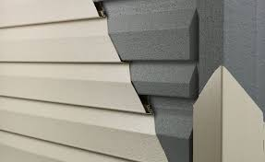
ENVIRONMENTAL PRODUCT DECLARATIONS (EPDs)
& GRAPHITE POLYSTYRENE INSULATED VINYL SIDING
Provider Number 50111211 | AIA Credit: 0.5 HSW | Course 31
Notes:
Welcome. I am BLANK and I want to thank you for attending today’s half-hour program, which is an add-on nano course for a course you should have already attended: Not Your Grandmother's Vinyl Siding, the Advantages of Graphite Polystyrene Insulated Vinyl Siding. This course, Environmental Product Declarations (EPD) and Graphite Polystyrene Insulated Vinyl Siding, is approved by the American Institute of Architects for 0.5 health, safety, and welfare credit hours Please include your full name, firm, email address, and if applicable, your AIA member number so that we can register your attendance. All participants will receive a certificate of completion for self-reporting purposes as well.

Slide 2
COPYRIGHT MATERIALS
This presentation is protected by U.S. and International copyright laws. Reproduction, distribution, display, and use of the presentation without written permission of BASF is prohibited.
©BASF, 2023
Notes:
This presentation is protected by U.S. and International copyright laws. Reproduction, distribution, display, and use of the presentation without written permission of BASF is prohibited.

Slide 3
AIA CES PROVIDER STATEMENT
AIA has registered and approved the following course for continuing education credit under Provider Number 50111211. All registered AIA CES Providers must comply with the AIA Standards for Continuing Education Programs. Any questions or concerns about this provider or this learning program may be sent to AIA CES (cessupport@aia.org or (800) AIA 3837, Option 3).
This learning program is registered with AIA CES for continuing professional education. As such, it does not include content that may be deemed or construed to be an approval or endorsement by the AIA of any material of construction or any method or manner of handling, using, distributing, or dealing in any material or product.
AIA CES has reviewed and approved AIA continuing education credit for this learning program. Learners must complete the entire learning program to receive continuing education credit. AIA continuing education Learning Units earned upon completion of this course will be reported to AIA CES for AIA members. Certificates of Completion for AIA and non-AIA members are available upon request.
Notes:
This learning program is registered with AIA CES for continuing professional education. As such, it does not include content that may be deemed or construed to be an approval or endorsement by the AIA of any material of construction or any method or manner of handling, using, distributing, or dealing in any material or product.

Slide 4
COURSE DESCRIPTION
This course is an extension of the overview course "Not Your Grandmother's Vinyl Siding, the Advantages of Graphite Polystyrene Insulated Vinyl Siding” that examines the advantages of graphite polystyrene insulated vinyl siding for new and existing buildings This 0.5 credit course provides greater detail about the environmental performance declarations (EPDs) for both graphite polystyrene and vinyl siding and how these can be used to help guide sustainable design decision making.
Prerequisite Knowledge: The participants should have completed the overview course "Not Your Grandmother's Vinyl Siding, the Advantages of Graphite Polystyrene Insulated Vinyl Siding.”
HSW Justification: The course focuses on using EPDs (Environmental Product Declarations) to aid in making informed decisions regarding sustainable design. Using GPS-insulated vinyl siding as an example, participants will gain insights into how these EPDs offer a comprehensive perspective that recognizes the lifecycle impacts of all component systems. By leveraging this knowledge, designers can enhance environmental performance by improving energy efficiency and sustainability.
Notes:
The course focuses on using Environmental Product Declarations (EPDs) to aid in decisions regarding sustainable design. Using GPS-insulated vinyl siding as an example, participants will gain insights into how these EPDs offer a comprehensive perspective that recognizes the lifecycle impacts of all component systems. By leveraging this knowledge, designers can enhance environmental performance by improving energy efficiency and sustainability.

Slide 5
BENEFITS OF GPS INSULATED VINYL SIDING AS A HIGH-PERFORMANCE BUILDING SYSTEM REVIEW
Improved Performance: Maintenance, Wind, Noise
Aesthetics: Better, more durable pigments
Superior Continuous Exterior Wall Insulation
Building Code/ ASHRE Compliance
Environmentally Beneficial
Effective Moisture Management
Tax & Funding Advantages
Notes:
In the previous program, “Not Your Grandmother’s Vinyl Siding,” we learned about the many advantages of graphite polystyrene insulated vinyl siding as a high-performance building system. We will refer back to several of these today but will focus on the environmental benefits and embodied carbon of GPS-insulated vinyl siding as described in Life Cycle Analysis (LCAs) and Environmental Product Declarations (EPDs).

Slide 6
Learning Objectives
Explain
Why and how EPDs are being used to measure and track carbon in public projects, green building programs, carbon calculators and design software.
Describe
Use
The function of both Environmental Product Declarations (EPDs) and Lifecycle Analysis (LCA) in sustainable design.
EPDs to determine the environmental benefits of the GPS-insulated vinyl siding system.
Notes:
After this half-hour course, attendees will be able to
Describe the function of both Environmental Product Declarations (EPDs) and Lifecycle Analysis (LCA) in sustainable design.
Explain why and how EPDs are used to measure and track carbon in public projects, green building programs, carbon calculators, and design software.
Use EPDs to determine the environmental benefits of the GPS-insulated vinyl siding system.

Slide 7
Learning Objective 1
WHAT ARE ENVIRONMENTAL PRODUCT DECLARATIONS (EPDs) & LIFE CYCLE ANALYSIS (LCAs)?
WHY AND HOW ARE THEY USED IN SUSTAINABLE DESIGN DECISION-MAKING?
Notes:
What are Environmental Product Declarations (EPDs) and Life Cycle Analysis (LCAs)? Why and how do we use them as sustainability decision-making tools?

Slide 8
EPDs: Sustainability Decision-Making Tools
Function as abbreviated Life Cycle Analysis (LCAs)
Can be industry-wide, product-specific, supply chain-specific, facility-specific.
Allows for comparisons with products performing same function.
First used in Sweden in 1997
Vary by scope according to Life Cycle ranges.
SOURCE: The International Organization for Standardization
Notes:
Environmental product declarations (EPDs) provide quantified environmental data using predetermined parameters to assess environmental impacts consistently. They were first used in Sweden in 1997 and function as short-form Life Cycle Analysis. There are many types of EPDs.
Examples include:
Industry-wide EPDs represent typical manufacturing impacts for a range of products for a group of manufacturers. Industry-wide EPDs provide the least specific data on a product’s embodied carbon footprint and cannot be used to compare products. Still, they help understand the typical impact of a product.
Product-specific EPDs represent the impacts of a specific product and manufacturer across multiple facilities.
Supply chain–specific EPDs use supply chain–specific data in the LCA to model the impacts of critical processes upstream in a product’s supply chain.
Facility-specific EPDs were introduced by the Buy Clean California Act in 2017. The California Department of General Services (DGS) defines a facility-specific EPD as a product-specific EPD in which the environmental impacts can be attributed to a single manufacturer and manufacturing facility.
Source: https://carbonleadershipforum.org/epd-requirements-in-procurement-policies/

Slide 9
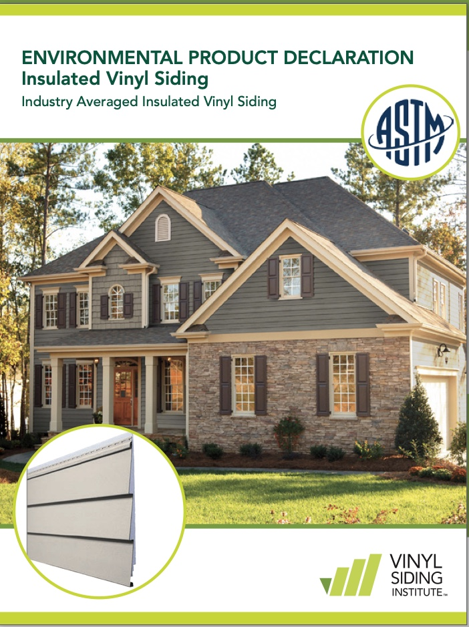
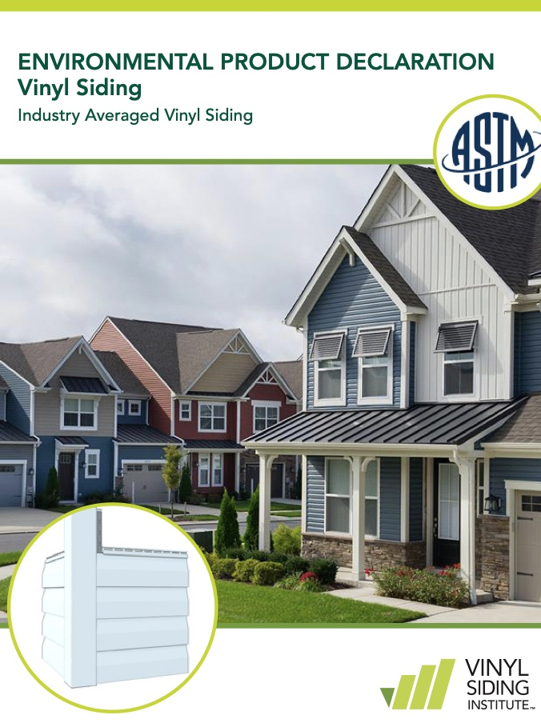
Examples of EPDs
Product Specific for GPS Insulation
Industry Wide
Notes:
Here are two examples. The one on the left is an EPD from BASF that summarizes the life cycle assessment of NEOPOR brand graphite polystyrene insulation. This is an example of a product-specific EPD.
The EPD on the right is an example of an industry-specific EPD. This one is for insulated vinyl siding. It was produced on behalf of the institute. It is common for trade associations like the Vinyl Siding Institute to fund and make available EPDs for the industry.

Slide 10
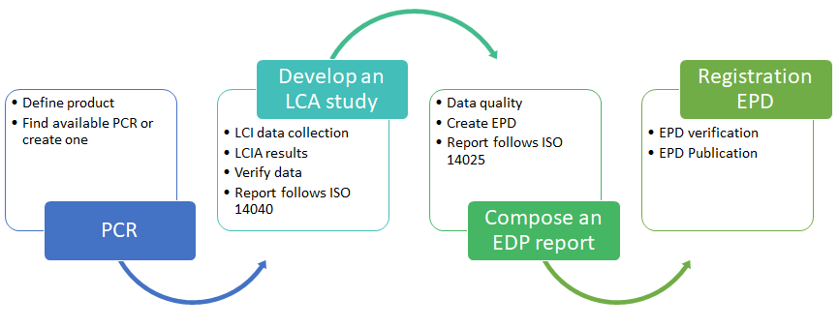
Developing an EPD
Develop
LCA
Register
EPD
Find
PCR
Create
EPD
The Sustainability Consortium
UL Environment
ASTM International
Carbon Leadership Forum
ICC Evaluation Services
3rd Party Provider
NSF International
*
PCR: product category rules
LCA: Life Cycle Analysis
EPD: Environmental Product Declaration
Notes:
Here, we see the workflow of making an EPD. The first step in creating an EPD is identifying the correct set of Product Category Rules (PCRs) to ensure that products within the same category are measured similarly. PCRs exist within building material categories like concrete, metals, finishes, insulation, etc.. As well as sub-types.
EPDs are based on Life Cycle Assessments (LCAs); however, EPDs differ from LCAs in many ways. For example, EPDs don’t include proprietary information about formulations or manufacturing processes. A certified independent provider verifies the LCA data and develops the EPD. The EPD is then registered and published.
Source:: https://en.wikipedia.org/wiki/Environmental_Product_Declaration

Slide 11
EPDs: Based on LIFE CYCLE ASSESSMENTS (LCAs)
Scope Options
1
Production
Cradle-to-Gate EPD
A1 Raw material | A2 Transport | A3 Manufacturing
2
Construction Process
Can include options and not all, information below
A 4 Gate-to-Site Transportation | A 5 Assembly
3
Use
B1 Use | B2 Maintenance | B3 Repair | B4 Replacement
Cradle-to-Grave EPD
B5 Refurbishment | B6 Operational Energy | B7 Operational Water
4
End of Life Stage
C1 Deconstruction | C2 Transport | C3 Waste processing | C4 Disposal
5
Cradle-to-Cradle EPD
D Reuse/ Recovery / Recycling Potential
Sources: One Click LCA | Ecochain.com
Notes:
The depth and breadth of an LCA can differ considerably depending on the goal of a particular LCA.
Source: “International Standard, ISO 14040: Environmental management – Life cycle assessment – Principles and framework.” (2006, revised 2016). ISO. Retrieved from https://www.iso.org/obp/ui/#iso:std:iso:14040:ed-2:v1:en
Here, we see a variety of LCA and EPD options.
Cradle-to-gate EPD involves only the manufacturing process and harvesting of a material. It has the minimum amount of data for life-cycle assessment.
Cradle-to-gate options include the minimum requirements in the cradle-to-gate option with a few additional information modules from cradle-to-grave EPD variation.
Cradle-to-grave EPD includes the whole life cycle of a product, explicitly covering its maintenance and the end of life. If you wish to create an EPD for your product or utilize your manufacturer’s EPD, this is the option you should select.
Cradle-to-cradle means a product is designed so that its materials and components can be repurposed- or recycled indefinitely. This makes products “circular” and reduces their environmental impacts.

Slide 12
Learning Objective 2
Why and how are EPDs used to measure and track carbon in public projects, green building programs, carbon calculators, and design software?
Notes:
Now that we understand EPDs, why and how are they used to further sustainable design and construction objectives?

Slide 13
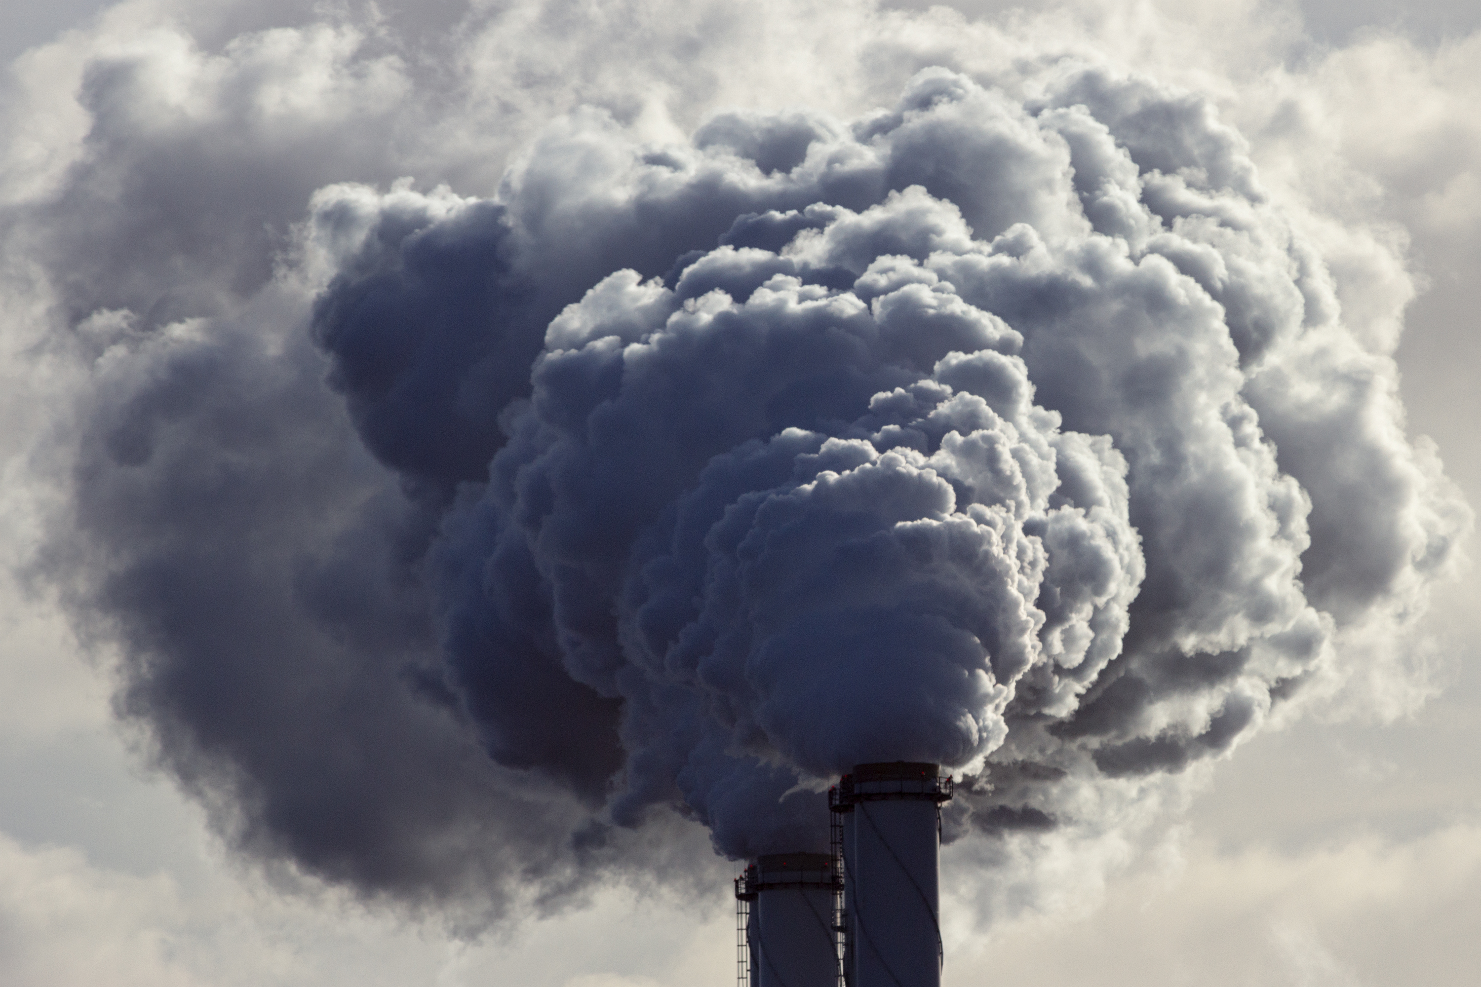
EPDs ARE CRITICAL FOR CARBON REPORTING
Verify Sustainability Claims
Required by LEED® , BREEAM®, GreenStar®, National Green Building Standard and more
Required by Many States, Municipalities i.e., CA, NYS, City of Portland
Notes:
National programs and federal, state, and municipal governments require EPDs to help verify overall sustainability claims. Some of these include the US Green Building Council’s LEED programs, BREEAM, the world’s longest-established method of assessing, rating, and certifying buildings, Green Home Institute’s GreenStar program, amd the National Green Building Standard, to name a few. (Sources: /-/media/Files/Standards_Development/NGBS/2018_Development_Process/2020-NGBS-Second-Draft-Standard.pdf; https://ecochain.com/blog/environmental-product-declaration-epd-overview/#:~:text=EPDs%20are%20often%20required%20in,LEED%2C%20BREEAM%2C%20and%20GreenStar.)
“For example, in the U.S., some states (California, Colorado, Oregon and Washington) all have carbon reduction policies that require EPDs for specific building products. Sustainable development goals – EPDs can help you measure the impact of your products and optimize your processes.” (Source: https://www.ul.com/services/environmental-product-declaration-certification#:~:text=For%20example%2C%20in%20the%20U.S.,products%20and%20optimize%20your%20processes.)

Slide 14
EPDS ARE STANDARDIZED & REQUIRED
IRA 2022/ EPA Programs
Increases EPD reporting
Develop policies to promote low-carbon, made-in-America materials in Fed. Projects
Buy Clean Initiative
Grants for standardization/certification for carbon efficiency.
U.S. General Services Administration
Interim IRA Low Embodied Carbon Material Requirements May 16, 2023
The largest investment in climate & energy in US History
Notes:
Furthermore, the federal government is funding programs to standardize EPDs further from a federal level and has included EPDs as a requirement in several federal certification and financing programs. These include the Buy Clean Initiative, the Investment Recovery Act of 2022, and more.
The Inflation Reduction Act of 2022 (IRA), Pub. L. No. 117-169, was enacted in August 2022. The IRA made the single largest investment in climate and energy in American history. The IRA will help the United States tackle the climate crisis, advance environmental justice, and secure our Nation’s position as a world leader in domestic clean energy manufacturing. This law puts the United States on a pathway to achieving the Administration’s climate goals, including a net zero operational emissions federal building portfolio by 2045, and net zero emissions procurement by 2050. IRA Section 60503 provides the U.S. General Services Administration (GSA) with $2.15 billion for the acquisition and installation of construction materials and products with substantially lower levels of embodied greenhouse gas emissions as compared to estimated industry averages, as determined by the Administrator of the U.S. Environmental Protection Agency (EPA). EPA issued its Interim Determination in December 2022. (https://www.gsa.gov/system/files/Interim%20IRA%20LEC%20Material%20Requirements%20-%20used%20in%20Pilot%20May%202023%2005162023.pdf)
The Buy Clean Initiative: The Federal Government is the largest purchaser in the world, with annual purchasing power of over $630 billion. To harness that procurement power while making historic investments in the nation's infrastructure, President's Biden charged his Administration through his December 2021 Federal Sustainability Plan and Executive Order 14057 to launch a Buy Clean Task Force and initiative to promote use of low-carbon, made in America construction materials. Through Buy Clean, the Federal Government is for the first time prioritizing the use of American-made, lower-carbon construction materials in Federal procurement and Federally-funded projects. This is advancing America's industrial capacity to supply the goods and materials of the future while growing good jobs for American workers. Buy Clean is a procurement policy to promote the purchase of construction materials and products with lower embodied greenhouse gas (GHG) emissions, taking into account the life-cycle emissions associated with the production of those materials. (Source: sustainability.gov)

Slide 15
HOUSING SUPPLY ACTION PLAN
Funds Housing
Requires Low Carbon & EPDs
The HOME Investment Partnerships Program (HOME) $1.5 billion to 664 participating jurisdictions to produce affordable housing
Development Block Grants (CDBG) $3.3 billion to 1239 states and localities to build stronger communities — The Community
The Green and Resilient Retrofit Program (GRRP) of eligible HUD-assisted multifamily properties. up to $4 billion in loan authority
Notes:
President Biden’s Housing Supply Action Plan intends to ease the burden of housing costs by boosting the supply of quality housing. The plan includes legislative and administrative actions that will help close America’s housing supply shortfall in 5 years, starting with the creation and preservation of hundreds of thousands of affordable housing units in the next three years. (Source: https://www.whitehouse.gov/briefing-room/statements-releases/2022/05/16/president-biden-announces-new-actions-to-ease-the-burden-of-housing-costs/)
These HUD-assisted developments are required to use materials with less Embodied Carbon and EPDs will play an integrated part in establishing compliance. (Source: https://www.hud.gov/sites/dfiles/Housing/documents/H-2023-05_GRRP_Notice_issued_2023-05-11.pdf)

Slide 16
EPD PLUGINS IN DESIGN TOOLS & NEW CARBON CALCULATORS
BIMSMITH
Master Spec
Revit
RIB
‘CostX
EC3
Cove.tool
Procore
Bentley
Notes:
There are many tools to help achieve the goals of green building programs and federal, state, and local carbon requirements. These include carbon calculators and plugins for design software that use EPDs to compare environmental impacts and report embodied carbon in designs. Examples are the EC3 software being integrated into existing programs like Revit, Procore, and Bentley. Other include carbon reporting features in BIMSmith, MasterSpec, and Speclink.

Slide 17
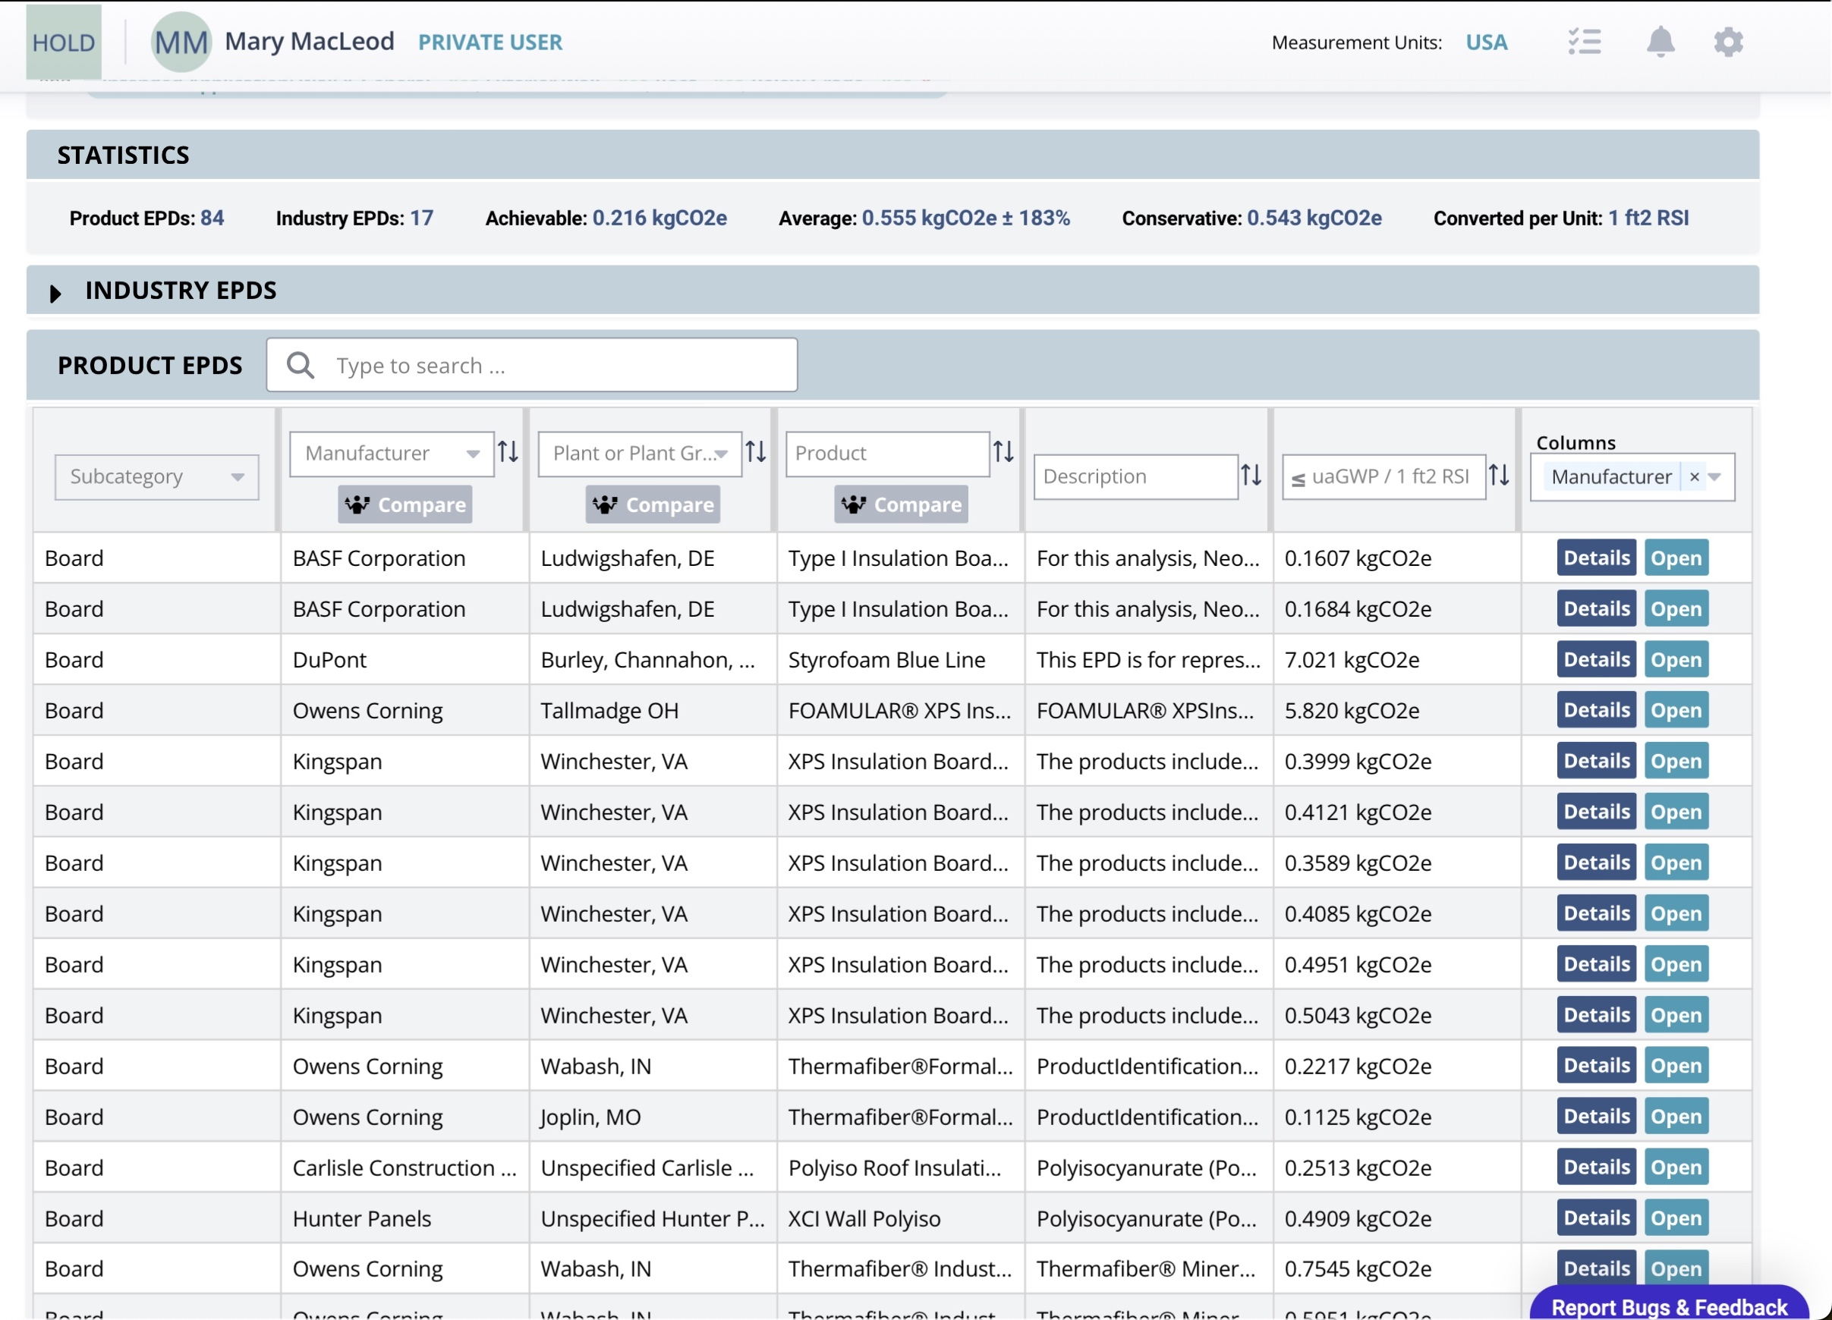
Notes:
Above is a screenshot that shows the results of an EC3 query for insulation sorted by lowest embodied carbon.

Slide 18
Learning Objective 3
EPDs TO DETERMINE THE ENVIRONMENTAL BENEFITS OF THE GPS-INSULATED VINYL SIDING SYSTEM.
Notes:
Learning Objective 3: Understanding the environmental attributes and carbon emissions of GPS-insulated vinyl siding through available EPDs and LCAs.

Slide 19
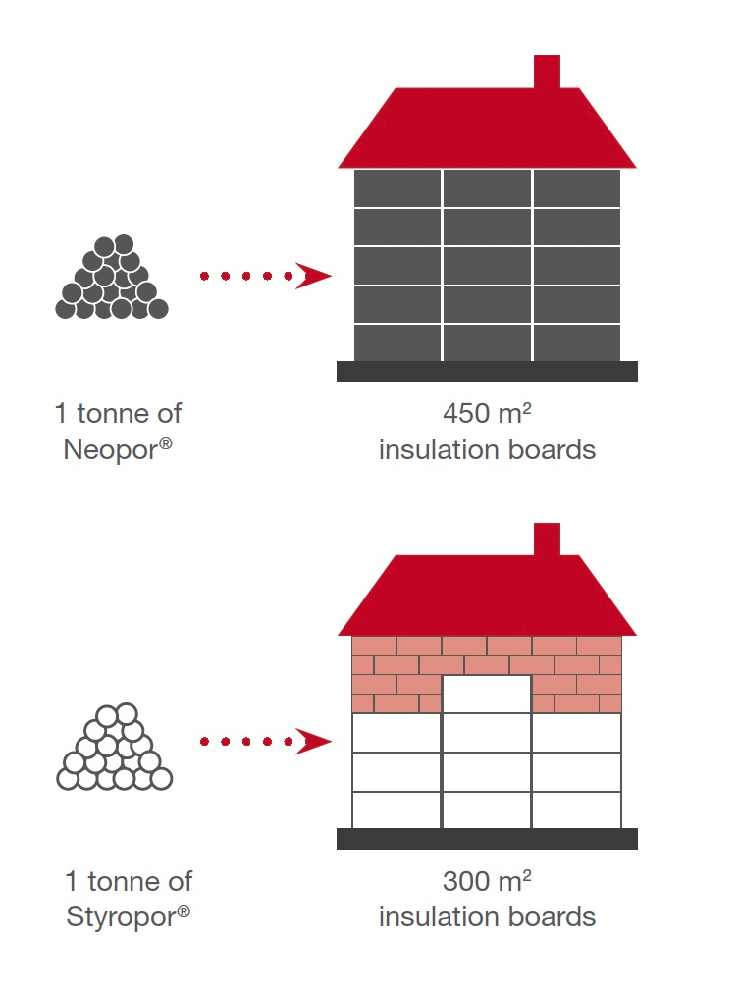
UNDERSTANDING THE OPERATIONAL AND EMBODIED CARBON OF GRAPHITE POLYSTYRENE INSULATION
More with Less Material
Less Density with More R-Value = Less Carbon
Less embodied carbon than any rigid insulation in NA
(50% less than regular EPS)
Uses 30% less material mass than XPS for the same R-value
+/- 25% more thermal resistance than EPS at the same thickness
Images Courtesy BASF
Notes:
Through LCA and product-specific EPDs, GPS has displayed lower embodied carbon than any other rigid insulation in North America, including EPS, XPS, and polyiso. It uses 30% less material mass than XPS for the same R-value. It also offers up to 25% more thermal resistance than EPS at the same thickness. Less density for more insulating value equals less material and a lighter carbon footprint.
GPS is in a specification category termed “Graphite Polystyrene.” It adheres to the same ASTM standards of traditional EPS and XPS, the other main polystyrene-based foams (ASTM C578); however, its environmental performance characteristics are different enough that the main specification tools in the AEC Industry in North America (BSD Speclink and MasterSpec) have created an entirely new “Graphite Polystyrene” category to help product specifiers identify its attributes.
Source: Information in this slide sourced from “Insulation Materials.” (n.d.). Energy Saver. Retrieved from https://www.energy.gov/energysaver/weatherize/insulation/insulation-materials

Slide 20
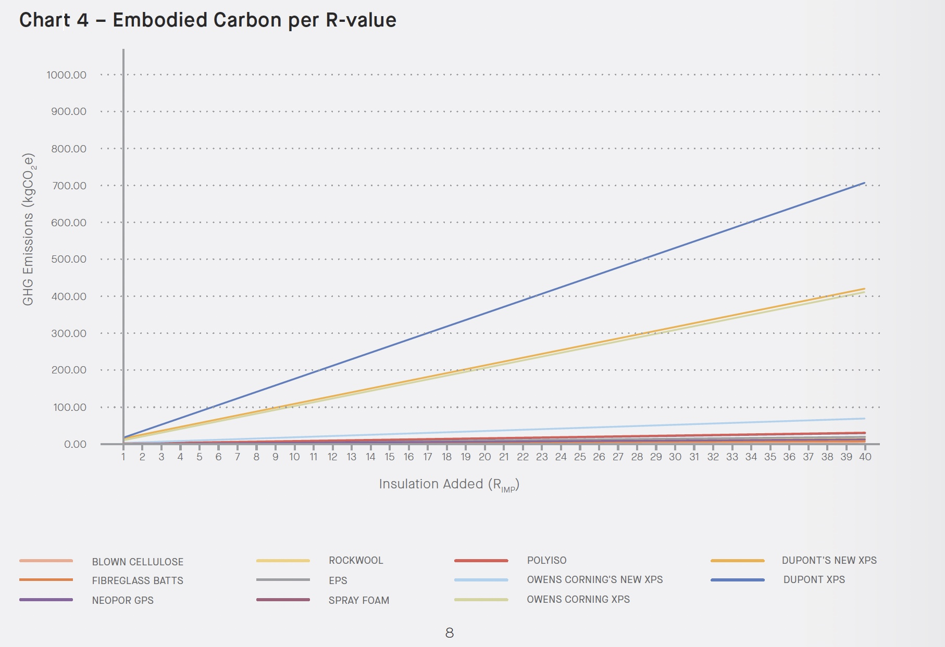
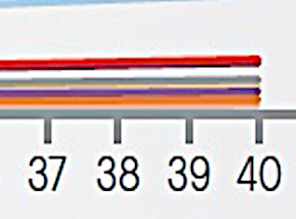
EMBODIED CARBON VALUES IN COMMON INSULATION MATERIALS, KPMB ARCHITECTS 2021 ANALYSIS
XPS: 15 - 20x GWP
Blown cellulose lowest but needs to be contained
GPS offers good embodied carbon values
Major Take Aways
Dupont XPS
Dupont New XPS
Owens Corning XPS
Owens Corning New XPS
Neopor GPS
Source: Embodied Carbon Values in Common Insulation Materials; KPMB Architects
Notes:
In 2021, KPMB Architects released the findings of a study that used EPDs to compare embodied carbon values for nine commonly used insulation types. The scenario seen above was an uninsulated bearing masonry house increasing the effective R-value from R4 to R24 heating with gas.
The insulation products considered include two XPS brands, two next-gen XPS brands, Polyiso, Rockwool, Neopor GPS, fiberglass batts, and blown cellulose. Here is what they found:
This chart shows the 11 materials and the embodied carbon values for 1m ² of each for thicknesses delivering R1 up to R40. The study found:
“Blown cellulose insulation has the lowest GWP value of the group…That said, it needs to be contained in a wall cavity or similar container, and, therefore, might not be applicable in as many situations…Polyiso, EPS, Rockwool, and GPS are all…significantly lower than XPS…Rockwool and GPS in particular—offer considerable flexibility regarding suitable installations, along with quite good embodied carbon values.”
(Source: Embodied Carbon Values in Common Insulation Materials https://www.kpmb.com/wp-content/uploads/2021/04/KPMB-LAB_Embodied-Carbon-in-Insulation.pdf_)

Slide 21
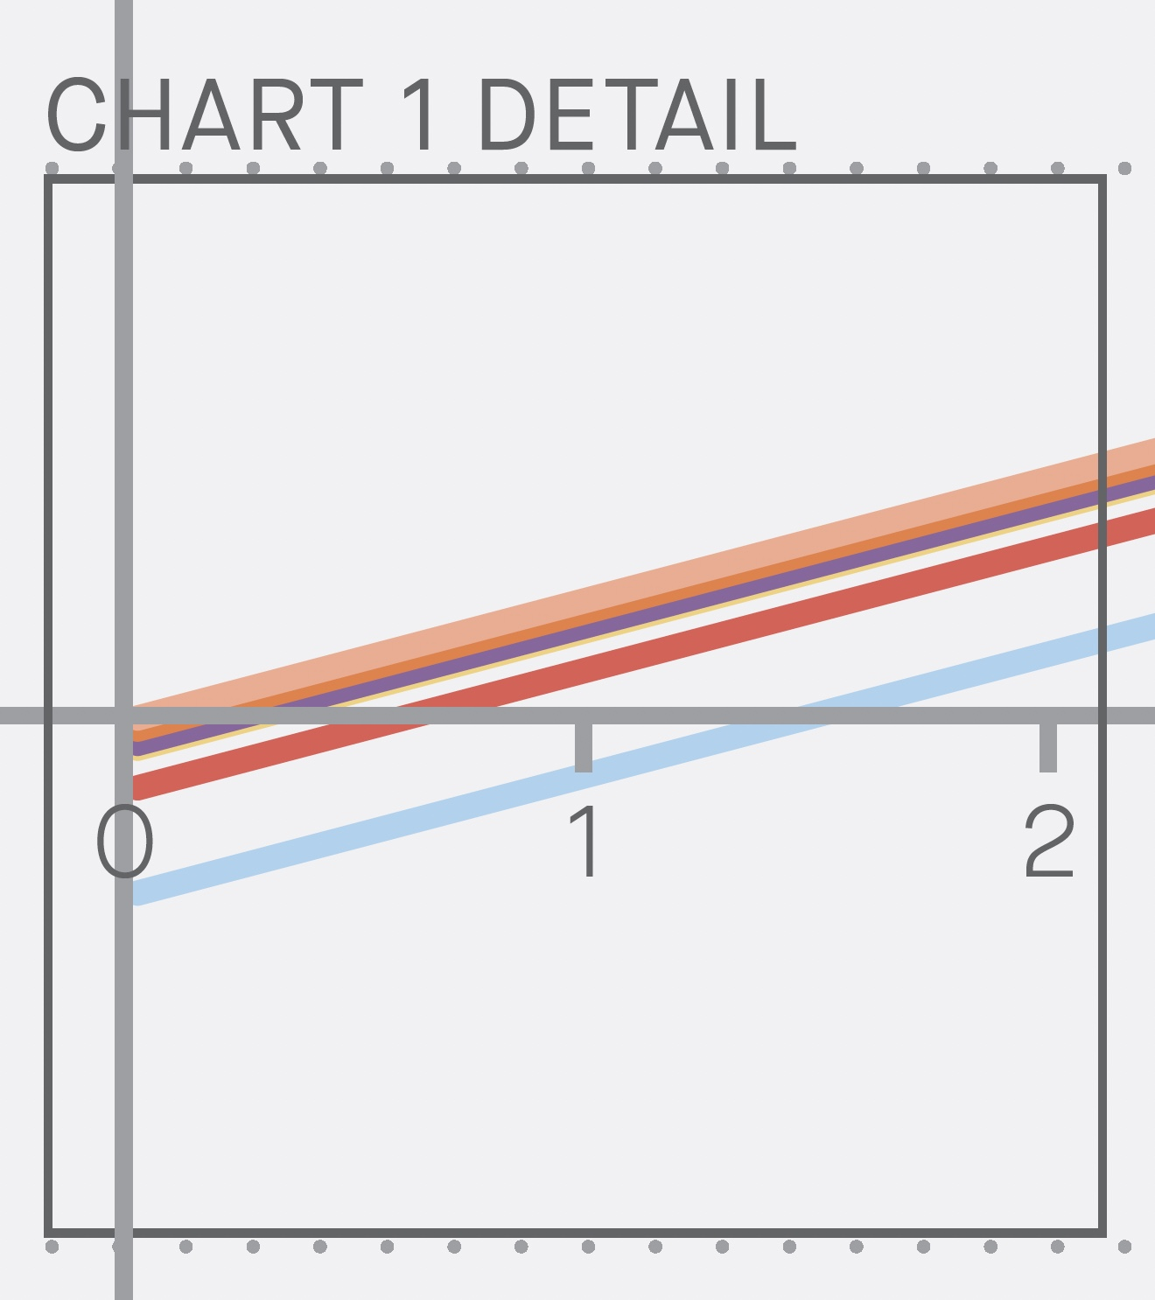
Carbon Payback Analysis Natural Gas Heating Scenario (0-16 Years)
GPS 6 mth payback
Source: Embodied Carbon Values in Common Insulation Materials; KPMB Architects
Notes:
But what about the carbon payback period? How long does it take for the insulation material to save more operational carbon emissions than it took to make it? This chart shows the payback period for the home, again heated with natural gas.
Using a heat pump scenario, the study found, “XPS is an outlier in this selection of materials, with a GWP 15 to 20 times greater than the other materials. In the electric heat pump scenario, it is not reasonable to expect the operational carbon savings ever to outweigh the embodied carbon of the material itself.”
For Neopor GPS, the payback period was roughly 6 months, the study found.

Slide 22
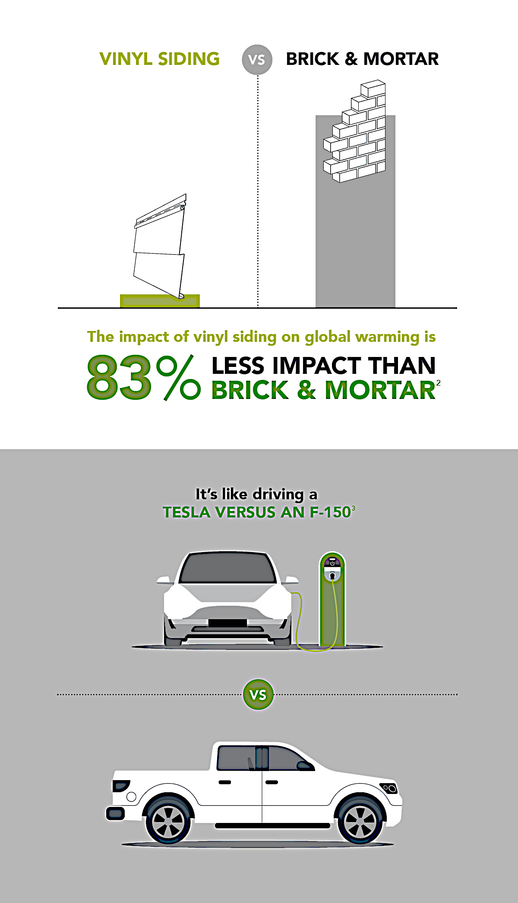
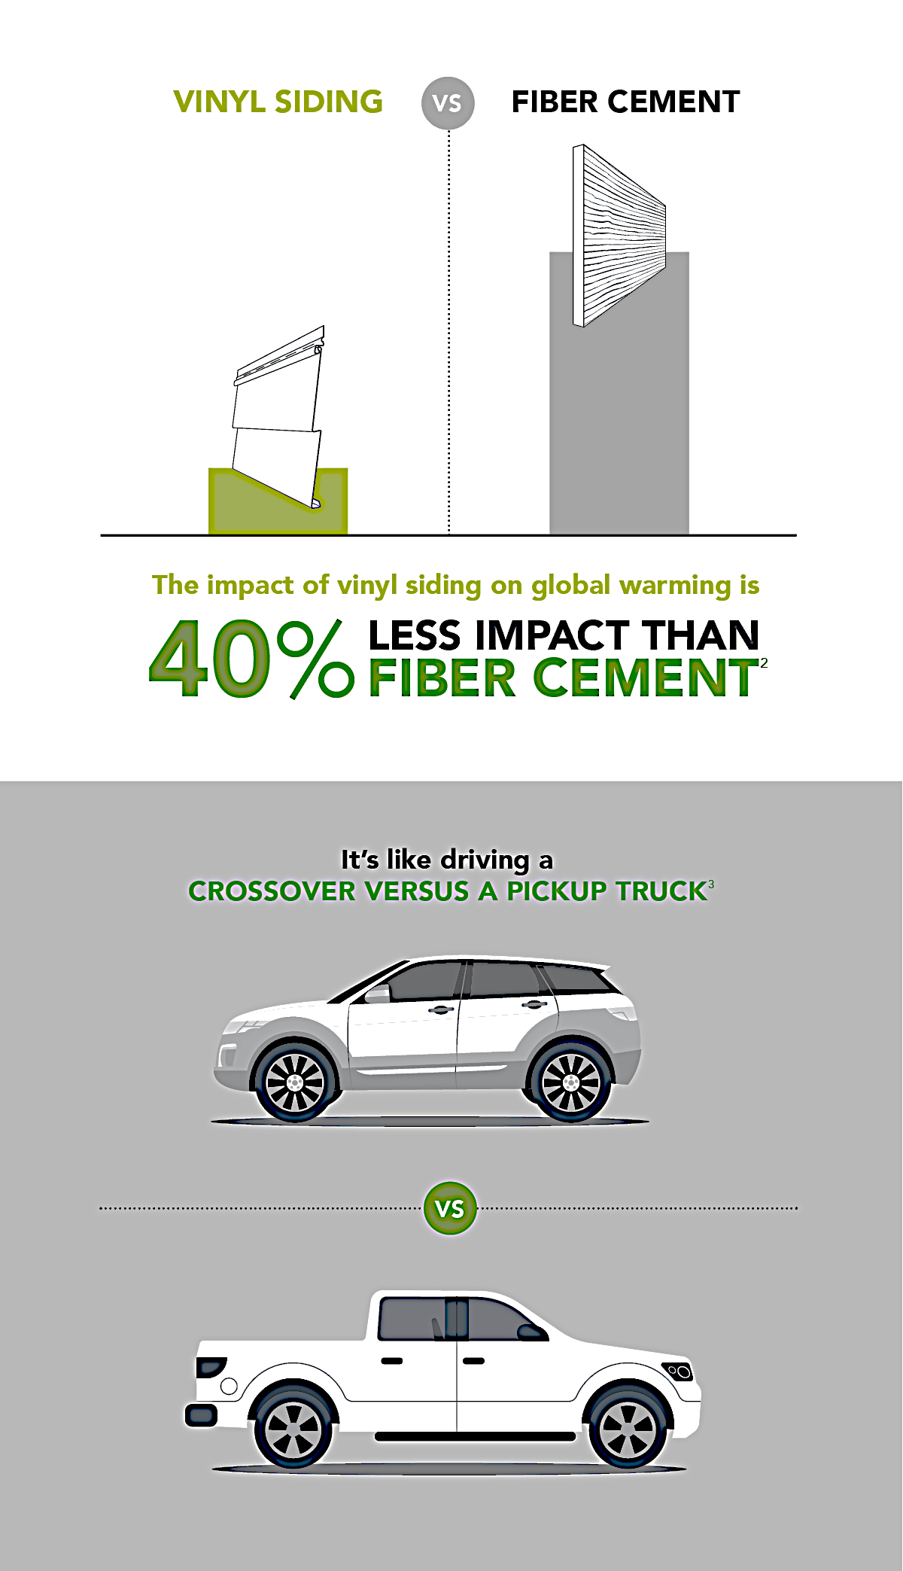
VINYL SIDING VS. FIBER CEMENT/BRICK GWP
Courtesy Vinyl Siding Institute
Notes:
Now, let’s look at the analysis of embodied carbon of vinyl siding in comparison with alternatives, according to a recent industry-wide EPD published by the Vinyl Siding Institute.
The Global Warming Potential (GWP) of vinyl siding versus fiber cement and brick parallels the auto industry. The prevalence of emissions stickers has helped us make informed decisions when selecting climate-friendly automobiles. For the built environment, comparing data in tools like EPDs can also serve this function. (speak to the slide)

Slide 23
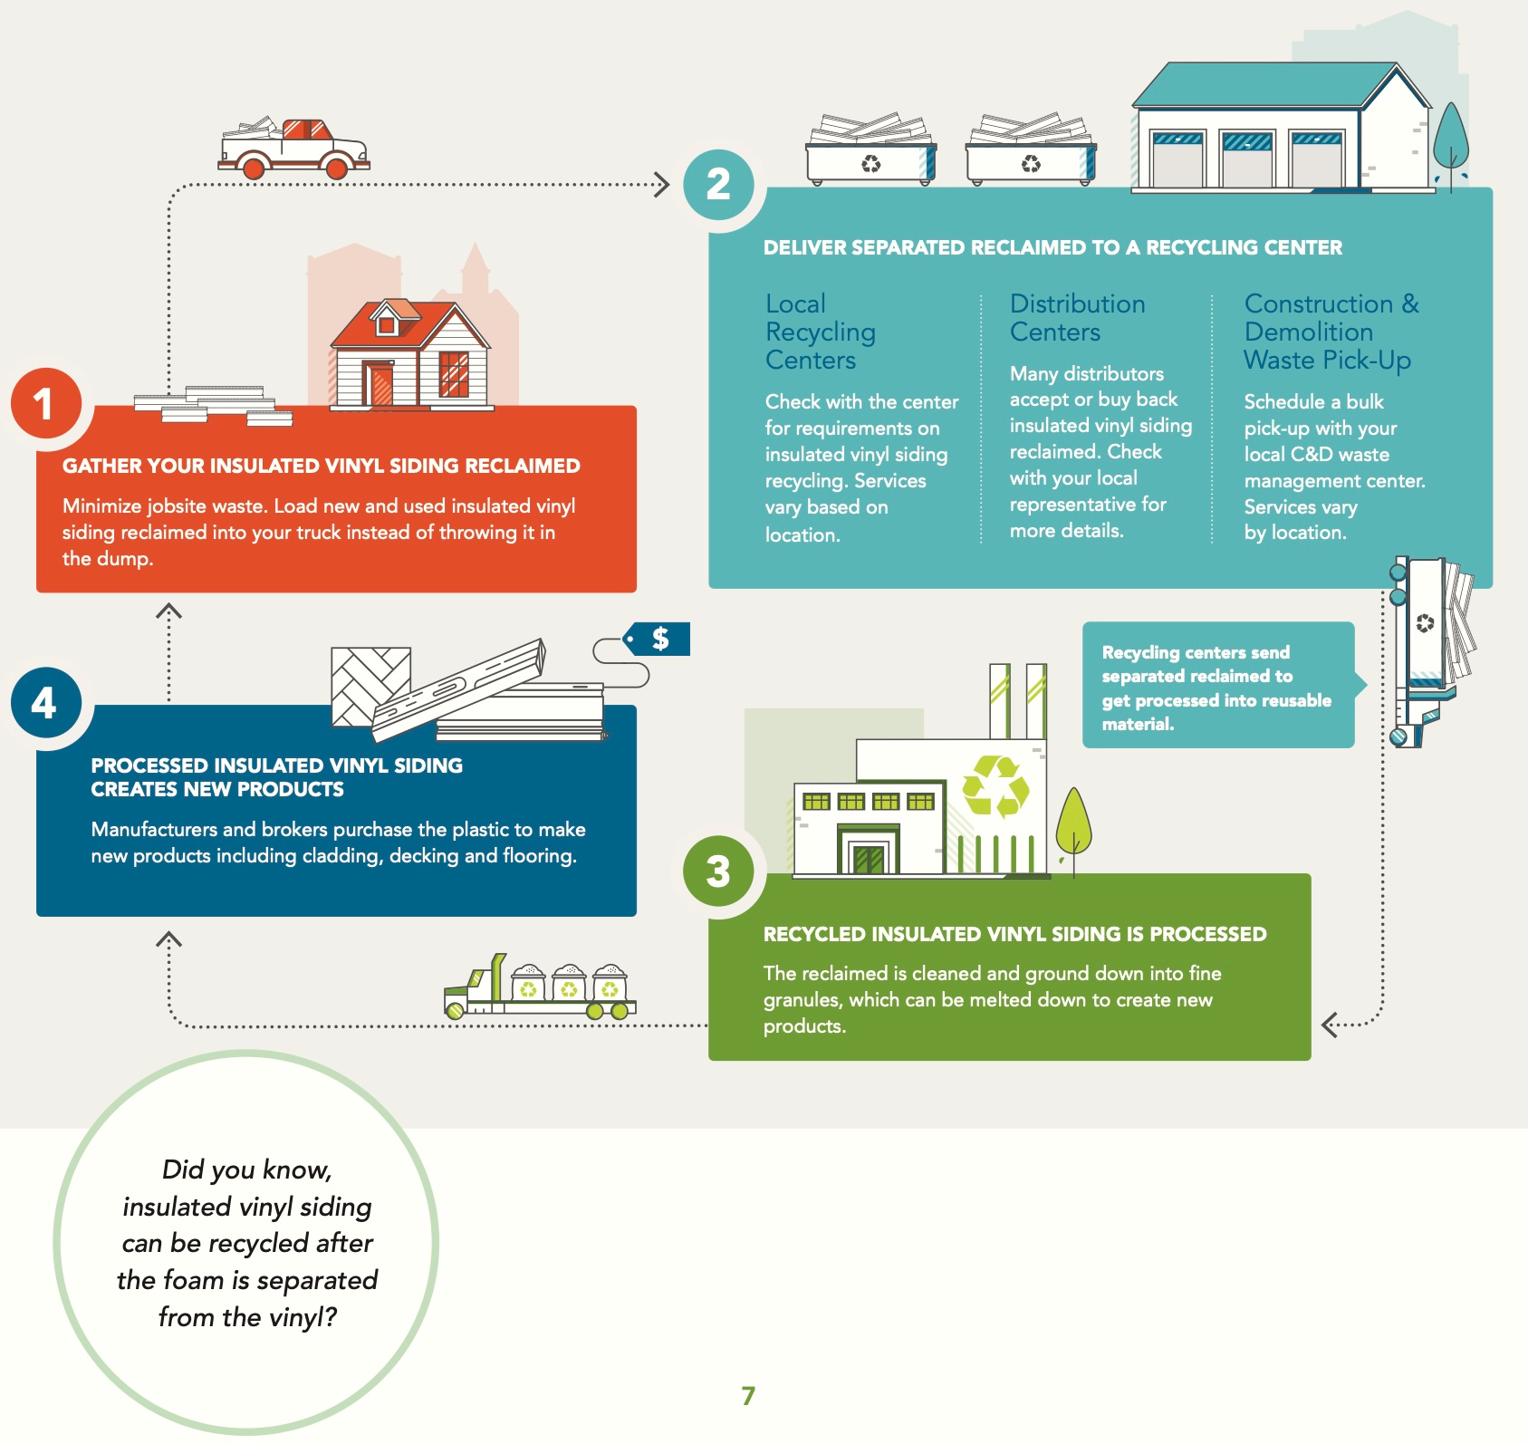
GPS INSULATED VINYL SIDING: RESOURCE EFFICIENT; 100% RECYCLABLE
Vinyl/PVC is 57% Salt
GPS 98% Air
Both 100% Recyclable
Courtesy Vinyl Siding Institute
Notes:
Additionally, insulated vinyl siding with either EPS or GPS insulation is exceptionally resource-efficient and uses few ingredients in manufacturing. It is also 100 % recyclable. (Speak to slide)

Slide 24
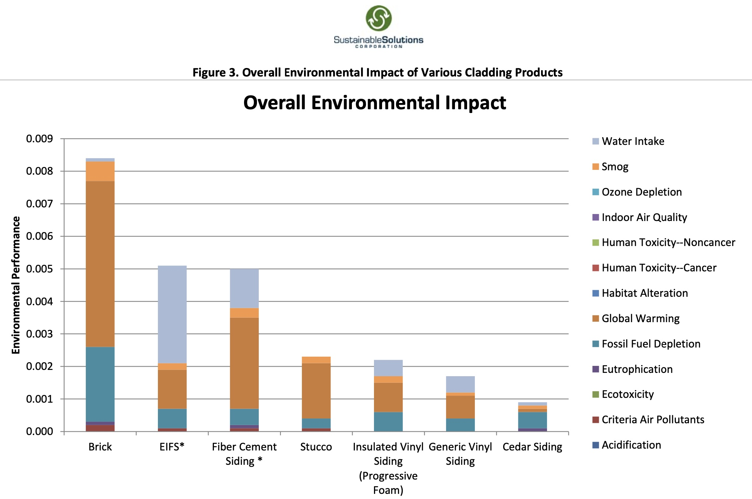
INSULATED VINYL SIDING HAS LOWER GLOBAL WARMING POTENTIAL THAN MOST OTHER OPTIONS
Based on the Building for Economic and Environmental Sustainability (Bees) software
Courtesy Progressive Foam
Notes:
Furthermore, a life cycle analysis conducted on behalf of Progressive Foam Technologies for insulated vinyl siding with EPS insulation provides further proof that insulated vinyl siding has far less embodied carbon than most other alternatives while reducing energy consumption and carbon emissions throughout its life.
(Source:https://www.progressivefoam.com/wp-content/uploads/LCA-Summary-Sheet.pdf)

Slide 25
ENVIRONMENTAL BENEFITS OF THE GPS INSULATED VINYL SIDING
Lightweight
Resilient
GPS Insulated Vinyl Siding
Reduces Energy Demand
Low maintenance
Continuous Insulation
Resource Efficient
Less Embodied Carbon
Recyclable
Notes:
In conclusion, based on the information we covered in today’s nano course and the prerequisite course, “Not Your Grandmother’s Vinyl Siding: the Advantages of Graphite Polystyrene Insulated Vinyl Siding,” we now know that GPS-insulated Vinyl siding has several environmental benefits, including its
Providing continuous insulation and reducing energy loss/carbon demand and emissions
lightweight properties which reduce the energy required for transportation
low global warming potential, low embodied energy, and recyclability
A shorter carbon payback period than most other insulation alternatives
Long life span, reduced maintenance, and resiliency, which also contribute to reducing environmental lifecycle impacts
Reduces energy and emissions during its lifetime.

Slide 26
Quiz
What is the difference between an Environmental Product Declaration and a Life Cycle Analysis?
Notes:
Now, it's time to test your knowledge. What is the difference between an Environmental Product Declaration and a Life Cycle Analysis?
How does the embodied carbon of insulated vinyl siding compare with brick and fiber cement siding?

Slide 27
Answer
EPDs are abbreviated LCAs.
Notes:
Now, it's time to test your knowledge. What is the difference between an Environmental Product Declaration and a Life Cycle Analysis?
How does the embodied carbon of insulated vinyl siding compare with brick and fiber cement siding?

Slide 28
Quiz
How does insulated vinyl siding compare to cementitious siding products for embodied carbon?
Notes:
Now, it's time to test your knowledge. What is the difference between an Environmental Product Declaration and a Life Cycle Analysis?
How does the embodied carbon of insulated vinyl siding compare with brick and fiber cement siding?

Slide 29
Answer
Insulated vinyl siding has about half the embodied carbon than cementitious siding products. Additionally, in the use phase, insulated vinyl siding reduced operational carbon. Uninsulated cementitious siding does not.
Notes:
Now, it's time to test your knowledge. What is the difference between an Environmental Product Declaration and a Life Cycle Analysis?
How does the embodied carbon of insulated vinyl siding compare with brick and fiber cement siding?

Slide 30
Questions & Resources
Progressive Foam Insulated Vinyl Siding: https://www.progressivefoam.com/product/insulated-vinyl-siding-
Graphite Polystyrene Insulation: https://neopor.basf.us/residential/above-grade-walls
Reducing Carbon with Neopor: https://neopor.basf.us/carbon
Neopor Specification: https://neopor.basf.us/files/pdf/XPS_Neopor_Sub_Packet.pdf
Neopor EPD: https://info.nsf.org/Certified/Sustain/ProdCert/EPD10327.pdf
EPD Insulated Vinyl Siding: https://www.vinylsiding.org/wp-content/uploads/2022/07/InsulatedVinylSiding_VSI_EPD_Template_April2022.vs11.pdf
Embodied Carbon Values in Common Insulation Materials; KPMB Architects
Notes:
Now, I’d like to open the floor for questions and comments and also point you to these resources mentioned in today’s course.

Slide 31
GPS Insulated Vinyl Siding Course Suite
A Full Suite of AIA CEU Approved Courses About the Advantages of GPS Insulated Vinyl Siding Are Now Available Under Provider 5011211
Main Course: Not Your Grandmother's Vinyl Siding: the Advantages of Graphite Polystyrene Insulated Vinyl Siding | AIA Credit: 1 LU HSW | COURSE 12
EPDs and Graphite Polystyrene Insulated Vinyl Siding | AIA Credit: 0.50 HSW | Course 31
GPS Insulated Vinyl Siding & Energy Code Compliance | AIA Credit: 0.50 HSW | Course 51
GPS Insulated Vinyl Siding & the 2022 Inflation Reduction Act | AIA Credit: 0.50 HSW HSW | Course 22
More Courses https://neopor.basf.us/resources/courses
Notes:
Also, please check out the other courses in this series, including GPS Insulated Vinyl Siding and Energy Code Compliance, GPS Vinyl Siding, and the 2022 Inflation Reduction Act. You can find information about these courses and more at https://neopor.basf.us/resources/courses

Slide 32
Contact
Name
Image
Phone
Email;
Notes:
Thank you for attending today’s course. Before you leave, please make sure that you have included your contact information and AIA member number on the sign-in sheet. We will register your attendance with AIA. All attendees will be receiving an electronic certificate of completion.

